Slide 1


Now is the Time to Grow Your
Recurring Electronic Giving!

Slide 2
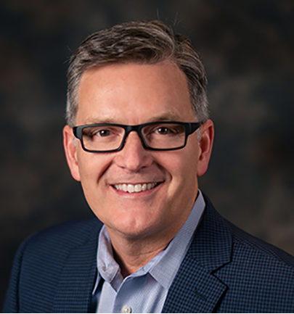
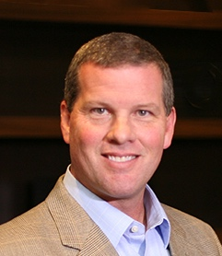
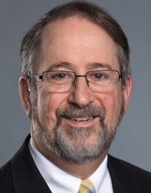
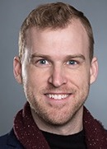
Leading This Webinar
Joe Park
CEO
Horizons Stewardship
Richard Rogers
Sr. Vice President
Horizons Stewardship
Ken Sloane, Director
Stewardship & Generosity
Discipleship Ministries
Blake Davis, Tech Support

Slide 3

The e-Giving Guide for Every Church
This step-by-step guidebook gives specific and practical advice for churches of every type and size. Rogers provides on-ramps for those who are just beginning to think about electronic giving and those who are already using it and want to do more. He gives clear instructions for each step and includes many charts, samples, and diagrams. This book is a powerful, easy-to-read resource for pastors, staff, finance committee members, stewardship teams, business administrators, administrative council members, and judicatory leaders. It will break open new ground in mission and ministry."

Slide 4


ksloane@umcdiscipleship.org
www.umcdiscipleship.org/stewardship
www.facebook.com/UMCstewardship
@umcstewardship
horizons.net
facebook.com/horizonsstewardship
Giving365.com
Free Horizons On Demand
Resource Library

Slide 5
Poll Questions
Did you worship in your church building this past Sunday?
Will you be worshiping in your building this Sunday?
Did you live stream your worship?
Do you offer the option of giving electronically?
How many households do “recurring giving” electronically?

Slide 6
Poll Questions
If you use electronic giving, what provider do you use?
  Vanco
  PushPay
  Tithe.ly
  PayPal
  EasyTithe
  Other

Slide 7
Popular Forms of Electronic Giving (e-Giving)
ACH/Bank Draft
Credit/Debit Card
Bill Pay (bank sends your church a check)
Kiosks
Dip Jars/Square

Slide 8
“What is Recurring e-Giving?”
Donor chooses an amount and payment frequency for gifts that are automatically sent to your church.
Monthly is the most common frequency, but weekly, twice a month and quarterly are also options.
If a gift does not automatically come to the church without any repetitive action from the donor, then it is not recurring.

Slide 9
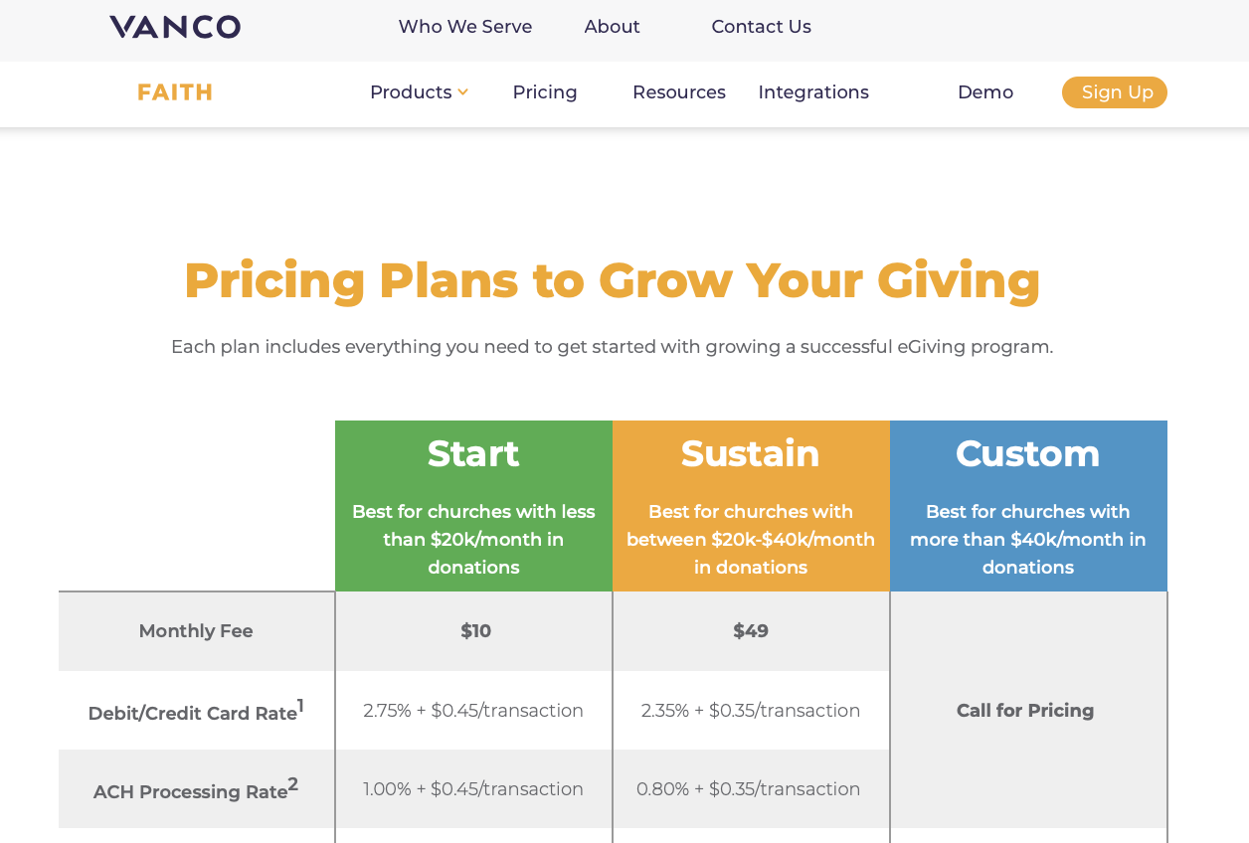
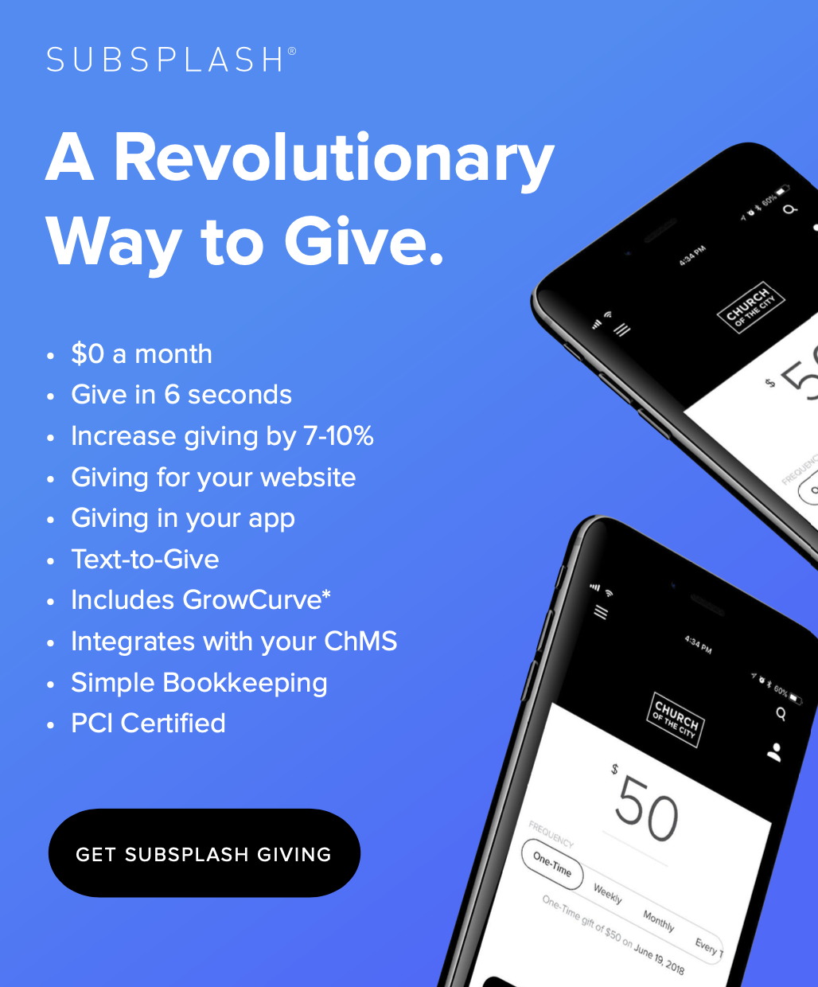
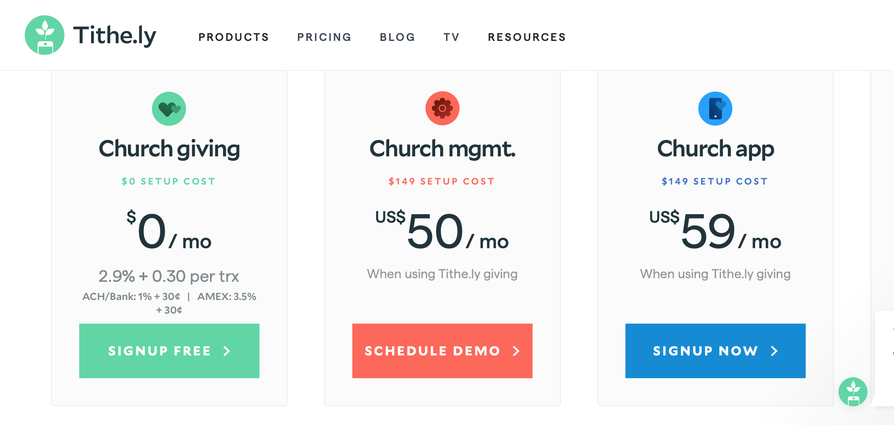
“What About the Cost?”
Notes:
Vanco, Push-Pay, Rebel, The costs vary and you will need to investigate - Richard

Slide 10
Ease of Use is Most Important to Donors
How easy (fast) is it to use your system?
Does the donor have options?
Does it feel seamless or like they’ve been sent somewhere else?
What are the default/suggested settings?
Notes:
Vanco, Push-Pay, Rebel, The costs vary and you will need to investigate - Richard

Slide 11


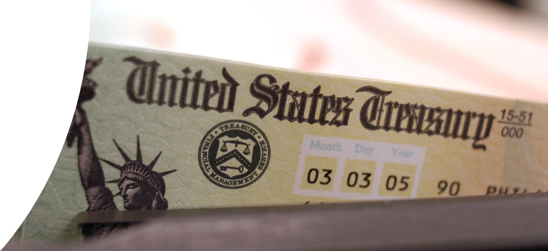
In 2015, 67% of Americans were already paying their recurring monthly bills with recurring electronic payments.
ACH Sign-up Cards are easy.
Create a video to demonstrate signing up online.

Slide 12
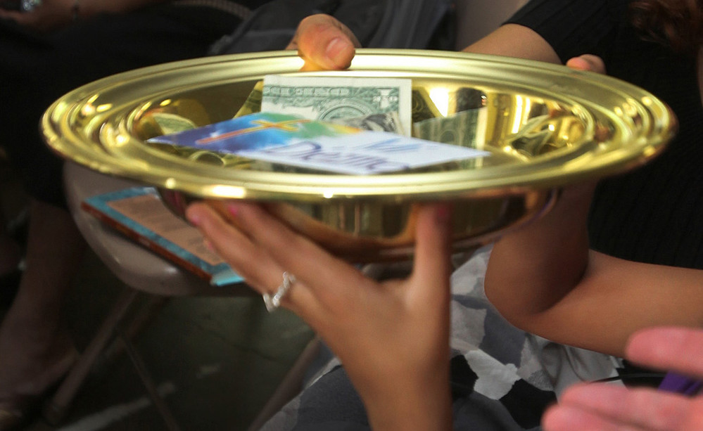
“We Like the Offering the Way it is”

Slide 13
Instead of passing empty plates, pass plates full of e-Giving Cards!

Slide 14

Reasons Donors Use Recurring Giving
Ease and convenience
Gifts are present even if they aren’t
Prevents falling behind
Church asked them to
Notes:
Richard to add increased giving data.

Slide 15
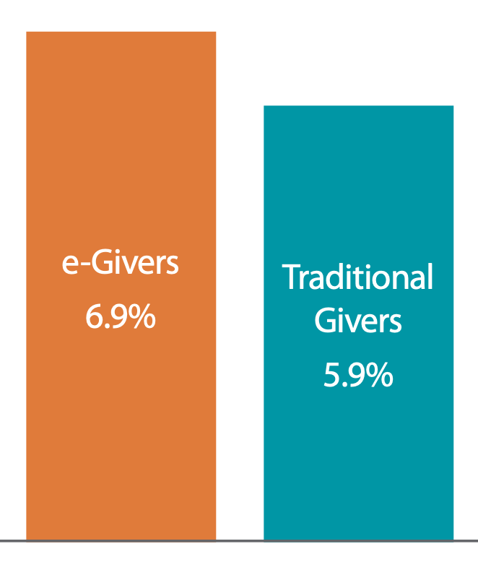
Financial Benefit of Recurring e-Giving
e-Givers gave 15% more than traditional givers Vanco 2017
e-Givers give 33% more than traditional givers Push Pay 2018
Non-Profit Recurring Donors give 42% Network for Good Giving Data
Recurring Donors give 5.4 times more over their lifetimes Classy State of Modern Philanthropy 2019

Slide 16
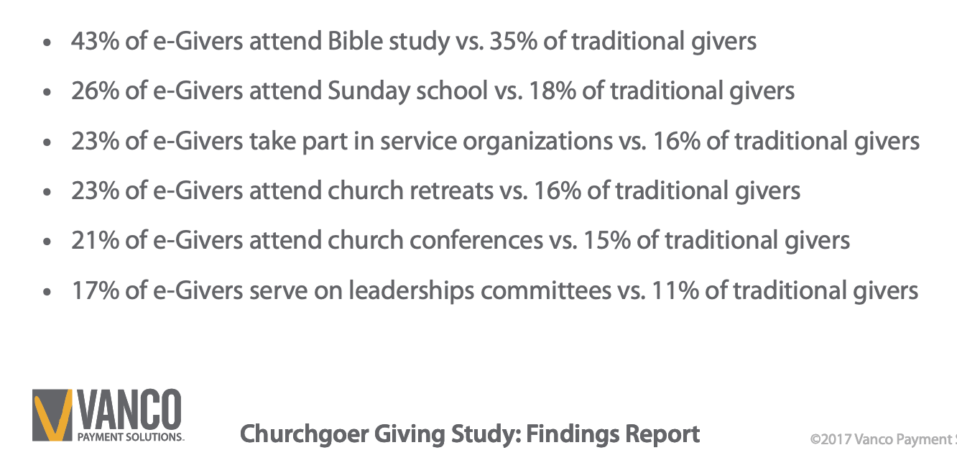
e-Givers are More Active and Engaged
Notes:
Richard to add increased giving data.

Slide 17

Getting People On Board!
Who Wants to sign up?
Notes:
Joe

Slide 18


Slide 19
Getting Started If You Don’t Have e-Giving
Go to your local bank and sign up for ACH/Bank Draft.
Mail everyone a letter explaining that you will soon have ACH/Bank Draft, but to use the two enclosed self-addressed stamped envelopes until you are able to mail them a Sign-up Card.
Begin following the plan outlined in the Horizons Recurring Giving Development Plan for COVID-19 Social Distancing.

Slide 20
Getting Started
Download the Horizons Recurring Giving Development Plan for COVID-19 Social Distancing from Giving365.com.
Recruit a Recurring Giving Promotion Team with a Chairperson.
3. Develop a Recurring Giving FAQ sheet.
4. Review and follow the Tips for Optimizing Your Church’s Website.

Slide 21
Getting Started
Ask Pastor, Finance Team and Church Leadership to sign up first.
Pastor and/or Chairperson shoot a two to three minute video to be sent to all members and regular attenders explaining the benefits and importance of recurring giving.
Send a letter with the FAQ, ACH/Sign-up Card and return
stamped envelope. If your church requires each person to set
their own account up online, consider sending both the
instructions and “how to video”.

Slide 22
Getting Started
8. Create your seat back card.
Introduce recurring giving in online worship or by phone if you
are not doing video worship.
Follow the resource guide five-week plan of online worship
engagement, follow-up’s, and thank you suggestions.

Slide 23
Questions?
Thank You!

Slide 24
Upcoming Webinars
Thursday, April 2, 2020 at 6:30PM CDT
Time to Create a New Financial Calendar (with Joe Park and Norma Quinn)
Thursday, April 23, 2020 at 6:30PM CDT
Stewardship in the Second Half of Life (with Clayton Smith)
Visit www.umcdiscipleship.org/stewardship for registration information.

Slide 25
ksloane@umcdiscipleship.org
www.umcdiscipleship.org/stewardship
www.facebook.com/UMCstewardship
@umcstewardship
horizons.net
facebook.com/horizonsstewardship
Giving365.com
Free Horizons On Demand
Resource Library

