Slide 1
For social media think about…
Likes, Comments, Retweets, etc.: Individual engagement metrics like a Share or a Retweet add up. In a Twitter report, you’ll see a total number of engagements per post or profile.
Post engagement rate: The number of engagements divided by impressions or reach. A high rate means the people who see the post find it interesting.
Account mentions: Organic mentions, like @mentions that aren’t part of a reply, or tagging a brand in an Instagram story without prompting, indicate good brand awareness.

Slide 2
How do you track organic mentions?
Create a hashtag for your faith community
Search for your name on all social media platforms
Tips to keep in mind?
  Respond quickly
  Stay positive
  Move to DM when possible
  Know when to stop communicating
  Turn the conversation around

Slide 3
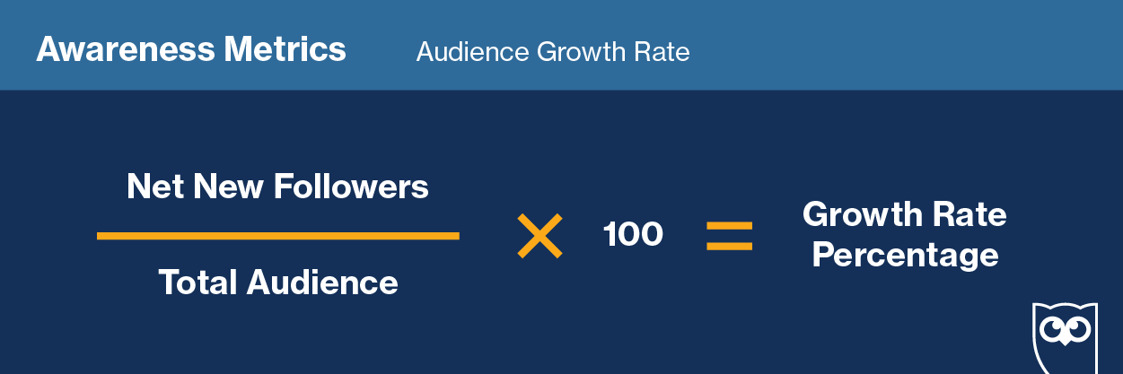
First step: measure awareness (graphics from hootsuite)
Who knows you are out there?
Benchmark- it’s not about how many likes you have but how fast you are getting the likes

Slide 4
Impressions vs. Reach
Impressions are how many times a post shows up in someone’s timeline
Reach is the potential unique viewers a post could have (usually your follower count plus accounts that shared the post’s follower counts).
This is why ENGAGEMENT matters so much
If you have high impressions but low engagement then what you said didn’t capture their attention enough for them to do something about it

Slide 5
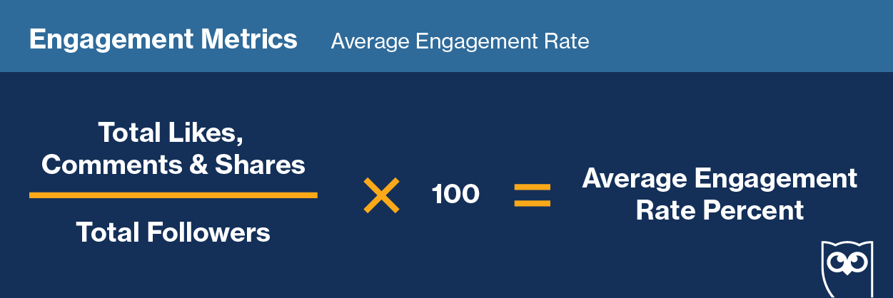
So how do you measure engagement?
.5-1% for Facebook and Twitter vs 3-6% for Instagram

Slide 6
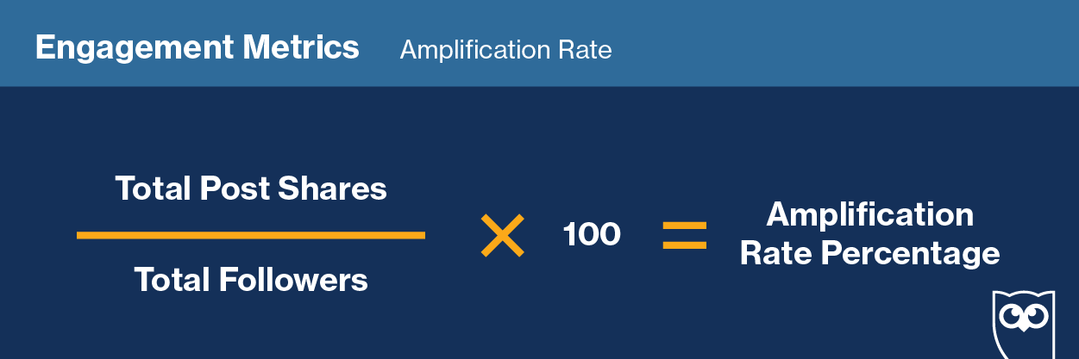
If you want to know when your followers are becoming members, look at the amplification rate

Slide 7
Other things to look at
Virality rate
Conversion rate- how many people click on the CTA
Bounce rate
For conversion and bounce rate data- google analytics is your friend
https://blog.hootsuite.com/social-media-metrics/

Slide 8
So potential benchmarks with regards to Social Media?
Look at increasing awareness each month (with a time element) and set percentage goals for each quarter. Ex. 2-3% increase each month or a minimum of 5% each quarter
Measure engagement. Ex. Minimum of 1% increase a month on Facebook and 3% on Instagram
Track your amplification rate and then set a quarter goal of increasing the types of posts with the highest amplification rate.

Slide 9
What about all the other benchmarks?
If you are just starting out- keep meeting 30-40 people a month and connecting with them on social media
Have hand-off events with smaller numbers that are virtual- try QIQO nights as a meet and greet mingle on zoom, or game nights, or organize a giving circle to bring help and hope to your community.
Think about launching a youtube channel, with 2-3 options for spiritual growth (worship services, meditative practices, kids’ worship)
For Sunday morning worship (if you pick Sunday am) look at those who watch live and those who watch the first minute and try to set a goal after the first quarter for the following quarter

Slide 10
Other benchmarks?
Quarterly goal for crowd funding or peer to peer funding on social media
At least once a quarter shake up your worship service and try something that feels relevant and interactive
Organizing a social media team that finds stories of transformation/connection from anyone OTHER THAN the planter
Small groups! Do surveys, sample personas, and figure out the platform that will work best (Facebook, zoom, amplify, “bubbled” in person groups) and have set benchmarks for the number and engagement of groups.

Slide 11
Reality check…
Share your name and where you are planting
What metrics you are looking at right now
  What’s working?
  What isn’t working?
  Where are you seeing growth?
  Where are you seeing decline?
  What brings you hope?
  What makes you anxious?

Slide 12
Feedback from planters based on the conversation…
Small group attendance is a great indicator of engagement. Fernie in LA saw his launch Sunday cancelled due to the first week of the covid shut down in March but his small group attendance grew from 30-60 in 2 months and is now around 72.
When worship is the same for more than 2-3 weeks in a row, viewership goes down so change it up and use different formats like Streamyard to give your tech folks a break

Slide 13
Use polls to help measure transformation and know that there are no standard metrics
Ex. Tyler in Minnesota might poll folks live in worship to see who engaged in an anti-racist conversation that week. So you are seeing who embraces the CTA (call to action) and applies it- that’s a metric we need to consider
Christian from UVC reminded us all that benchmarks and metrics are so contextual right now so look at where you are now and set benchmarks based on where you need to go- but it will vary from planter to planter
Gabrielle echoed that and talked about her shift in Indiana where the 2nd week of worship is discipleship talk around a table and the 5th week is a serve Sunday

Slide 14
Innovative ideas?
Brendan Galvin is doing panel discussions in lieu of sermons on Sunday and it’s been popular
Kris Sledge is doing community conversations and hosting an educational pod at the church
Wendy is using streamyard and really encouraging small group involvement and they haven’t seen a dip in worship yet… they use zoom rooms every 6th week for deeper connection
Jason from VA mentioned the importance of rethinking staffing and replacing current staff with Social Media Directors and Outreach Coordinators
Do a venmo challenge to give back to your community in huge ways!!!

