Slide 1

Introduction to Lay Servant Ministries
THE BASIC COURSE—Youth Addendum

Slide 2
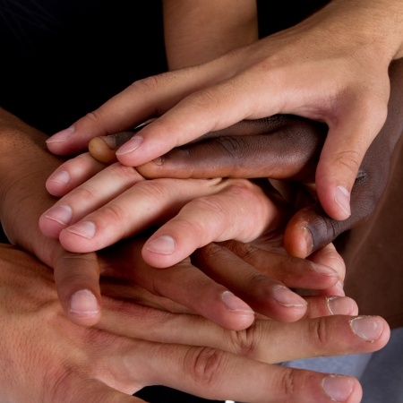
Introductions

Slide 3

SESSION 1:
Learning Outcome Goals
Be able to
1. describe the reality of the priesthood of all believers and God’s call on our lives
2. discuss spiritual gifts, their meaning and purpose
3. describe the need for a response to God’s call
4. discuss the early Methodist movement and the role of laity

Slide 4

WORSHIP
Notes:
Read Scripture: I Peter 2:9-10
Sing: “We Are Marching” (TFWS #2235b)

Slide 5
Priesthood of Believers
“But you are a chosen race, a royal priesthood, a holy nation, a people who are God’s own possession. You have become this people so that you may speak of the wonderful acts of the one who called you out of darkness into his amazing light. Once you weren’t a people, but now you are God’s people. Once you hadn’t received mercy, but now you have received mercy.”—I Peter 2:9-10 (CEB)
Notes:
5
That’s you and that’s me – not just clergy, but laity and clergy called to being the light of Christ to others
We are to express evangelical faith in evangelical living. I quote from Wesley’s Gen. Rules and the Book of Discipline the expectations as people of faith. ”It is therefore expected of all who continue therein that they should continue to evidence their desire of salvation. First by doing no harm, by avoiding evil of every kind. Secondly: by doing good of every possible sort, and, as far as possible, to all men [people]. Thirdly: by attending upon all the ordinances of God.
To Wesley Discipline was not church law; it was a way of discipleship.

Slide 6

Prayer
I have heard your call to priesthood, my Lord.
I have heard your call to be in mission and ministry.
Thank you for calling me out of darkness into your marvelous light.
May I declare your praises in all that I am and in all that I do! Amen.

Slide 7
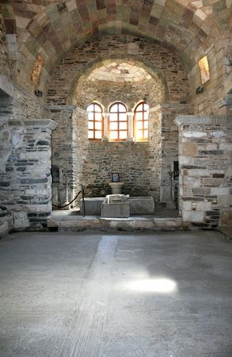
MINISTRY OF THE BAPTIZED
Notes:
7
Read from Book of Discipline pg. 94, paragraph 126, “Ministry of All Christians.“ “All Christians are called through their baptism to this ministry of servanthood in the world to the glory of God and for human fulfillment.”

Slide 8
(The Call to Ministry)
Participation in disciplined groups such as covenant discipleship groups or class meetings is an expected part of personal mission involvement. Each member is called upon to be a witness for Christ in the world, a light and leaven in society and a reconciler in a culture of conflict. Each member is to identify with the agony and suffering of the world and to radiate and exemplify the Christ of hope.

Slide 9
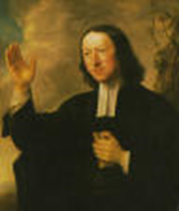
Wesleyan Emphases
Understanding of God’s Grace
- Prevenient
- Justifying
- Sanctifying
Faith Evidenced by Works of Piety and Mercy
  -Scriptural Holiness
  -Social Holiness

Slide 10
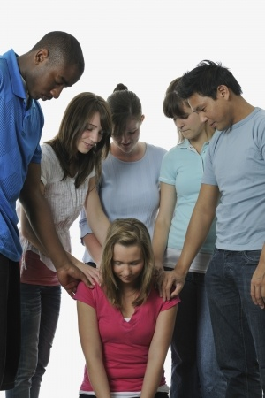
Called by
GOD
  To Love
  and Serve
Notes:
10
Read - Paragraph 126 of Book of Discipline - “This means that all Christians are called to minister wherever Christ would have them serve and witness in deeds and words that heal and free." The ministry of the laity is an option for those who have heard God’s call, It is a frontline ministry because lay persons have direct access to the community and the real world thru their secular jobs and activities.
The call to ministry is both a privilege and an obligation. We are privileged to be in relationship with God and to be a part of Holy nation, a royal priesthood, one of God’s own people and to proclaim the mighty acts of God.
God’s call is also an obligation to respond by holy living and obedience to Christ. I John 2:6 says, whoever says I abide in him ought to walk just as he walked.
Read - Paragraph 127 of Book of Discipline - The ministry of the laity is an option for those who have heard God’s call, It is a frontline ministry because lay persons have direct access to the community and the real world thru their secular jobs and activities.
The call to ministry is both a privilege and an obligation. We are privileged to be in relationship with God and to be a part of Holy nation, a royal priesthood, one of God’s own people and to proclaim the mighty acts of God.
God’s call is also an obligation to respond by holy living and obedience to Christ. I John 2:6 says Whoever says I abide in him ought to walk just as he walked

Slide 11
SPIRITUALGIFTS
“…you aren’t missing any spiritual gift while you wait for our Lord Jesus Christ to be revealed.”—I Corinthians 1:7 (CEB)
Notes:
11
Gifts of grace.

Slide 12
The Meaning and Scope of Spiritual Gifts
Gifts are for service
God assigns and empowers
All Christians are included
Limits and variety of gifts known only to God
Use determines health and growth
Notes:
Take a spiritual gifts assessment and discuss results.

Slide 13
SPIRITUAL GIFTS ARE
Unmerited blessings from God
Job descriptions for ministry
Means for discovering God’s will
Guarantees of effective service
Means to efficient service
Securities for health and growth
Revealed presence of the living Christ
Guarantor of lasting results

Slide 14
SPIRITUAL GIFTS ARE NOT
Acquired skills or natural talents
Roles or offices
For self-gain or division
Fruit of the Spirit
The same for everyone

Slide 15
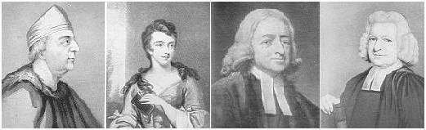
THE WESLEYS
Samuel, Susanna, John, Charles
Notes:
15
Our Wesleyan heritage provides us with models of faithful ministry.
The Rev. Samuel Wesley was an Anglican priest who served the rectory at Epworth for 35 years.
His wife Susanna often disagreed with him about theology and politics – something nearly unheard of in those days. Once in his absence Samuel’s replacement in the rectory was doing a less than satisfactory job so Susanna started to have prayer meetings in their home for her children, servant, and others who wished to attend. Susanna was scolded by Samuel, and she responded that he must command her to stop so that when they stood in judgment she would not be judged guilty for neglecting the opportunity to do good to souls.

Slide 16

Closing Prayer
Teach me to do what pleases you,
because you are my God.
Guide me by your good spirit
into good land.
Amen.
Psalm 143:10 (CEB)

Slide 17
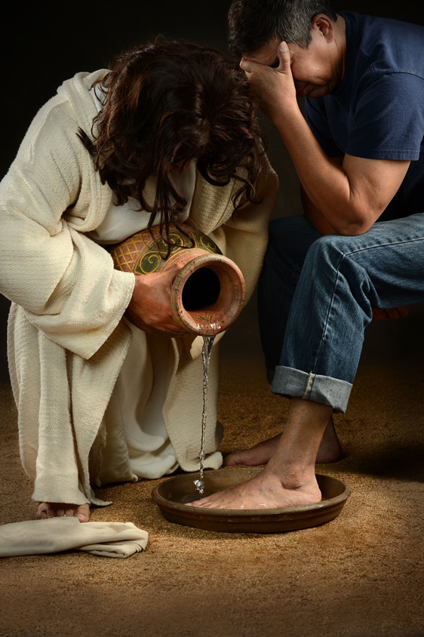
LAY SERVANTS SERVE BY
LEADING

Slide 18
SESSION 2:
Learning Outcome Goals
Be able to
1. describe servant leadership
2. discuss the important roles in leadership
3. describe and discuss what it means to be a spiritual leader
4. demonstrate the principles of Christian conferencing and describe aspects of consensus and discernment

Slide 19
WORSHIP
Notes:
Read Scripture: John 13:12-17
Sing: “Make Me a Servant” (TFWS #2176)

Slide 20
“After he washed the disciples’ feet, he put on robes and returned to his place at the table. He said to them, “Do you know what I’ve done for you? You call me ‘Teacher’ and ‘Lord,’ and you speak correctly because I am. If I, your Lord and Teacher, have washed your feet, you too must wash each other’s feet. I have given you an example: just as I have done, you also must do. I assure you, servants aren’t greater than their master, nor are those who are sent greater than the one who sent them.”—John 13:12-17 (CEB)
Notes:
The teachings of Jesus on servant ministry and leadership shape this ministry.

Slide 21
Prayer
Eternal God, in the sharing of a meal
your son established a new covenant for all people,
and in the washing of feet
he showed us the dignity of service.
Grant that by the power of your Holy Spirit
these signs of our life in faith
may speak again to our hearts,
feed our spirits, and refresh our bodies. Amen.
Reprinted from Revised Common Lectionary Prayers, copyright © 2002 Consultation on Common Texts. Used with permission.

Slide 22

SERVANT
LEADERSHIP
“…Whoever wants to be first among you will be your slave.”—Matthew 20:26b (CEB)
Notes:
22
All Christians who are called to leadership are called to servanthood. The Book of Discipline states in paragraphs 131 and 132 that the ministry of all Christians is one of service for the mission of God in the world.

Slide 23
SERVANT LEADERSHIP
The ministry of all Christians is one of service for the mission of God in the world.
Notes:
The ministry of all Christians is one of service for the mission of God in the world. It is both a privilege and an obligation. It is a privilege through our spiritual relationship with God to be part of a holy priesthood, and it is an obligation because of that relationship to form new Christian disciples and to guide them in their witness.

Slide 24
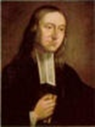
The General Rules…
“It is therefore expected of all who continue therein that they should continue to evidence their desire for salvation
First: By doing no harm, by avoiding evil of every kind…
Notes:
To Wesley, these were not rules of religion but the way of discipleship.

Slide 25

(The General Rules)
Secondly: By doing good; by being in every kind merciful after their power; as they have opportunity, doing good of every possible sort, and as far as possible to all…
Thirdly: By attending upon all the ordinances of God…
(The Book of Discipline ¶104)
Notes:
The ordinances of God are the means of grace: Prayer
Bible Study
Worship
Lord’s Supper
Fasting or Abstinence
Christian Conferencing
Acts of Mercy and Justice

Slide 26
PRACTICING CONSENSUS
A leader in a church feels that a new ministry should be started in the community. It will require funding and support from the congregation. Should the church support it?
The choir needs new robes! The current ones are shabby and there are not enough of the right sizes. Should the church buy new ones or try to find some that another church has for sale?
A problem has been noted with the conduct of a person in leadership. How should the person be approached about his/her behavior?
Notes:
Use this time to do an exercise in consensus. Divide into small groups of four to six persons and give them one of the situations listed here. Ask them to come to a consensus on a solution using the process in their participant’s book on page 41.

Slide 27
Closing Prayer
Lord, teach me what your statutes are about, and I will guard every part of them.
Help me to understand so I can guard your instruction and keep it with all my heart.
Amen.
Psalm 119:33-34 (CEB)

Slide 28

LAY SERVANTS SERVE
BY
CARING

Slide 29
SESSION 3:
Learning Outcome Goals
Be able to
1. discuss the biblical basis for caring ministry
2. compare and contrast acts of compassion and acts of justice
3. discuss several types of caring ministries
4. discuss ways to show care for creation

Slide 30
WORSHIP
Notes:
Read Scripture: Matthew 25:35-37, 40
Sing: “Make Me a Servant” (UMH #389)

Slide 31

CARING
“For I was hungry and you gave me food to eat. I was thirsty and you gave me a drink. I was a stranger and you welcomed me. I was naked and you gave me clothes to wear. I was sick and you took care of me. I was in prison and you visited me.”—Matthew 25:35-36 (CEB)

Slide 32
Prayer
Lord, forgive my possessive and selfish nature. Help my attempts at becoming a good steward of all the opportunities and gifts that you provide.
Help me to remember and reach out to those without daily bread or the Good News of salvation! Please make me generous like you. Amen.
(Adapted from Pete Hammond, Lessons, Prayers & Scriptures on the Faith Journey [Intervarsity/USA Marketplace], 109.)

Slide 33
Privileges
We shower daily, while others bathe in dirty rivers occasionally.
We eat three meals a day, plus unneeded snacks,
while others starve.
We sleep warm and soundly while others never rest.
We have closets filled with unworn clothing
while others wear all they have each day.
(Pete Hammond, Lessons, Prayers & Scriptures on the Faith Journey, [Intervarsity/USA Marketplace], 109.)

Slide 34
(Privileges)
We have extended families, while others live alone.
We own homes, sometimes more than one, while others are homeless.
We enjoy safety, while others live with death, war, and violence daily.
We work or change jobs, while others beg for minimal survival.
We travel extensively and freely, while others live their whole lives where they were born.
(Pete Hammond, Lessons, Prayers & Scriptures on the Faith Journey, [Intervarsity/USA Marketplace], 109.)

Slide 35
(Privileges)
We attend schools and continuing education,
while others suffer illiteracy.
We make and protect retirement plans,
while others die far too early in poverty.
We have extensive medical systems,
while others have no health care and die early.
Unlike millions around the world, we North Americans are inordinately blessed, tempted to assume our rights to these gifts, even to fighting for them, and frequently misusing these privileges which are on loan from God.
(Pete Hammond, Lessons, Prayers & Scriptures on the Faith Journey, [Intervarsity/USA Marketplace], 109.)

Slide 36


WORKS OF MERCY
Acts of Compassion…Acts of Justice
Notes:
36
Acts of compassion are those things we do to meet the needs of our neighbor who is anyone we encounter who is in need. Acts of justice are related because that is when we ask the questions, “Why” and “What?” Why is our neighbor suffering? What is the cause?
These are more than random acts of kindness; they are intentional acts that show Christ’s love to a hurting world!
Acts of compassion are anything one does to demonstrate God’s love by caring for creation and neighbor.
Acts of compassion show our care for others by actually doing something.
Acts of justice are the public extension of our acts of compassion. To do justice is to love God and the world, especially those who are poor, hungry, abused and vulnerable. To witness to Jesus Christ in the world through acts of justice is to serve those whom Christ came to serve. Another act of justice is to examine our own attitudes toward the poor, the prisoner, the victim.
List acts of compassion and justice that the class has performed. Discuss the differences between them.

Slide 37
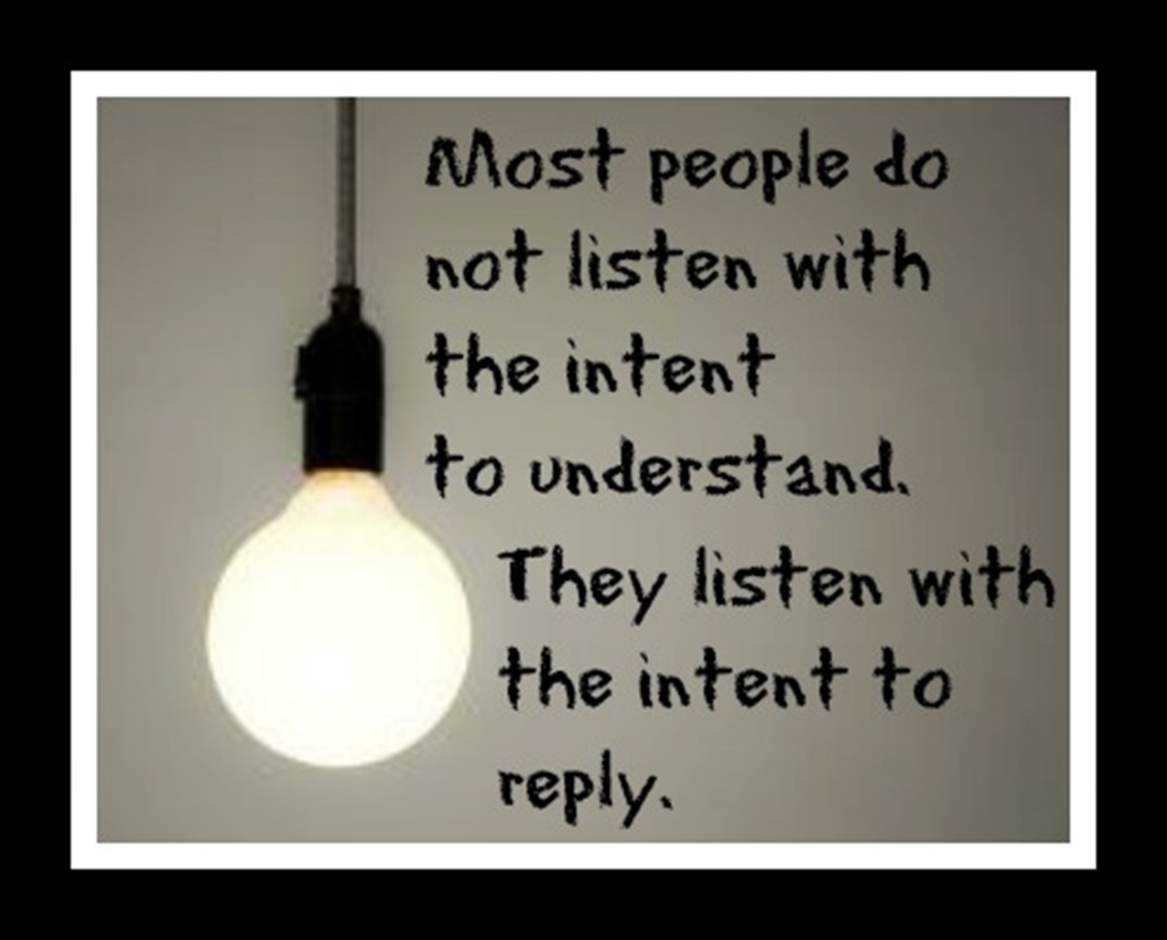

Slide 38


Types of Caring
Ministries
PRAYER MINISTRY
PRISON MINISTRY
(KAIROS)
STEPHEN MINISTRY
Others?

Slide 39
Prayer Ministry
Active
Intercessory
Caring
Compassionate
Loving
Notes:
Prayer is an action; it is doing something. Look to see where God is at work, and join God in that work. Even though we feel bad because we can’t always “do” something in the terms of accomplishing a task, sometimes praying is exactly what we need to be doing. Prayer is powerful as long as prayer is active, intercessory, caring, compassionate, and loving.

Slide 40
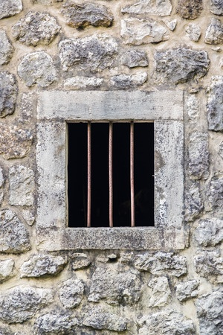
Prison Ministry
KAIROS
“In the love of Christ, who came to save those who are lost and vulnerable, we urge the creation of genuinely new systems for the care and support of the victims of crime and for rehabilitation that will restore, preserve, and nurture the humanity of the imprisoned.”
(Social Principles, 68.F)
Notes:
In 1996, General Conference added to the Social Principles a statement regarding restorative justice ministries that states, “In the love of Christ, who came to save those who are lost and vulnerable, we urge the creation of genuinely new systems for the care and support of the victims of crime and for rehabilitation that will restore, preserve, and nurture the humanity of the imprisoned.” -(Social Principles, 68.F)
Kairos is an organization of ministries that addresses the spiritual needs of incarcerated men, women, and children, their families, and those who work in the prison environment in order to bring Christ’s love and forgiveness and to assist in the transition toward becoming productive citizens. Kairos came out of the Cursillo movement and the Walk to Emmaus.

Slide 41

Stephen Ministry
“Carry each other’s burdens and so you will fulfill the law of Christ.”—Galatians 6:2 (CEB)
Notes:
41
Stephen Ministry is the one-to-one lay caring ministry that takes place in congregations that use the Stephen Series system.
Stephen Ministry congregations equip and empower lay caregivers—called Stephen Ministers—to provide high-quality, confidential, Christ-centered care to people who are hurting.
Stephen Ministry began in 1975 and is now in more than 12,000 congregations, and more than 600,000 people have trained as Stephen Ministers (laypeople who provide care to those who are hurting) in their congregations.

Slide 42
CARING
Discuss types of caring ministries in your church.
Identify ways individuals or congregations can do more to reach out into the community.

Slide 43

Stewardship of Creation
“The Lord God took the human and settled him in the garden of Eden to farm it and to take care of it.”—Genesis 2:15 (CEB)
“We do not inherit the Earth from our ancestors; we borrow it from our children” (Native American Proverb)
Notes:
43
List ways we can be good stewards of the earth and other gifts God has given.
Discuss making a commitment to practice care of creation.
What can we do in our wasteful culture to help improve our environment and the world’s natural resources?

Slide 44
Closing Prayer
For the beauty of the earth,
For the glory of the skies,
For the love which from our birth
over and around us lies;
Lord of all, to thee we raise
this our hymn of grateful praise. Amen.
Amen.
Public Domain, “For The Beauty of the Earth”, UMH #92
Notes:
May be sung.

Slide 45

LAY SERVANTS SERVE
BY
COMMUNICATING

Slide 46
SESSION 4:
Learning Outcome Goals
Be able to
1. discuss the importance of communication skills in various settings
2. list respectful communication guidelines
3. describe the process of mutual invitation
4. demonstrate listening skills
5. share faith stories with another participant

Slide 47
WORSHIP
Notes:
Read Scripture: Romans 10:14-15, 17
Sing: “To God be the Glory,” verses 1 and 2 (UMH #98)

Slide 48
“So how can they call on someone they don’t have faith in? And how can they have faith in someone they haven’t heard of? And how can they hear without a preacher? And how can they preach unless they are sent? As it is written, ‘How beautiful are the feet of those who announce the good news.’ ”
So faith comes from listening, but it’s listening by means of Christ’s message.
Romans 10:14-15,17 (CEB)
Notes:
We are called to share the good news:
- It is not standing on the street corner shouting Bible verses!
- It is sharing from your heart, your faith story with those with whom you have a relationship!

Slide 49
Prayer For God’s Reign
We believe in you, O God, for you have made the suffering of humanity your suffering. You have come to establish a kingdom of the poor and humble. Today we sing to you, because you are alive, you have saved us, you have made us free. Amen.
(Cuba, 20th Cent. The United Methodist Book of Worship, 511).

Slide 50
The Nicene Creed
We believe in one God, the Father, the Almighty, maker of heaven and earth, of all that is, seen and unseen.
We believe in one Lord, Jesus Christ, the only Son of God, eternally begotten of the Father, God from God, Light from Light, true God from true God, begotten, not made, of one Being with the Father; through him all things were made.
For us and for our salvation he came down from heaven, was incarnate of the Holy Spirit and the Virgin Mary and became truly human. For our sake he was crucified under Pontius Pilate; he suffered death and was buried.
(UMH 880)

Slide 51
(The Nicene Creed)
On the third day he rose again in accordance with the scriptures; he ascended into heaven and is seated at the right hand of the Father. He will come again in glory to judge
the living and the dead, and his kingdom will have no end.
We believe in the Holy Spirit, the Lord, the giver of life, who proceeds from the Father and the Son, who with the Father and the Son is worshipped and glorified, who has spoken through
the prophets. We believe in one holy catholic and apostolic church. We acknowledge one baptism for the forgiveness of sins. We look for the resurrection of the dead,
and the life of the world to come. Amen.
(UMH 880)

Slide 52
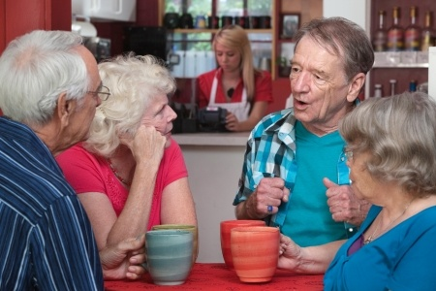
Communication Settings
Person-to-person
Personal Space
Mutual Understanding
Social media
  Facebook
  Twitter
  e-mail

Slide 53

Sharing Your Faith Story
Notes:
Have the group divide into pairs and share their faith stories with each other.
Have them evaluate the communication skills and listening skills of each other.
Each person has ten minutes to tell his or her story.
After everyone has shared, spend ten minutes evaluating both the speaker and the listener.
(See Evaluation Questions on page 49 and 51 in the Basic Course Leader’s Guide appendix.)

Slide 54
Closing Prayer
Take my life! Lord, put me to doing your work and your will in the world so that the lost and hungry souls may be attracted to your love and mercy and be drawn into the embrace of your love. Amen.
(Rueben Job and Norman Shawchuck, A Guide to Prayer for All Who Seek God [Nashville: Upper Room Books, 2003], 407.)
Notes:
May be sung.

Slide 55
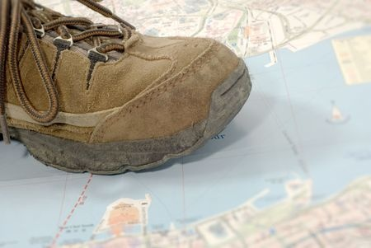
LAY SERVANTS SERVE
BY GOING
INTO THE WORLD

Slide 56
SESSION 5:
Learning Outcome Goals
Be able to
1. describe roles in fulfilling Great Commission
2. discuss importance of continued study and spiritual growth in the life of Christian leaders
3. discover important role of hospitality in the church
4. describe appreciative inquiry and asset-based community development and discuss ways these tools can be used to spread the gospel

Slide 57
WORSHIP
Notes:
Read Scripture: Matthew 28:16-20
Sing: “Lead Me, Lord” (UMH 473)

Slide 58
The Great Commission
“Now the eleven disciples went to Galilee, to the mountain where Jesus told them to go. When they saw him, they worshipped him, but some doubted. Jesus came near and spoke to them. “I’ve received all authority in heaven and on earth. Therefore, go and make disciples of all nations, baptizing them in the name of the Father, and of the Son and of the Holy Spirit, teaching them to obey everything that I’ve commanded you. Look, I myself will be with you every day until the end of this present age.”
—Matthew 28:16-20 (CEB)

Slide 59
Prayer
God, you are like a baker. The leaven you provide raises our hopes. You shape our lives with your hands—they are strong yet gentle.
We ask that you warm us in the oven of your love. Form our common lives by your grace so that we may in turn nourish hope in the world. We trust in you. Amen.

Slide 60
God’s Ways Are Not Our Ways
We desire pleasure and freedom from pain.
God invites us to growth and maturity.
We seek escape from difficulty.
God encourages us to engage the world’s brokenness.
We want quick answers to our questions.
God asks us to “Be still and know that I am God.”
We demand solutions to our problems.
God teaches life-long learning amid inconvenience, conflict, and pain.
(Pete Hammond, Lessons, Prayers & Scriptures on the Faith Journey, Intervarsity/USA Marketplace, p 93.)

Slide 61
(God’s Ways Are Not Our Ways)
We want power and recognition.
God calls us to humility.
We want relief from stress.
God gives us hope in harsh realities.
We want safety and security.
God beckons us to sacrificial servanthood.
We want health and comfort.
(Pete Hammond, Lessons, Prayers & Scriptures on the Faith Journey, Intervarsity/USA Marketplace, p 93.)

Slide 62
(God’s Ways Are Not Our Ways)
God offers inner serenity and peace.
We want happiness—now.
God delivers joy all through life.
“My plans aren’t your plans, nor are your ways my ways, says the Lord. Just as the heavens are higher than the earth, so are my ways higher than your ways, and my plans than your plans.”—Isaiah 55:8-9 (CEB).
(Pete Hammond, Lessons, Prayers & Scriptures on the Faith Journey, Intervarsity/USA Marketplace, p 93.)

Slide 63

We are called!
Notes:
We are called to participate in God’s mission to the world. These are some of the ways to become equipped for this mission. Practice the spiritual disciplines so that you are spiritually grounded. Improve your skills – re-assess your giftedness. Work in areas for which you have a passion. But most of all, spend time with God – listening for God’s will in all you do.

Slide 64

Forms of Ministry
Lay Servant
Lay Speaker
Lay Minister
Deaconess/Home Missioner
Specialized Ministry
Missionary
Local Pastor
Deacon
Elder
Notes:
The United Methodist Church has myriad of forms of ministry that equip and empower people. One additional path is that of the lay missioner, but through a new collaboration between the National Plan for Hispanic/Latino Ministries, the General Board of Higher Education and Ministry, and Discipleship Ministries, the lay missioner will be integrated into the Certified Lay Ministry program.
All forms of ministry are of kingdom value! God has called us ALL to ministry. God may be calling you into ministry as a layperson or as a clergyperson. The important thing is that you respond to that call. The gifts assessment is one of those tools that can help us determine where our gifts fit best.
Lay Servant Ministries is an excellent way to deepen our discipleship and to explore that call to ministry.
As we learned earlier, the clergy have the responsibility to equip and empower the saints for ministry. We are the saints. One of the best lay leadership development tools The United Methodist Church has is lay servant ministries. Through this inroad to ministry, laypersons learn and practice leadership through service in the local church and/or beyond as they participate in study, in caring for the congregation, in communicating and in leading through various means in the congregational ministry of the church in the community.

Slide 65
Going into the World
Lay Servants are
Ready to serve
Informed
Committed
Equipped
Notes:
Lay Servants are People who are;
Ready and desirous to serve the church
Well informed on and committed to the Scriptures and the doctrine, heritage, organization, and life of the U.M. Church
Willing to receive specific training to develop skills in witnessing to the Christian faith through spoken communication, church and community leadership, and care-giving ministries

Slide 66
ONGOING OUTREACH: Hospitality
What are some ways you can practice hospitality at church or during a meeting this week?
What are some ways you can practice hospitality outside the church in your community and workplace?
What difference does hospitality make – to others and to you?
Notes:
If we are the body of Christ in the world, why aren’t we reaching out to the least and the lost? Why are we so inwardly focused on our church members and church buildings? God has called us! We have a wonderful opportunity to participate in God’s mission to the world, and that goes beyond our church walls. Not only are we to practice hospitality inside the church building, but we are also to practice hospitality in the community as an outreach. How are we creating a sense of belonging among the least and the lost in the community outside our church walls? How can you or your congregation be the presence of Christ in the community outside the doors?

Slide 67
Closing Prayer
Sarum Blessing
God be in your head, and in your understanding.
God be in your eyes, and in your looking.
God be in your mouth, and in your speaking.
God be in your heart, and in your thinking.
God be at your end, and at your departing. Amen. (UMBW 566)

Slide 68
THANK YOU
for serving!

Slide 69
Copyright
“Basic Course Lay Servant Ministries” Copyright © 2013 The General Board of Discipleship of The United Methodist Church, PO Box 340003, Nashville TN 37203-0003. Website: http://www.umcdiscipleship.org. This presentation may be reprinted and used for nonprofit local church and educational purposes with the inclusion of the complete copyright citation plus the words "Used by permission." It may not be sold, republished, altered, used for profit, or placed on a website not under the auspices of The General Board of Discipleship.
Notes:
69

