Slide 1

Lay Servants Lead in Conflict Resolution
ClipArt Credit: https://pixabay.com/en/photos

Slide 2
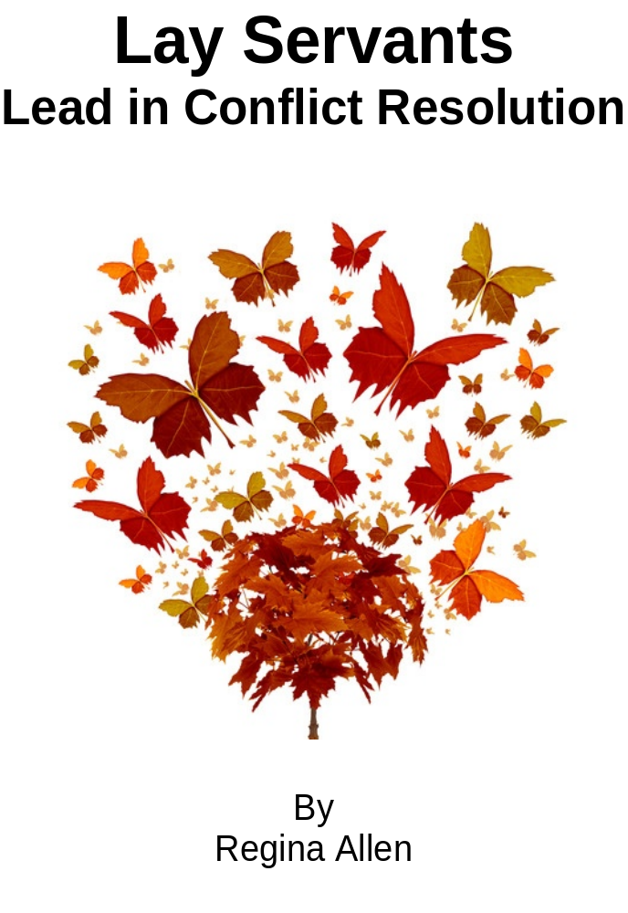
Lay Servants Lead in Conflict Resolution
WELCOME!
Notes:
Welcome everyone to the course and have introductions.

Slide 3
COURSE GOALS—To be able to…
Differentiate between conflict management (mandate) and conflict resolution (cooperation)
Refine your listening skills in hopes that your knowledge and talents as leaders in the church will be increased
Develop new methods in looking at conflict (there is no right or wrong, just differing opinions that are unable to see beyond personal opinion)
More fully understand and implement Matthew 18:19-20 in daily life
Notes:
Review course goals.

Slide 4
1: Changing Attitudes and Transforming Conflict
Upon completion of this session, you should be able to identify some benefits of conflict and how you have personally grown through conflict in your own life.
Notes:
At the end of this session, you should be able to identify some benefits of conflict and how you have personally grown through conflict in your own life.

Slide 5
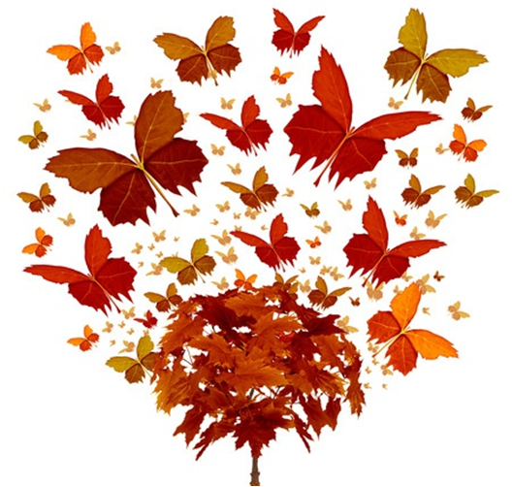
Devotion
Notes:
Devotion and prayer (suggested Scripture: Matthew 5:23-26)

Slide 6

DISCUSSION
Notes:
What is conflict?
Where have you encountered conflict?
What was the outcome?
How did it affect you?
How did it affect others involved?
Consider conflict management vs. conflict resolution.
What are your thoughts on the differences between the two?
Can you define conflict in a positive way?
Discuss ways you grow through conflict.

Slide 7

SMALL GROUPS
Notes:
In small groups, discuss ‘The Response of a Negative Attitude’ and ways you may have dealt with this yourself.
• How have you been negative in conflict, or when have you been unwilling to see anything but your own way?
• Can you share ways you might have handled it differently?
Share the small group discussions with the larger group.
Review the ‘Path of the One Who Harms’ beginning at the bottom of page 35 through page 36.

Slide 8

JOURNALING
Notes:
Have the class (individually) write down what they feel they need to change in their life. Have them save the list and periodically check and see how they are doing.

Slide 9
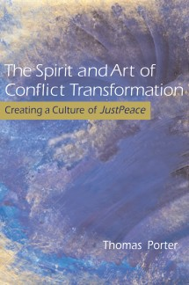
ASSIGNMENT
Read Chapters Three and Four of “The Spirit and Art of Conflict Transformation—Creating a Culture of JustPeace”
Notes:
Read Chapters Three and Four before the next session.

Slide 10

PRAYER
“Lord, make me an instrument of your peace,
Where there is hatred, let me sow love;
where there is injury, pardon;
where there is doubt, faith;
where there is despair, hope;
where there is darkness, light;
where there is sadness, joy;
Notes:
Closing Prayer:
“Lord, make me an instrument of your peace,
Where there is hatred, let me sow love;
where there is injury, pardon;
where there is doubt, faith;
where there is despair, hope;
where there is darkness, light;
where there is sadness, joy;

Slide 11
O Divine Master, grant that I may not so much seek to be consoled as to console;
to be understood as to understand;
to be loved as to love.
For it is in giving that we receive;
it is in pardoning that we are pardoned;
and it is in dying that we are born to eternal life. Amen.”—Attributed to St. Francis of Assisi but actual author is anonymous dating previous to 1912, copyright expired
PRAYER
Notes:
O Divine Master, grant that I may not so much seek to be consoled as to console;
to be understood as to understand;
to be loved as to love.
For it is in giving that we receive;
it is in pardoning that we are pardoned;
and it is in dying that we are born to eternal life. Amen.”

Slide 12
2: Learning Skills and Becoming Peacemakers
Upon completion of this session, you should be aware of the importance of listening, especially in times of conflict, and forgiving in order to listen more clearly.
Notes:
At the end of this session, you should be aware of the importance of listening, especially in times of conflict, and forgiving in order to listen more clearly.

Slide 13
Devotion
Notes:
Devotion and prayer (suggested Scripture: Matthew 18:21-35)

Slide 14
DISCUSSION
Notes:
Ask the group to reflect on times that they felt like no one was listening to them; when they didn’t listen to someone else.
What interferes with them listening to someone else?
How did it feel when they weren’t listened to?
How can they make a bigger effort in listening to others?

Slide 15

ROLE PLAY
Notes:
Break into pairs or very small groups and role play – first activity, get as much information about yourself to your partner as you can in less than five minutes.
Now introduce partners to the group sharing as much as possible.
Consider:
How could you have listened better?
How could you have spoken more clearly the information you wanted to share?
Discuss:
‘Listening’ is a verb and verbs describe action, thus it takes practice and work, as does any activity. We too often forget that it is NOT all about ME, which is where many conflicts begin, so take time to think and organize your thoughts before you speak and listen actively with love.
As Christians we are called to love one another as we love ourselves and to forgive all who have trespassed against us. This seems all too easy to do when things are going our way and we are sitting quietly meditating or praying, but when we have to interact with others, especially others that have different opinions than we do or are someone that is holding a grudge against us. We become defensive and often unwilling to totally forgive. We rationalize that I don’t have to forgive them if they don’t forgive me, but that isn’t what we are told to do. We are to forgive unconditionally, even while the words still sting in our hearts and minds.

Slide 16
JOURNALING
Notes:
Have the class (individually) write down everything they have learned about forgiveness.
What have they seen or experienced about forgiveness?
When, who, and for what have they struggled to forgive?
Are there some things they forgive more easily?
Some people they forgive more easily?
Does their forgiveness change by who and what, be they family, friend, or total stranger?
Allow time for the group to share, if they wish.

Slide 17
SMALL GROUPS
Notes:
Forgiving is the first step in peacemaking, and it is important that you know that peace in order to facilitate the resolution of conflicts of others, if and when you are asked to assist. It will also help you in ‘Making disciples for Jesus Christ for the transformation of the world’. We are not to take on others’ problems but guide others to be open-minded and forgiving.
In pairs or very small groups, have them think about what has worked for them and others in resolving conflict over their life and how others have helped them or they have helped others.
What does it mean to be a meditating presence?
Consider your own personality, can you fill this role?
What do you need to change to be a good listener or concise speaker?

Slide 18
ASSIGNMENT
Read Chapters Five and Six before the next session – think of unresolved conflict in your present life that you might be willing to share with the group in the upcoming sessions.
Notes:
Assignment: Read Chapters Five and Six before the next session – think of unresolved conflict in your present life that you might be willing to share with the group in the upcoming sessions.

Slide 19
PRAYER
“Lord, make me an instrument of your peace,
Where there is hatred, let me sow love;
where there is injury, pardon;
where there is doubt, faith;
where there is despair, hope;
where there is darkness, light;
where there is sadness, joy;
Notes:
Closing Prayer:
“Lord, make me an instrument of your peace,
Where there is hatred, let me sow love;
where there is injury, pardon;
where there is doubt, faith;
where there is despair, hope;
where there is darkness, light;
where there is sadness, joy;

Slide 20
O Divine Master, grant that I may not so much seek to be consoled as to console;
to be understood as to understand;
to be loved as to love.
For it is in giving that we receive;
it is in pardoning that we are pardoned;
and it is in dying that we are born to eternal life. Amen.”—Attributed to St. Francis of Assisi but actual author is anonymous dating previous to 1912, copyright expired
PRAYER
Notes:
O Divine Master, grant that I may not so much seek to be consoled as to console;
to be understood as to understand;
to be loved as to love.
For it is in giving that we receive;
it is in pardoning that we are pardoned;
and it is in dying that we are born to eternal life. Amen.”

Slide 21
3: Engaging in Conflict—Process Rituals
Upon completion of this session, you should be able to identify some benefits of conflict and how you have personally grown through conflict in your own life.
Notes:
At the end of this session, you should be able to identify some benefits of conflict and how you have personally grown through conflict in your own life.

Slide 22
Devotion
Notes:
Devotion and prayer (suggested Scripture: Matthew 5:43-44)

Slide 23
DISCUSSION
Notes:
Setting the stage for discussion may be more important than the decisions made.
There are several things to keep in mind to help make the resolution process as successful as possible. The book The Spirit and Art of Conflict Transformation contrasts the adversarial process vs. the collaborative process. We are all familiar with the adversarial process as the system our courts use and we often model our lives around this model, we act as though someone has authority over us in almost all circumstances. The collaborative process as it was presented presents everyone as equal. Each person is empowered by all others, empowered with the right and authority to share their views without fear of being diminished in the eyes of others in the process.
It is very important to know the circumstances of the conflict and how it has been handled up to this point. If some or all of the participants have been treated unfairly, it will be much more difficult to convince them to honestly share. The whole process is based on everyone being totally honest, but in a loving way. Honesty is what making peace is truly all about. If those involved feel they have no real value, they will not be open and honest.
It is important that all participants in the process feel equal; a circle or round table is a good way to start. Avoid any situation where some participants are higher than others or seated in such a way that anyone would appear to have more importance. Make sure all participants can see everyone. If someone can’t be seen, that individual may feel he/she can’t be heard.

Slide 24

CIRCLE WAY
Notes:
(Make sure all are familiar with the Circle Way on pgs. 80 – 85.)
Set the room in a fashion that the participants are in a circle and everyone can see each student.
Ask students if there is any scenario that they would like to share that could be used as a sample for the group to problem solve using the Talking Piece. If there is more than one have the group select which scenario to use first. If there are none, consider the following:
Your pastor is over worked but there are several in the church that want a contemporary worship service added to the 2 or 3 worship services the pastor already leads. There are no additional monies for an associate and no one has taken the lead for leading this new service or taking the lead in one of the existing services.
• Stress to the participants they need to own this problem and select their own preferences so they can fully feel the impact of the controversy.
• Use an object that is easily seen and passed from one person to another as the ‘talking piece’ and have the group present their opinions in a loving truthful manner.
• Remind them of the rules if the group wanders from the topic or anyone isn’t following the process or trying to monopolize the conversation.
• This process should not be rushed, but it should keep moving, if a break is needed feel free to call for a 10-minute recess before coming back to the circle.
• If time permits use additional scenarios to practice this process.
• It is not an easy process to learn and can be difficult to facilitate – allow others the opportunity to facilitate if time permits.
• Each scenario should open with a prayer for understanding and close with a simple ‘thank you’ for the Lord’s presence.

Slide 25
JOURNALING
Notes:
Have the class (individually) write down everything they have learned about engaging in conflict.
What have they seen or experienced through engaging in conflict?
What does it mean to engage in healthy conflict?
Allow time for the group to share, if they wish.

Slide 26
DISCUSSION
Notes:
How did they feel using the ‘talking piece’?
Is this something they would feel comfortable doing with a strange group?
Are there other ways they would feel more comfortable facilitating a group? Explore other options as suggested.
Review and discuss the questions on page 100 while reflecting on the circle(s) they just participated in.

Slide 27
ASSIGNMENT
Read Chapters Seven and Eight before the next session.
Notes:
Assignment: Read Chapters Seven and Eight before the next session.

Slide 28
PRAYER
“Lord, make me an instrument of your peace,
Where there is hatred, let me sow love;
where there is injury, pardon;
where there is doubt, faith;
where there is despair, hope;
where there is darkness, light;
where there is sadness, joy;
Notes:
Closing Prayer:
“Lord, make me an instrument of your peace,
Where there is hatred, let me sow love;
where there is injury, pardon;
where there is doubt, faith;
where there is despair, hope;
where there is darkness, light;
where there is sadness, joy;

Slide 29
O Divine Master, grant that I may not so much seek to be consoled as to console;
to be understood as to understand;
to be loved as to love.
For it is in giving that we receive;
it is in pardoning that we are pardoned;
and it is in dying that we are born to eternal life. Amen.”—Attributed to St. Francis of Assisi but actual author is anonymous dating previous to 1912, copyright expired
PRAYER
Notes:
O Divine Master, grant that I may not so much seek to be consoled as to console;
to be understood as to understand;
to be loved as to love.
For it is in giving that we receive;
it is in pardoning that we are pardoned;
and it is in dying that we are born to eternal life. Amen.”

Slide 30
4: Finding the Positive and Meeting Needs
Upon completion of this session, you should be able to see how conflict can help you see there is more than one side to every issue and all parties have valid concerns that need to be addressed.
Notes:
Upon completion of this session, you should be able to see how conflict can help you see there is more than one side to every issue and all parties have valid concerns that need to be addressed.

Slide 31
Devotion
Notes:
Devotion and prayer (suggested Scripture: I Corinthians 13:13)

Slide 32
DISCUSSION
Notes:
Read “The Rabbi’s Gift” to begin this session.
Discuss the value of treating each other as though you thought that the Messiah is a person in the group you are trying to facilitate. Would you facilitate differently? (Remember this is a positive attendant in every group “where two or more are gathered in my name” Matthew 18:20.)
A first step in creating positive discussion is to explore how the group got to where they are now;
• Did they try to solve the problem in a destructive manner?
• Are there major personality issues?
• Are there trust issues among those in conflict?
• Are there any other issues to consider?
These questions need to be addressed before setting up talks. Everyone needs to understand all the issues and agree they will keep an open mind and listen with loving ears. Listening is the most important criteria for resolving and avoiding conflict.

Slide 33
Appreciative Inquiry
Notes:
Define and review Appreciative Inquiry in Chapter Seven of ‘The Spirit and Art of Conflict Transformation’.
Discuss how Appreciative Inquiry is different from just allowing everyone an opportunity to speak his or her mind. Remember to start with the positive; this is the way Paul taught us to address each other in his letters in the New Testament. He always began with greetings and praises, and then gently stated issues that were important and needed to be addressed. This is the same manner in which we are to show our love to others in resolving all differences.
ACTIVITY: (20 min.)
Using a scenario offered by one of the participants or the same scenario as in the last session, use the Appreciative Inquiry method to come to a solution.

Slide 34
JOURNALING
Notes:
Have the class make a list of people they have personally had conflicts with. How have they handled those conflicts? Make a list of some of the good things about each of the people or circumstances that are on the list and list what your need is in each.
Allow time for the group to share, if they wish.

Slide 35
DISCUSSION
Notes:
Discuss the differences in how you felt with the different methods of discussion. How did it make people feel to be praised prior to being disagreed with?
Why don’t persons take the extra time to always praise first and make sure the needs are addressed?
Can they see how this could help them in circumstances in their day-to-day life?
Now share some of your top suggestions with the whole group and discuss ways to implement some of these strategies into their lives life each day.
Are these suggestions realistic?

Slide 36
SMALL GROUPS
Notes:
Discuss in pairs or very small groups how they could handle the day-to-day conflicts and reduce hard feelings.

Slide 37
ASSIGNMENT
Read Chapters Seven and Eight before the next session.
Notes:
Assignment: Read Chapters Nine and Ten before the next session.

Slide 38
PRAYER
“Lord, make me an instrument of your peace,
Where there is hatred, let me sow love;
where there is injury, pardon;
where there is doubt, faith;
where there is despair, hope;
where there is darkness, light;
where there is sadness, joy;
Notes:
Closing Prayer:
“Lord, make me an instrument of your peace,
Where there is hatred, let me sow love;
where there is injury, pardon;
where there is doubt, faith;
where there is despair, hope;
where there is darkness, light;
where there is sadness, joy;

Slide 39
O Divine Master, grant that I may not so much seek to be consoled as to console;
to be understood as to understand;
to be loved as to love.
For it is in giving that we receive;
it is in pardoning that we are pardoned;
and it is in dying that we are born to eternal life. Amen.”—Attributed to St. Francis of Assisi but actual author is anonymous dating previous to 1912, copyright expired
PRAYER
Notes:
O Divine Master, grant that I may not so much seek to be consoled as to console;
to be understood as to understand;
to be loved as to love.
For it is in giving that we receive;
it is in pardoning that we are pardoned;
and it is in dying that we are born to eternal life. Amen.”

Slide 40
5: Addressing Harm and Healing
Upon completion of this session, you should be able to identify the differences between justice and revenge while working toward resolution with restitution.
Notes:
Upon completion of this session, you should be able to identify the differences between justice and revenge while working toward resolution with restitution.

Slide 41
Devotion
Notes:
Devotion and prayer (suggested Scripture: Luke 12:13-15 and 19:7-10)

Slide 42
JOURNALING
Notes:
Have the class define in their journal: justice, revenge, restitution, retributive justice and restorative justice.

Slide 43
DISCUSSION
Notes:
Open a discussion on these definitions. How do they differ?
Have the group consider situations that each could be used as an appropriate solution to conflict and why.
Discuss where our society is, as each sees it, with revenge vs. restitution.
Does the lawsuit frenzy reflect on revenge or restitution?

Slide 44
JOURNALING
Notes:
Have each person journal for a few minutes on how to work at restoring justice within their own communities.
Allow time for the group to share.
Can these ideas be expanded upon?

Slide 45
SMALL GROUPS
Notes:
Brainstorm situations of conflict the class has been involved in or are aware of.
Break into small groups to discuss appropriate consequences of these situations from what they have learned in this class.

Slide 46
PRAYER
“Lord, make me an instrument of your peace,
Where there is hatred, let me sow love;
where there is injury, pardon;
where there is doubt, faith;
where there is despair, hope;
where there is darkness, light;
where there is sadness, joy;
Notes:
Closing Prayer:
“Lord, make me an instrument of your peace,
Where there is hatred, let me sow love;
where there is injury, pardon;
where there is doubt, faith;
where there is despair, hope;
where there is darkness, light;
where there is sadness, joy;

Slide 47
O Divine Master, grant that I may not so much seek to be consoled as to console;
to be understood as to understand;
to be loved as to love.
For it is in giving that we receive;
it is in pardoning that we are pardoned;
and it is in dying that we are born to eternal life. Amen.”—Attributed to St. Francis of Assisi but actual author is anonymous dating previous to 1912, copyright expired
PRAYER
Notes:
O Divine Master, grant that I may not so much seek to be consoled as to console;
to be understood as to understand;
to be loved as to love.
For it is in giving that we receive;
it is in pardoning that we are pardoned;
and it is in dying that we are born to eternal life. Amen.”

Slide 48
Evaluations
Notes:
Complete class evaluations.

Slide 49
THANK YOU!

