Slide 1

Leading Missional
Small Groups

Slide 2
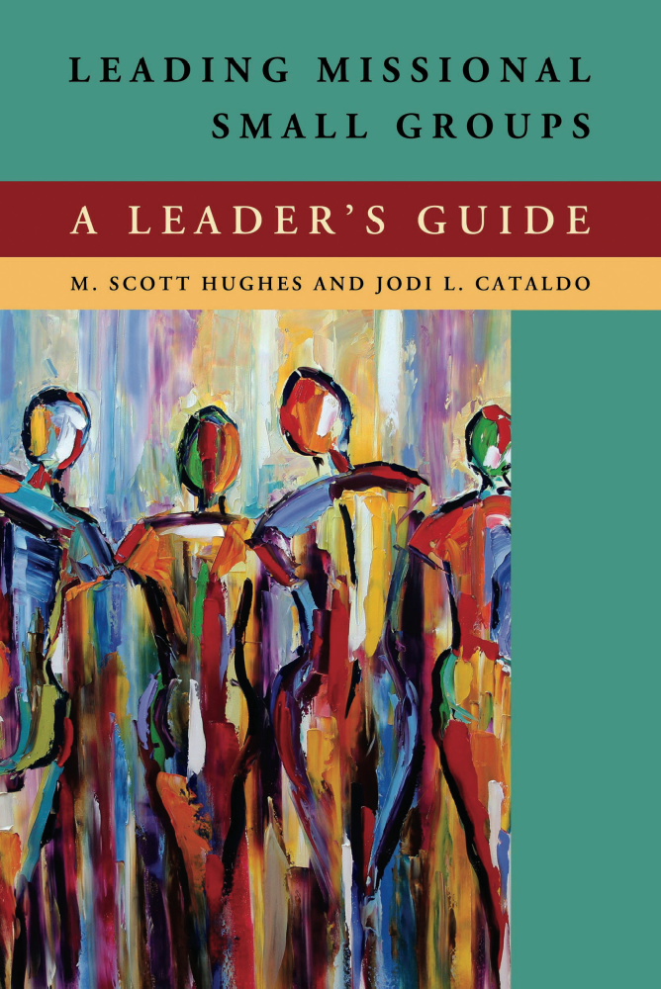
Leading Missional
Small Groups
WELCOME!
Notes:
Welcome everyone to the course and make introductions.

Slide 3
COURSE GOALS—
To gain a better understanding of…
The missional foundations set by John and Charles Wesley in the beginnings of the Holy Club
What it means to be missional and why we are called to be missional
How the means of grace shape us to serve “missionally”
What a missional community is
How to organize for a missional community and what that means
Notes:
Review course goals.

Slide 4
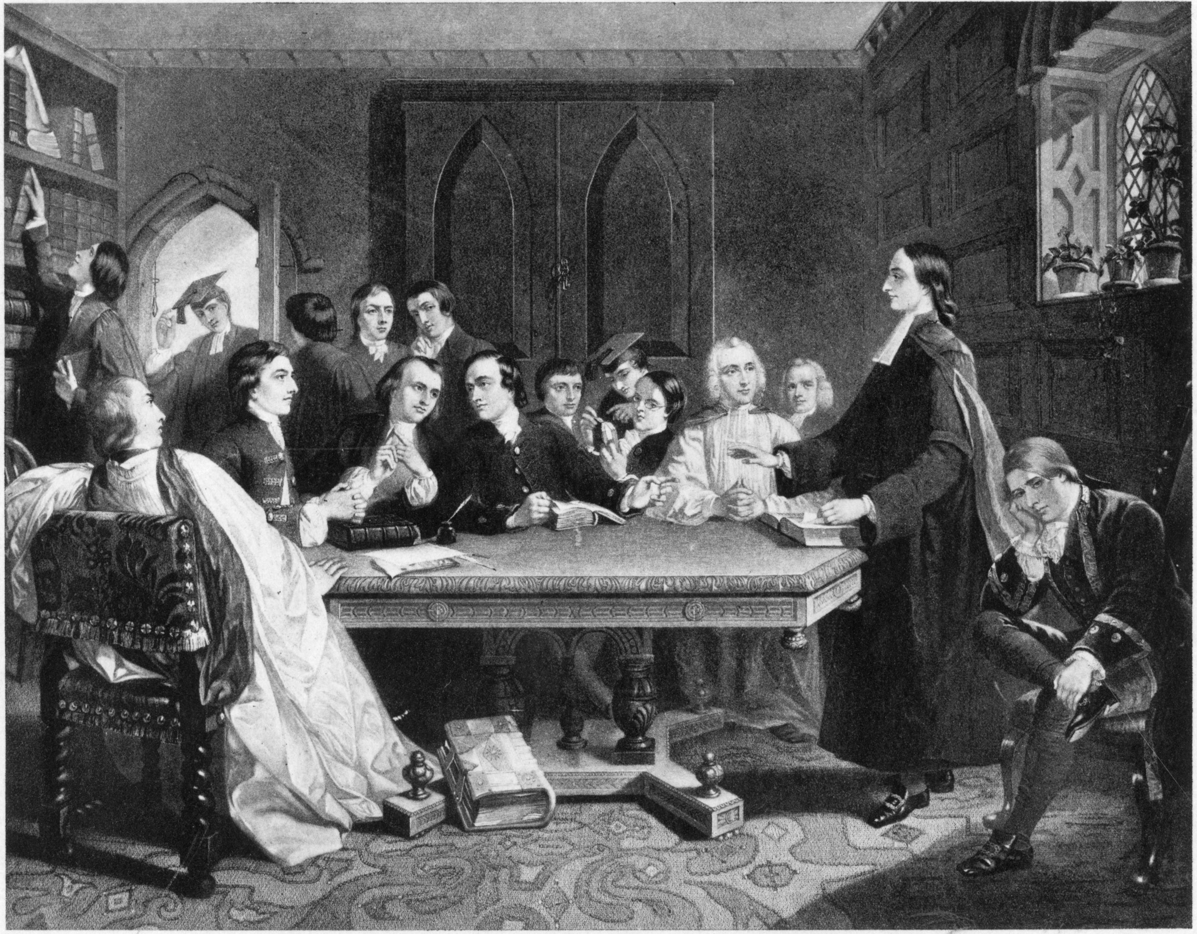
1: Missional Beginnings—The Holy Club
Session Goal: To gain a better understanding of the missional foundations set by John and Charles Wesley in the beginnings of the Holy Club.
Photo credit: www.umc.org
Notes:
This session is designed to help you gain a better understanding of the missional foundations set by John and Charles Wesley in the beginnings of the Holy Club.

Slide 5
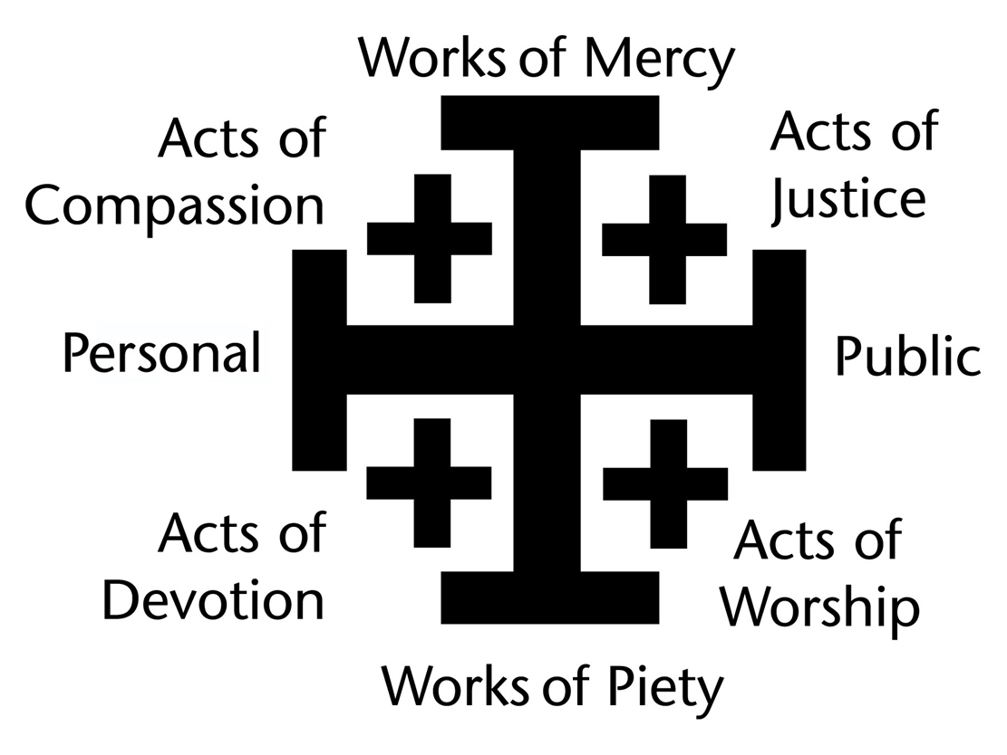
GENERAL RULE
To witness to Jesus Christ in the world, and to follow his teachings through acts of compassion, justice, worship, and devotion under the guidance of the Holy Spirit.
Notes:
Using post-it newsprint (non-bleed-through), or something similar, hang a copy of the graphic for “The General Rule of Discipleship” divided into four sections: Acts of Compassion, Acts of Devotion, Acts of Justice, and Acts of Worship. The General Rule of Discipleship is to witness to Jesus Christ in the world, and to follow his teachings through acts of compassion, justice, worship, and devotion under the guidance of the Holy Spirit.
Provide colored markers. As people arrive for the first session, have them identify examples of acts of compassion, acts of devotion, acts of justice, and acts of worship on the large sheet of newsprint next to the appropriate section.

Slide 6
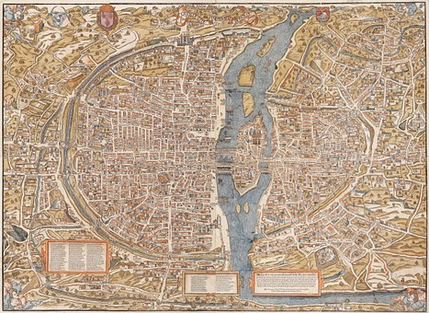


Worshiping Together
Notes:
Sing together “Change My Heart, O God” (The Faith We Sing, 2152)
Read Psalm 119:33-40 responsively as follows…

Slide 7
Psalm 119:33-40 (CEB)
LORD, teach me what your statutes are all about,
and I will guard every part of them.
Help me understand so I can guard your Instruction
and keep it with all my heart.
Lead me on the trail of your commandments
because that is what I want.
Notes:
LORD, teach me what your statutes are all about,
and I will guard every part of them.
Help me understand so I can guard your Instruction
and keep it with all my heart.
Lead me on the trail of your commandments
because that is what I want.

Slide 8
Psalm 119:33-40 (CEB)
Turn my heart to your laws, not to greedy gain.
Turn my eyes away from looking at worthless things.
Make me live by your way.
Confirm your promise to your servant—
the promise that is for all those who
honor you.
Notes:
Turn my heart to your laws, not to greedy gain.
Turn my eyes away from looking at worthless things.
Make me live by your way.
Confirm your promise to your servant—
the promise that is for all those who honor you.

Slide 9
Psalm 119:33-40 (CEB)
Remove the insults that I dread because your rules are good.
Look how I desire your precepts!
Make me live by your righteousness.
Notes:
Remove the insults that I dread because your rules are good.
Look how I desire your precepts!
Make me live by your righteousness.

Slide 10
Dear God,
“O that we could begin this day in devout meditations, in joy unspeakable, and in blessing and praising thee, who hast given us such good hope and everlasting consolation.
Notes:
Pray together:
Dear God,
“O that we could begin this day in devout meditations, in joy unspeakable, and in blessing and praising thee, who hast given us such good hope and everlasting consolation.

Slide 11
Lift up our minds above all these little things below, which are apt to distract our thoughts; and keep them above, till our hearts are fully bent to seek thee every day, in the way wherein Jesus hath gone before us, though it should be with the loss of all we here possess. Amen.” (Wesley)
Notes:
Lift up our minds above all these little things below, which are apt to distract our thoughts; and keep them above, till our hearts are fully bent to seek thee every day, in the way wherein Jesus hath gone before us, though it should be with the loss of all we here possess. Amen.” (Wesley)

Slide 12

WESLEYAN
TRIVIA!
Notes:
Play Wesleyan Trivia: As an icebreaker, ask the following trivia questions about our missional beginnings to get the conversation started. Reward correct answers with small candies. Following the activity, have more candy on hand for everyone to share.
Where was John Wesley’s heart “strangely warmed”? (Aldersgate Street in London)
Who, along with his friend, William Morgan, took the first step in developing a missional small group that later became known as the Holy Club? (Charles Wesley; John Wesley later joined and made it a threesome.)
How often did this small group receive Communion? (weekly; when John became the leader, the meetings became more regular.)
Because the Holy Club received Communion weekly, it was given a nickname. What was it? (Sacramentarians)
Because the Holy Club practiced regular devotional reading of Scripture, it was given yet another nickname. What was it? (Bible moths)
Why did Charles Wesley believe they were called “Methodists” by others? (Because of the methodical manner they went about being Christians.)
What is the name of your class leader who is passionate about missional small groups? (Your name.)

Slide 13

DISCUSSION
Notes:
Read Matthew 4:18-25 together.
John and Charles Wesley grew to understand that as they were being transformed by God’s grace they became transforming agents in the world. It was not enough to have mere head knowledge about Christian principles; rather, they needed to BE disciples of Jesus in every aspect of their own lives. This hunger to be all that Christ would want them to be gave them the impetus to form a system of support and accountability, the Holy Club. Through the Holy Club, John and Charles organized a community for the formation of its members and for participation in God’s mission to the world.
• Read Matthew 4:18-22
• Discuss:
1. If you were one of those first people Jesus called to be a disciple, how would you have responded?
2. Why do you think the first disciples of Jesus were willing to leave behind their jobs and family to follow Jesus?
• Read Matthew 4:23-25
• Discuss:
1. What was Jesus teaching and preaching?
2. How would Jesus’ ministry be good news?
3. If you were one of those first disciples who began to follow Jesus, what do you think you would be thinking and feeling as you witnessed how Jesus was “fishing” for people?

Slide 14
The Great Commandment
—to put love of God and neighbor above all else
The Great Commitment
—to embody God’s love individually
The Great Requirement
—to live God’s love through our actions
The Great Commission
—to go and take God’s love into the world
The Great Redemption
—to invite all to experience God’s love
Notes:
• Read “The Beginnings of Methodism” on pages 18-20 of Transforming Community.
In the text, we read about how the Holy Club got started and what it became.
• Discuss:
1. What components of the Holy Club did you resonate with the most?
2. Which components of the Holy Club do you have the hardest time incorporating into your life?
The Holy Club is grounded upon a number of biblical principles that can be summarized in the five charges of Jesus. Invite different participants to read:
• The Great Commandment – Matthew 22:37-39
• The Great Commitment – Matthew 16:24
• The Great Requirement – Micah 6:8
• The Great Commission – Matthew 28:19-20
• The Great Redemption – John 3:16
In the Great Commandment (Matthew 22:37-39), we learn that disciples put love of God and neighbor above all else; in the Great Commitment (Matthew 16:24), we learn that disciples are to embody God’s love individually; in the Great Requirement (Micah 6:8), we learn that disciples are to live God’s love through our actions; and in the Great Commission (Matthew 28:19-20), we learn that disciples are to go and take God’s love into the world to invite others to experience the wondrous gift of God’s love. The Great Redemption (John 3:16) is lived out as an example of why we do what we do, what we are called to do, and how we are to live out that calling. Throughout the story of Scripture, we see that God is calling together a community of love who glorify God through loving God and loving neighbors.

Slide 15

DISCUSSION
Notes:
Communities of love are how we participate in God’s mission to the world; thus, communities of love are the foundation of truly missional congregations. Our Wesleyan tradition models what this means through the example of “the Holy Club.”
Discuss:
1. Why do you think it is important for Christians be part of small groups?
2. What would you consider to be the core elements of a missional small group?
Even more than seeking assurance of salvation, John and Charles Wesley wanted every aspect of their lives to be governed by the love of God— by holiness of heart and life. This was the goal of the Holy Club—to be transformed into people who exuded Christ-like love. Their goal was holiness of heart AND life and one of the primary means of getting there was the Holy Club.

Slide 16

SMALL GROUPS
Notes:
If you use holiness of heart and life as the compass point, how would you map out the journey to get there? (For example, practicing accountability, Bible study, prayer, the means of grace.)
• Small groups: (Divide into small groups of four to five people. Ask each group to take some time thinking about the goal of holiness of heart and life and the components of the Holy Club; then talk about what a map leading to that compass point, or goal, would look like. Next have the groups share their maps. This should take about 30 minutes.)

Slide 17
DISCUSSION
Notes:
With the whole group, reread Matthew 4:18-25.
• Ask the following questions (which are adapted from page 25 of Transforming Community):
1. What are the four critical insights the Wesley brothers learned that would characterize the early Methodist movement?
2. What similarities do you see between the beginnings of Methodism and the beginnings of Jesus’ ministry?
3. How do Jesus’ ministry and the Holy Club demonstrate what missional small groups look like?
4. Are their places in your local church or elsewhere where you talk with others about what it means to follow Jesus in our world today? Where are places in which those conversations might occur?
5. Do you pray or read Scripture on a regular basis? Does anyone hold you accountable for your growth in holiness of heart and life?

Slide 18

Celebrate Together
Notes:
Sing together “Into My Heart” (The Faith We Sing, 2160)
• Encourage a few people to share briefly how they have felt “strangely warmed” (an assurance of salvation) as they have sought holiness of heart and life.

Slide 19
Prayer…
“Blessed are you, O Lord and Lover, source of beauty and depth of passion. Strengthen and inspire us to do the word we hear and live the faith we confess. Amen.”
Reprinted from Revised Common Lectionary Prayers, copyright © 2002 Consultation on Common Texts.
Notes:
Pray together:
“Blessed are you, O Lord and Lover, source of beauty and depth of passion. Strengthen and inspire us to do the word we hear and live the faith we confess. Amen.”

Slide 20
2: Being Missional—
The Pursuit of Holiness
Session Goal: To gain a better understanding of what it means to be missional and why we are called to be missional.
Photo credit: www.umc.org
Notes:
This session is designed to help you gain a better understanding of what it means to be missional and why we are called to be missional.

Slide 21
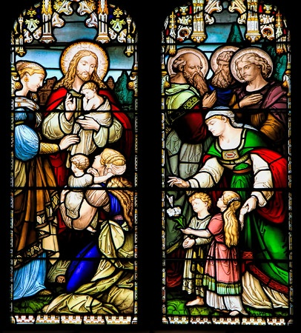
Whom do you consider ‘holy’ and why?
Notes:
Have the class answer the question, “Whom do you consider ‘holy’ and why?”

Slide 22

Worshiping Together
Notes:
• Sing together “Cry of My Heart” (TFWS, 2165)
• Take this time for the group to learn spiritual centering.
Psalm 46:10 tells us, “Be still, and know that I am God! I am exalted among the nations, I am exalted in the earth.” Let’s now close our eyes and center ourselves.
Say, “As we read the verse again, focus on a single word. The word might be God, still, know, or exalted. As you hear the verse again, rest in the fact that God is inviting us… ‘Be still, and know that I am God! I am exalted among the nations, I am exalted in the earth.’ (Allow some moments of quiet.) As we maintain an attitude of solitude, let us listen to the Scripture from Psalm 46:1-7, 11.”
(Read slowly and contemplatively.)
“God is our refuge and strength, a help always near in times of great trouble.
That’s why we won’t be afraid when the world falls apart,
when the mountains crumble into the center of the sea, when its waters roar and rage,
when the mountains shake because of its surging waves.
(pause; if possible, play the sounds of waves at this point)
There is a river whose streams gladden God’s city, the holiest dwelling of the Most High.
God is in that city. It will never crumble. God will help it when morning dawns.
(pause; if possible, play morning sounds at this point)
Nations roar; kingdoms crumble. God utters his voice; the earth melts.
The Lord of heavenly forces is with us! The God of Jacob is our place of safety.
(pause)
The Lord of heavenly forces is with us! The God of Jacob is our place of safety.” (CEB)
(Let the room go silent for a few moments and then close the prayer with “amen.”)

Slide 23

JOURNALING
Notes:
Option 1:
Take time for journaling on Psalm 46:10 where it states, “Be Still, and know that I am God!” The focus word should be “God.” This can be done by creating a word cloud or collage (See sample on page 26 in the appendix) or by writing a prayer, writing about God’s presence in the Psalm, or by reflecting on the need for solitude in an overstimulated culture.
Option 2:
• Distribute the blank sheets of paper and drawing utensils. Have each person create a “word collage” based on his/her knowledge of God. What words would he/she use to describe God? Take only five minutes for this drawing activity.
• After the class has contemplated these words that express class members’ knowledge of God, invite a couple of people to talk about what they have drawn, if they feel comfortable doing so.

Slide 24
DISCUSSION
Notes:
In much of the Sermon on the Mount, Jesus contrasts “showy” religion with the proper motivations of the heart. Ask a volunteer to read Matthew 5:30.
• Ask: “Why would this have been a surprising, if not shocking, statement for Jesus to have made?”
• Ask a volunteer to read Matthew 6:1-18. Ask: “Whom do you think Jesus is referring to by using the label ‘hypocrite’?”
• Ask: “Do you think Jesus is advocating for a faith that is solely private (makes no public demonstrations of faith)? Why or why not?”
• Ask: “How do these verses illustrate for us the difference between knowing about God as a concept and knowing God as a living reality in our lives?” (Discuss as a group and ask for examples of personal experience.)

Slide 25
SMALL GROUPS
  1. How would you describe the difference between the “faith of a servant” and the “faith of a child of God”? Have you experienced a similar shift in your life?
  2. How does the Sermon on the Mount help you to understand the difference between a “showy” public demonstration of deeds from a religion that grows out of a vital relationship with God?
Notes:
• Small Groups: Have each small group read and discuss “The Faith They Found” on pages 31-33 of Transforming Community. Have them use the following discussion questions:
1. How would you describe the difference between the “faith of a servant” and the “faith of a child of God”? Have you experienced a similar shift in your life?
2. How does the Sermon on the Mount help you to understand the difference between a “showy” public demonstration of deeds from a religion that grows out of a vital relationship with God?

Slide 26
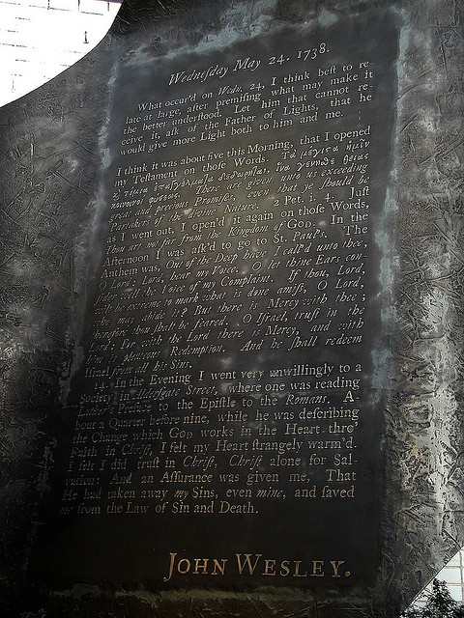
recognition of the power of the Holy Spirit to change human hearts
that it is all a gift of God, which leads to a fundamental change in motivation
that these motivations laid a new foun­dation for the pursuit of holiness
The Aldersgate Experience
Notes:
On pages 31-33 of Transforming Community, Knight and Powe discuss Wesley’s spiritual journey after Aldersgate. They write, “out of his experience at Aldersgate and struggle to properly understand it, John Wesley gained three insights that would shape his Methodist movement” (page 32). Those three insights are:
1. recognition of the power of the Holy Spirit to change human hearts
2. that it is all a gift of God, which leads to a fundamental change in motivation
3. that these motivations laid a new foundation for the pursuit of holiness.
• Ask: “What negative images or connotations are often attached to holiness in our culture?”
• Ask: “How do Knight and Powe, drawing on Wesley, present a different understanding of holiness?”
On page 33 of the text, the writers state this about the Wesleys, “Before they tried to love God and others in hopes of pleasing God and obtaining assurance of salvation. While this genuinely propelled them into mission, it was compromised by the fact that their prime motivation was self-interest. Now they were truly set free to love as God loves, not as a means to an end, but as an end in itself. Their motivation for mission was their love for God and their neighbor.”
Ask: “Why is the pursuit of holiness (being set free to love as God loves) essential to being missional? How is the pursuit of holiness (being set free to love as God loves) related to being missional?”

Slide 27

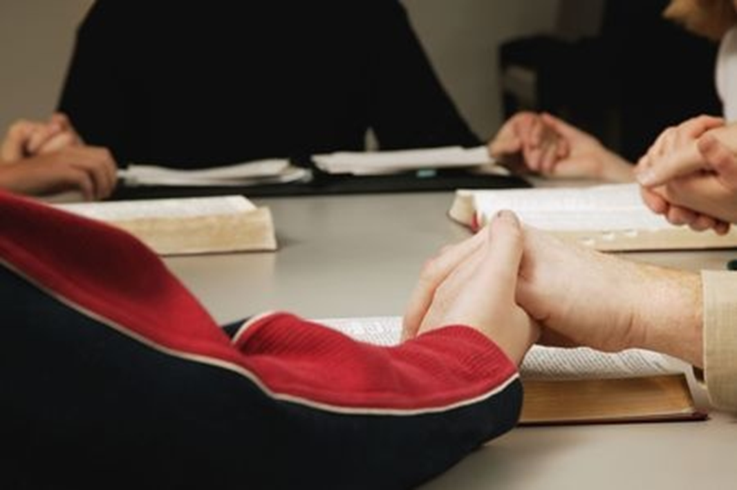
The Wesleyan Means of Grace
Notes:
Knight and Powe say of the means of grace: “We use [means of grace] because we are always in need of grace, and God has promised that we can come to them and find grace…the means of grace are where God has promised we will encounter the transforming power of the Holy Spirit” (page 36).
Ask: “How do small groups function as a means of grace?”
It is true that small groups can function as a means of grace. However, it is also true that groups can fall short of that goal. A poorly run small group can descend into group therapy session or mere fellowship time.
Ask: “What practices or habits could small groups include to maintain a pursuit of holiness?”
One way to make sure small groups function as missional groups is to keep accountability at the forefront of the group’s attention. Using a rule of life, or more specifically the General Rule of Discipleship as a rule of life, provides structure and focus. Rules of life and similar group covenants assist members of the small group to be intentional about pursuing holiness of heart and life.

Slide 28
Three Rules
Do no harm.
Do good.
Attend upon the ordinances of God.
Notes:
“Is it advisable for us to preach in as many places as we can without forming any societies?”
At annual conferences, this question of Wesley’s was addressed because it dealt with the purpose of lay preachers, and it provided a summary of the mission of the Methodist movement. (See page 44, Transforming Community.)
Ask: “What danger did the early Methodists sense about preaching without forming societies as a means of grace?”
From the societies, small groups called “bands” were developed. Bands were for those who had the faith of a child of God and were growing in love for God and neighbor. These bands were based on James 5:16. They confessed their sins to one another and they prayed for one another so that they could experience healing, spiritually and physically. Because they were confessional in nature and highly personal, it became necessary to develop a discipline for the bands that was composed of three rules:
1. Do no harm.
2. Do good.
3. Attend upon the ordinances of God.
• Read The Book of Discipline of The United Methodist Church, 2016, par. 104—THE GENERAL RULES OF THE METHODIST CHURCH and discuss the statements for each of the three rules as to why they are being cited.
• Ask: “Which of the specific practices (besides one of the main three rules) could be restated for today?”
• Ask: “Are there any specific practices that seem especially difficult to keep?”
• Have each person complete Worksheet A on The United Methodist Rule of Life. Instruct participants to use the text on pages 45-46 of Transforming Community and The Book of Discipline of The United Methodist Church 2016, par. 104—THE GENERAL RULES OF THE METHODIST CHURCH to describe in their own words what the rules should mean in their own lives.
• Ask volunteers to share some of their responses and learnings from the activity.

Slide 29
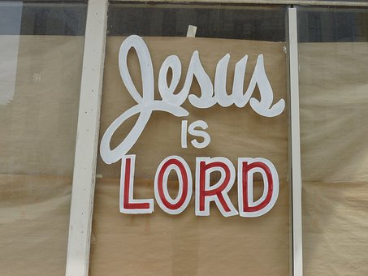
SMALL GROUPS
Notes:
• Small Groups: Using the sample covenant on page 27 (the appendix), have each small group practice what it means to be part of a band, or a missional small group, in pursuit of holiness of heart and life.

Slide 30

Celebrate Together
Notes:
• Sing together “We are Called” (TFWS, 2172).
• Encourage each person to share in a brief sentence where he or she has seen evidence of God’s grace, not in a showy manner, but in the evidence of the heart.
• Pray together the Lord’s Prayer.

Slide 31
3: Living Missional—Acts of Piety/Acts of Mercy
Session Goal: To gain a better understanding of how the means of grace shape us to serve “missionally.”
Photo credit: www.umc.org
Notes:
This session is designed to help you gain a better understanding of how the means of grace shape us to serve “missionally.”

Slide 32

MEANS OF GRACE
Notes:
Using post-it newsprint (non-bleed-through) or something similar, title the page “Means of Grace” and draw a line to divide the sheet into two sections. One section should be Acts of Piety and the other Acts of Mercy. Have colored markers available. As people arrive, have them write down acts of piety and acts of mercy on the large sheet of newsprint in the appropriate section.

Slide 33

Worshiping Together
Notes:
• Sing together “Who Is My Mother, Who Is My Brother” (TFWS, 2225)
• Read a word from John Wesley (Sermon 24: “Upon Our Lord’s Sermon on the Mount IV,” II. 2):
“…(I)t is impossible for any that have it, to conceal the religion of Jesus Christ. This our Lord makes plain beyond all contradiction, by a two-fold comparison: “Ye are the light of the world: A city set upon a hill cannot be hid.” Ye Christians are “the light of the world,” with regard both to your tempers and actions. Your holiness makes you as conspicuous as the sun in the midst of heaven. As ye cannot go out of the world, so neither can ye stay in it without appearing to all mankind….Love cannot be hid any more than light; and least of all, when it shines forth in action, when ye exercise yourselves in the labour of love, in beneficence of every kind. As well may men think to hide a city, as to hide a Christian; yea, as well may they conceal a city set upon a hill, as a holy, zealous, active lover of God and man.”

Slide 34
“Holy Lord, maker of us all, you call us to love our neighbors as ourselves and teach us that faith without works is dead. Open us to the opportunities for ministry that lie before us, where faith and works and the need of our neighbor come together in the name of Jesus Christ, our Savior. Amen.”
Reprinted from Revised Common Lectionary Prayers, copyright © 2002 Consultation on Common Texts.
Notes:
“Holy Lord, maker of us all, you call us to love our neighbors as ourselves and teach us that faith without works is dead. Open us to the opportunities for ministry that lie before us, where faith and works and the need of our neighbor come together in the name of Jesus Christ, our Savior. Amen.”

Slide 35
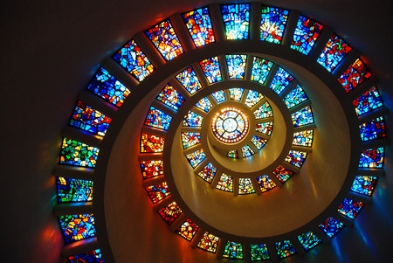
The Nature of Discipleship
Copyright: <a href='https://www.123rf.com/profile_kirkikis'>kirkikis / 123RF Stock Photo</a>
Notes:
Have volunteers read from Luke 9:18-27, Luke 10:25-37, Acts 4:32-35.
• For Luke 9:18-27, ask: “What does this passage reveal about the nature of discipleship (following Jesus)?”
• For Luke 10:25-37, ask: “What does this passage demonstrate about the radical nature of loving others that disciples are called to? What might it also say about the importance of ministering to people’s physical needs as well as spiritual needs?”
• For Acts 4:32-35, ask: “In what specific ways does the early church present a model for being missional?”
• Ask: “What do these Scripture verses tell us about being a missional community?”

Slide 36
DISCUSSION
Notes:
Read “Going to the People” on pages 43-44 of Transforming Community.
The Wesleys learned a critical lesson about what the church should actually be. It is interesting that United Methodists still struggle with this lesson today. Does the church wait for people to come to it, or does the church go to the people? What some may term these two vastly different concepts are “attractional” versus “missional.”
Discuss: What are the differences between “attractional” and “missional” churches? According to this excerpt from page 44 of Transforming Community, what makes Methodism a missional movement?

Slide 37
SMALL GROUPS
“Is it advisable for us to preach in as many places as we can, without forming any societies? The answer is short and clear: By no means. We have made the trial in various places; and that for a considerable time. But all the seed has fallen as by the highway side. There is scarce any fruit remaining.” (Wesley, Works)
Notes:
“Is it advisable for us to preach in as many places as we can, without forming any societies? The answer is short and clear: By no means. We have made the trial in various places; and that for a considerable time. But all the seed has fallen as by the highway side. There is scarce any fruit remaining.” (Wesley, Works)
In small groups, have the participants discuss the quote (above) from Wesley’s conferences with his preachers:
1. Why did they meet in societies?
2. When the societies became too large, what was the solution?

Slide 38
DISCUSSION
Notes:
Although the development of the class meetings was really unplanned, they created an environment of accountability. When the leaders raised funds for the preaching house in Bristol (a contribution of one penny a person), they had the opportunity to learn about the people’s needs and to call the members of that class meeting to accountability. As class meetings increased in numbers of participants, rather than calling on each member at their house, the members met together weekly at the same location. The main purpose of the meetings became accountability. In the class meetings, members were asked how it was with their soul, as well as how they were giving relief for the poor. The class meetings provided a place for advice, encouragement, and conversation regarding the discipline—acts of piety and acts of mercy. The classes provided a significant way for people to come to know the love of God, and their hearts and lives were transformed. The transformation experienced by the early Methodists was not just private spiritual growth. It was also about increasing in love toward their neighbors.
• Discuss the differences between private religion and charity work on the one hand, and personal/social holiness and being missional on the other.
• Ask: “Methodists were to do good to both the bodies and to do good with the souls of their neighbors. Why are both necessary for ministry that is seeking to be missional?”
Wesley had a vision for “social holiness.” Although Methodists today think that means acts of compassion and acts of justice, Wesley used the term to say that religion was not solitary, but communal. Social holiness, in Wesley’s understanding, was a community of Christians who were either seeking or growing in love. These communities (societies, classes, and bands) were designed to open people’s hearts and lives to the work of the Holy Spirit—lives transformed.
Ask: “As the Methodist communities developed, what were the four ways this process of small groups carried out their mission?”
1. As communities of ___________(witness)
2. As communities of ___________(testimony)
3. As communities of ___________(hospitality)
4. As communities of ___________(service)

Slide 39

SMALL GROUPS
Notes:
In small groups, have participants discuss the following questions:
1. How do our churches engage in these practices today?
2. How can each small group also practice these?
Missional small groups, as Wesley discovered, are far more effective in maintaining a connection with acts of piety and acts of mercy because they offer accountability.
• Practice exercising accountability through the small group. Have people in the small groups share how they have done the following in the past week: (If participants cannot remember a specific example they performed, allow the option to share how they saw another person demonstrate that act.)
Acts of Mercy
1. Acts of compassion for people and God’s creation this last week.
2. Acts of justice…witnessing for justice, encouraging forgiveness and reconciliation.
Acts of Piety
3. Acts of devotion…spending time daily in prayer and Bible reading, taking a full day of Sabbath during the week.
4. Acts of worship through participation in corporate worship.

Slide 40
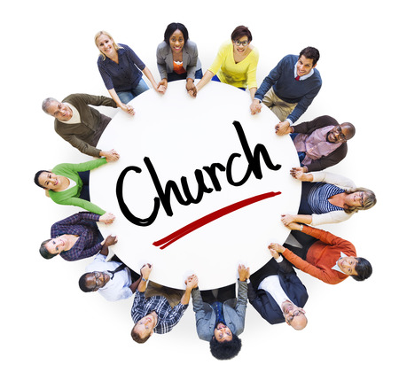
DISCUSSION
Notes:
• Ask the following questions (modified from those at the end of chapter three of Transforming Community):
1. Revivalists in the late nineteenth century spoke of coming to the altar and getting saved. Wesley’s Methodists spoke of a way of salvation with conversion not as an end but the beginning of growth in love. What has been your
understanding of conversion? How does Wesley’s model confirm or challenge your experience?
2. How did Wesley’s gathering people into societies and classes contribute to their growing in the knowledge and love of God and in love for their neighbor?
3. In what ways is your local church a witness to the good news of Jesus Christ? In what ways might it become an even stronger witness?
4. Are there opportunities to share testimonies in your church’s worship services or small groups? What are some ways opportunities for sharing can be created?

Slide 41
Celebrate Together
Notes:
• Encourage each person to talk about places where he or she has seen God this past week.
• Encourage each person to talk about missed opportunities to couple doing good to bodies with doing good to souls.
• Pray together “A Covenant Prayer in the Wesleyan Tradition” (607, United Methodist Hymnal).
I am no longer my own, but thine.
Put me to what thou wilt, rank me with whom thou wilt.
Put me to doing, put me to suffering.
Let me be employed by thee or laid aside for thee,
Exalted for thee or brought low by thee.
Let me be full, let me be empty.
Let me have all things, let me have nothing.
I freely and heartily yield all things
To thy pleasure and disposal.
And now, O glorious and blessed God,
Father, Son, and Holy Spirit,
Thou art mine, and I am thine. So be it.
And the covenant which I have made on earth,
Let it be ratified in heaven. Amen.
• Sing together “Grace Alone” (TFWS, 2162)

Slide 42
4: The Missional Community—The World is Our Parish
Photo credit: www.umc.org
Session Goal: To gain a better understanding of what missional community is.
Notes:
This session is designed to help you gain a better understanding of what missional community is.

Slide 43
Salvation is…
To be a witness is…
To be authentic means…
Notes:
Have participants add words to “Salvation is…”; “To be a witness is…”; “To be authentic means…” on butcher paper or a newsprint sheet using colored markers.

Slide 44

Worshiping Together
Notes:
• Sing together “Go Ye, Go Ye into the World” (TFWS, 2239).
• Read in unison the following excerpt from Wesley’s Journal—June 11, 1739, found on page 57 of Transforming Community:
“I look upon all the world as my parish; thus far I mean, that, in whatever part of it I am, I judge it meet, right, and my bounden duty to declare until all that are willing to hear, the glad-tidings of salvation. This is the work which I know God has called me to: and sure I am that his blessing attends it. Great encouragement have I therefore, to be faithful in fulfilling the work he hath given me to do. His servant I am, and, as such, am employed according to the plain direction of his word, as I have opportunity, doing good unto all men. And his providence clearly concurs with his word; which has disengaged me from all things else, that I might singularly attend on this very thing, and go about doing good.”

Slide 45
“Mighty and powerful God, through Jesus Christ our Savior you come to save people in all times and places, offering them life in your presence. Give us open hearts to receive your Chosen One, that through him we may dwell with you as faithful and committed disciples. Amen.”
Reprinted from Revised Common Lectionary Prayers, copyright © 2002 Consultation on Common Texts.
Notes:
• Pray together:
“Mighty and powerful God, through Jesus Christ our Savior you come to save people in all times and places, offering them life in your presence. Give us open hearts to receive your Chosen One, that through him we may dwell with you as faithful and committed disciples. Amen.”

Slide 46
THE WORLD THROUGH GOD’S EYES
Copyright: <a href='https://www.123rf.com/profile_kirkikis'>kirkikis / 123RF Stock Photo</a>
Notes:
“The World Through God’s Eyes”: Give class participants a half sheet of paper and have each person draw a representation of what he or she thinks the world looks like through God’s eyes.
Ask a few people to talk about their pictures.

Slide 47
DISCUSSION
Notes:
Reflecting on Acts 3:1-10, Knight and Powe challenge us with this question, “How many people have we helped and felt like we did our good deed without going any further?” Have the participants discuss their response to this question.
• Read Acts 3:1-10: What were the three aspects of doing good that the authors name? (Paying attention to those beyond our doors; eliciting their participation in what we do in the community; and making sure we seek their physical and spiritual well-being. Which of these three does your congregation do best? Which does your congregation need to work on the most?
• Have a participant read the opening paragraphs of chapter 4 of Transforming Community up to “Community Is Our Parish.”
As we read through this portion of the text, we see that central to being missional is the transformation of the heart—the outward focus of a changed heart enlarged by the inner working of God’s love. God calls us through salvation to a new life where we see the world differently as we grow into the image of Christ. Knight and Powe state that “the idea of limiting community to only those who are part of the congregation cheapens our love for neighbor.” Although the typical definition of “parish” means a bounded group of individuals who belong to a particular ecclesial body, Wesley intentionally draws the circle wider. This was lived out through the Oxford Holy Club by not only caring for their community’s own spiritual formation, but also engaging with those who were not part of their smaller circle through their ministry with the incarcerated and disenfranchised. At the heart of their missional engagement was internal and external renewal. Wesley was committed to taking the gospel outside the walls of the “defined” parish; thus, his declaration that the world was his parish.
• Ask:” How far away does the average church member live from the church? What percentage of church members live within a five-mile radius of the church?”
• Wesley did not have a “come to” mentality; rather, he had a “go to” mentality.
Ask: “How well do the church members know (not merely think they know) the needs of the surrounding community? How can we expand the boundaries of our parish by ‘going to’?”
• Discuss the questions below (which are based on questions found on page 69 of Transforming Community). Be sure to focus on the second question.
1. How do our ministries seek the well-being of others and share the transforming power of the gospel?
2. How might living out our membership vows in the world become a transformational experience not only for others, but for us?

Slide 48

THE MIRROR OF THE SOUL
Notes:
• Ask someone to read Matthew 6:22-23.
It is said that the eyes are the mirror of the soul.
Ask: “As God’s love is enlarging in our hearts, how should our motivations shift in how we view our neighbors?”
Knight and Powe write “if the community [the world] is our parish, then we live out this transformation in concrete ways that God’s grace shines through us. Those who are in the community experience God’s grace through our loving acts” (page 62). They further state, “there is a thin line between being intentional about doing acts of mercy and misconstruing these acts in terms of the church’s role as a social agency. … The acts themselves often improve one’s social plight, but the church’s calling is to holiness and not simply to be social caretakers”(page 62).
• Ask someone to read Matthew 6:13-16.
Ask: “If the church is the light of the world (especially as the world presents itself in our local community), what are we inviting and pointing people to? Asked similarly, what is the end goal we are working toward when we invite and witness to the local community?”
• Discuss. In answering the above questions, have any new ideas or perspectives dawned about ways your church could be a light to the surrounding community?
• Small Groups Role-Play: Divide into small groups and have each small group develop a role-play based that represents the difference between acts of mercy just as something they do compared to another act of mercy done as a call to holiness of heart and life.
• Ask: “In each of these scenarios, what or who was being pointed to or witnessed as the group carried out acts of mercy? How did group members model being authentic?”
We are called to witness, but that witness needs to come from the heart through word and deed. In that way, the message is authentic, and we will be able to point others to God’s transforming power. Without holiness of heart and life, we are like salt that has lost its flavor, or a light that has been hidden under a bushel, or an eye that has gone bad and mirrors something even deeper that is lacking within our souls.
“The word witness by definition has to do with seeing. A witness is someone who sees something take place and is able to report on it. . . .. When we think about witnessing in this way, it is not so much of how we see, but how others see us. If others see us as dim witnesses, then it comes across like we put our light under a bushel. In our mind we may be burning bright, but others do not see our light” (Knight & Powe, page 74). “As a witness we often share from the perspective of how we see or understand things, but we must be mindful of the way others [the world, the community] see us” (Knight & Powe, page 74).
• Ask: “Can you give any specific examples of when a church tried to ‘do good,’ but it was received as ‘doing harm’?”
We must ask ourselves if the world, the community, is able to experience God’s transforming grace in the way we witness. When we share authentically, we are focused on building relationships with our local community. We invite them to experience the grace-filled community that has made a difference in our lives. In this way, our light shines even brighter!

Slide 49
SMALL GROUPS
Notes:
• Break into small groups again and discuss the following questions, which are based on questions from page 84 of Transforming Community:
1. What does it mean to be a light in your community?
2. From the perspective of the community, what are they “witnessing” from your congregation?
3. In what ways is your congregation’s witnessing authentic? In what ways is it inauthentic?
4. What current ministry is making a difference in your community? What difference is it making in the lives of others? If you cannot name one, what ministry can you start?

Slide 50
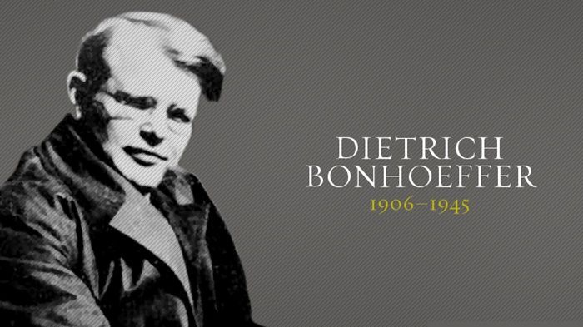
Notes:
• Watch TEDxSMU Salon 2012 - Brandon Lazarus on YouTube: https://www.youtube.com/watch?v=P3v6oTtfym4
• The Dietrich Bonhoeffer House (an intentional community) uses the church’s membership vows as a way to connect with the disenfranchised in an impoverished area of Dallas. When people become a part of this house, they covenant to live out the rule of life in the community through their prayers, their presence, their gifts, their service, and their witness. (par. 217, Book of Discipline)
• Using Worksheet B found in the appendix, have each participant write ways in which he or she faithfully participates in the ministries of the church (prayers, presence, gifts, service, witness), using the perspective of Wesley that the world is our parish.
• Allow time for feedback.

Slide 51
Celebrate Together
Notes:
• Encourage participants to talk about places where they have seen membership vows lived out in the community and world.

Slide 52
“God of the lowly and the mighty, you know the ugliness of your people when we harm and destroy one another, yet you offer us forgiveness if we but turn to you. Expand our hearts to receive the mercy you give us, that, in turn, we may share your grace and mercy with others each moment of our lives. Amen.”
Reprinted from Revised Common Lectionary Prayers, copyright © 2002 Consultation on Common Texts.
Notes:
• Pray together: “God of the lowly and the mighty, you know the ugliness of your people when we harm and destroy one another, yet you offer us forgiveness if we but turn to you. Expand our hearts to receive the mercy you give us, that, in turn, we may share your grace and mercy with others each moment of our lives. Amen.”
• Sing together “We All Are One in Mission” (TFWS, 2243).

Slide 53
5: Organizing a Missional C.O.M.M.U.N.I.T.Y.
Session Goal: To gain knowledge and skills about how to organize for a missional community and what that means.
Photo credit: www.umc.org
Notes:
This session is designed to help you gain knowledge and skills about how to organize for a missional community and what that means.

Slide 54
“The good you do today, people will often forget tomorrow; do good anyway.
Give the world the best you have, and it may never be enough; give the world the best you’ve got anyway.
You see, in the final analysis, it is between you and God; it was never between you and them anyway.”
--Mother Teresa
Notes:
Have participants add specific examples of acts of mercy to Mother Teresa’s poem “Anyway,” which is displayed on a large piece of newsprint or butcher paper.( Some examples might be: serve coffee to the busy parents in the waiting line to drop off their children at school, and you might get a complaint because it is not a cappuccino with a double shot of espresso, but do it anyway.)
“The good you do today, people will often forget tomorrow;
Do good anyway.
Give the world the best you have, and it may never be enough;
Give the world the best you’ve got anyway.
You see, in the final analysis, it is between you and God;
It was never between you and them anyway.”
--Mother Teresa

Slide 55

Worshiping Together
Notes:
• Sing together “The Summons” (TFWS, 2130).
• Read Psalm 86:8-13 responsively.

Slide 56
Psalm 86:8-13 (CEB)
My Lord! There is no one like you among the gods!
There is nothing that can compare to your works!
All the nations that you’ve made will come and bow down before you, Lord; they will glorify your name because you are awesome and a wonder worker.
You are God. Just you.
Notes:
My Lord! There is no one like you among the gods!
There is nothing that can compare to your works!
All the nations that you’ve made will come and bow down before you, Lord; they will glorify your name because you are awesome and a wonder worker.
You are God. Just you.

Slide 57
Psalm 86:8-13 (CEB)
Teach me your way, Lord, so that I can walk in your truth.
Make my heart focused only on honoring your name.
I give thanks to you, my Lord, my God, with all my heart, and I will glorify your name forever
Notes:
Teach me your way, Lord, so that I can walk in your truth.
Make my heart focused only on honoring your name.
I give thanks to you, my Lord, my God, with all my heart, and I will glorify your name forever

Slide 58
Psalm 86:8-13 (CEB)
Because your faithful love toward me is awesome
And because you’ve rescued my life from the lowest part of hell.
Notes:
Because your faithful love toward me is awesome
And because you’ve rescued my life from the lowest part of hell.

Slide 59
“God of hope, you call us home from the exile of selfish oppression to the freedom of justice, the balm of healing, and the joy of sharing. Make us strong to join you in your holy work, as friends of strangers and victims, companions of those who others shun, and as the happiness of those whose hearts are broken. We make our prayer through Jesus Christ our Lord. Amen.”
Reprinted from Revised Common Lectionary Prayers, copyright © 2002 Consultation on Common Texts.
Notes:
Pray together:
“God of hope, you call us home from the exile of selfish oppression to the freedom of justice, the balm of healing, and the joy of sharing. Make us strong to join you in your holy work, as friends of strangers and victims, companions of those who others shun, and as the happiness of those whose hearts are broken. We make our prayer through Jesus Christ our Lord. Amen.”

Slide 60

Building a Missional Community
Notes:
Build a Missional Community Exercise. Provide enough small blocks of wood so there is one block per class participant. Have each person write an act of piety or an act of mercy on his/her block that would help build a missional community (examples “visiting in prison,” “caring for the lonely,” “prayer,” “covenant”) and then have participants build a structure together using the “named” blocks of wood.

Slide 61
MEANS OF GRACE
Notes:
Ask: “What are some everyday examples of things you use to organize your life (jewelry box, shoe rack, calendar)? What do each of these things have in common?” (A purpose. Give structure and control.)
John and Charles Wesley brought people together into a community—societies, classes and bands—to work out their salvation. This common purpose formed and informed their entire ministry. They described such societies as a “company of men having the form and seeking the power of godliness, united in order to pray together, to receive the word of exhortation, and to watch over one another in love, that they may help each other to work out their salvation.” (Wesley)
The purpose was centered in works of piety and works of mercy. To grow in holiness required both kinds of formational habits. The structure and process provided by the Wesleys was not a short-term proposal, but one that could be sustained for lifetime growth in sanctification.
• Have a participant read Acts 2:42-47.

Slide 62

SMALL GROUP
Notes:
Read again Acts 2:42-47.
• Small-Group Discussion: Name works of piety and works of mercy that are present in the community of believers in Acts 2:42-47. What was the result of their participation in works of piety and mercy? How often did they participate in the works of piety and/or mercy? What has been your biggest learning about these formational practices?

Slide 63
C.O.M.M.U.N.I.T.Y.
Notes:
It is not enough that we live out our purpose through missional communities/small groups one day a week. If we are seeking to work out our salvation or to grow in the knowledge and love of God and neighbor, we need daily practices…just like those modeled for us in Acts 2 in the community of believers. They were bound together in one common purpose–to work out their salvation by growing in the knowledge and love of God and neighbor.
In organizing a missional community or small group, the identification of a common purpose is foundational. Small groups that are intentionally missional can answer questions such as: What’s the purpose of the small group? To what end is the group working? How will you live out this purpose? Knight and Powe provide the acrostic C.O.M.M.U.N.I.T.Y. to help guide the organization of missional communities or small groups. Let’s look at these components and talk about each one:
• First, ask participants to work together in completing the acrostic without looking up the answers:
o C
o O
o M
o M
o U
o N
o I
o T
o Y
• Discuss how each characteristic contributes to a small group being missionally focused:
• C = Connect. The community connects individuals together in various ways around the work of holiness—connecting to God, to others in the faith community, to others in the broader community through works of piety and works of mercy.
• O = Open. The community has to be open to all and actively seeking others. It may be that as some move further and deeper in their walk, a smaller group could be formed to increase commitment and greater accountability.
• M = Mercy. The mercy we receive from God should also be extended to others, so they can also experience God’s grace. We receive God’s mercy through worship, prayer, and most of all, through love—God’s unconditionally forgiving love.
• M = Mutuality. Mutuality is the way we experience community. It is all about respect. Mutuality requires vulnerability, and that sometimes makes us uncomfortable. All individuals must be respected equally, recognizing that each and every person has something to give to the community as a whole.
• U = Unconventional. Being unconventional requires creativity. Understand the context and think of some unconventional ways you might connect with others to further the work of the community. Wesley did this through street preaching in his day. What are some creative or unconventional ways your small group or community might exercise hospitality in your context?
• N = Narrative. Knight and Powe write that “the narrative is the way we inhabit the biblical text. For the Wesleys, the narrative shapes us toward a deeper love of God and neighbor. When we are inviting and sustaining people into and in the community, it is the narrative that enables us to have common language to make this happen” (pages 96-97). Remember that the narrative is not dependent on one person. It is developed in community, and the community shares the common narrative.
• I = Invitational. Being invitational means much more than simply sharing information. It is about extending an invitation to a transformed life lived out in community, giving the opportunity for others to experience God’s transformation.
• T = Trustworthy. The Wesleys proved themselves to be trustworthy by being authentic in their caring for both the spiritual and the physical needs of others. When a community is trustworthy, the small group will be much more effective in inviting and sustaining others in their journeys. It is important to think of ways to reach out to others in ways that carry authenticity.
• Y = Yearning. The Wesleys yearned for transformation into the image of Christ. This same yearning led them to form communities—classes, bands and societies—so that they and others could work out their salvation and grow in their knowledge and love of God and love of neighbor. They yearned for transformation through their daily practices. A yearning for transformed hearts will provide a strong missional foundation for the community in its daily practices of loving God and neighbor. What is your community yearning for?

Slide 64
DISCUSSION
Notes:
• Have one of the participants read Matthew 7:24-29. Ask and discuss the following questions, which are based on questions found on page 102 of Transforming Community:
1. On what foundation are we building our community? How is Jesus the foundation for missional small groups?
2. What are the characteristics of the acrostic that best support the foundation of our faith community today? What characteristics do we need to work on to create a stronger faith community?
3. Are there ways in which our congregation is like a “house of sand”? What might address these concerns?
4. What new missional effort can our congregation start that will make a difference in people’s lives? How would missional small groups help our church be more faithful to Jesus’s command in Matthew 28:18-20 (The Great Commission)?

Slide 65
SMALL GROUPS
Notes:
• Exercise in building C.O.M.M.U.N.I.T.Y. Distribute Worksheets C-E to all the participants. Have the class break up into small groups. Ask the participants to complete each worksheet for their local church. Allow them to talk in their small groups to assist one another with any questions or issues.
• Worksheet C – Have participants review Worksheets A and B (The United Methodist Rule of Life) and the acrostic C.O.M.M.U.N.I.T.Y. for guidance regarding the “Main Characteristics of the Group.”
• Worksheet D – Tell participants to look back to the Sample Covenants used from Lesson 2 to create a sample covenant for their missional small groups.
• Another option would be to use Worksheet E – Tell participants to refer back to Worksheet B to create a Rule of Life to be used by each missional small group.
• Worksheet E – Have participants use the sample worksheet to create role expectations for facilitators and participants.
• Have each group report back to the larger group. Discuss: “What are you most excited about? Where do you still have questions or need help?”

Slide 66

Celebrate Together
Notes:
• Read the following quote from John Wesley:
“Lastly. As he has time, he “does good unto all men;” unto neighbours and strangers, friends and enemies: And that in every possible kind; not only to their bodies, by “feeding the hungry, clothing the naked, visiting those that are sick or in prison;” but much more does he labour to do good to their souls, as of the ability which God giveth; to awaken those that sleep in death; to bring those who are awakened to the atoning blood, that, “being justified by faith, they may have peace with God;” and to provoke those who have peace with God to abound more in love and in good works. And he is willing to “spend and be spent herein,” even “to be offered up on the sacrifice and service of their faith,” so they may “all come unto the measure of the stature of the fullness of Christ.” (Wesley, Works 9:41)
• Sing together “The Servant Song” (The Faith We Sing, 2222)

Slide 67

“God of grace and glory, you call us with your voice of flame to be your people, faithful and courageous. As your beloved Son embraced his mission in the waters of baptism, inspire us with the fire of your Spirit to join in his transforming work. We ask this in the name of our Savior Jesus Christ, who lives and reigns for ever and ever. Amen.”
Reprinted from Revised Common Lectionary Prayers, copyright © 2002 Consultation on Common Texts.
Notes:
• Pray together:
“God of grace and glory, you call us with your voice of flame to be your people, faithful and courageous. As your beloved Son embraced his mission in the waters of baptism, inspire us with the fire of your Spirit to join in his transforming work. We ask this in the name of our Savior Jesus Christ, who lives and reigns for ever and ever. Amen.”

Slide 68
THANK YOU!

