Slide 1

Leading Worship

Slide 2
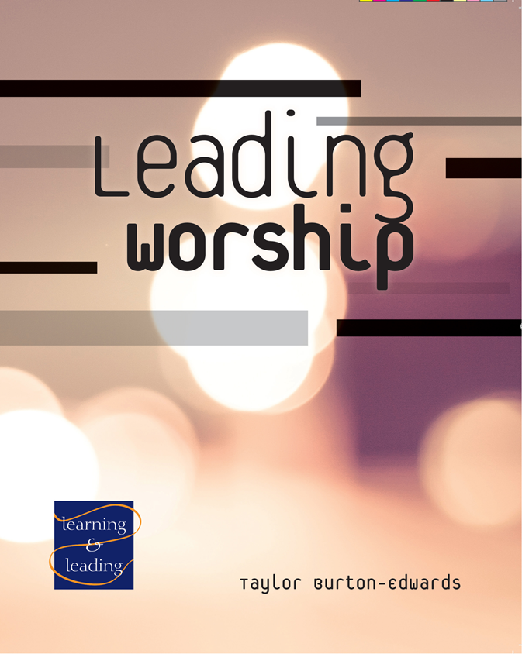
WELCOME!
Notes:
Introduce yourself and welcome participants. Invite participants to make brief introductions:
Tell us a brief bit about your history.
What is your church involvement?
Why are you taking this class?

Slide 3
COURSE GOALS
To understand the history of Christian worship, paying particular attention to the development of current United Methodist ritual and ritual resources, the basic pattern of worship, the Christian year, and the Revised Common Lectionary.
To understand the largely non-verbal ways in which worship leaders model the kind of energy needed in each movement and moment of worship and the flow from one to the next.
To gain experience as a worship team through leading and receiving feedback on the first two movements of Sunday worship.
To gain experience as a worship team through leading and receiving feedback on the second two movements of Sunday worship.
To have a wider understanding of additional patterns of worship, including morning and evening prayer, extending the table, and group devotional acts—praying or singing the psalms and lectio divina.
Notes:
Review course goals.
To understand the history of Christian worship, paying particular attention to the development of current United Methodist ritual and ritual resources, the basic pattern of worship, the Christian year, and the Revised Common Lectionary.
To understand the largely non-verbal ways in which worship leaders model the kind of energy needed in each movement and moment of worship and the flow from one to the next.
To gain experience as a worship team through leading and receiving feedback on the first two movements of Sunday worship.
To gain experience as a worship team through leading and receiving feedback on the second two movements of Sunday worship.
To have a wider understanding of additional patterns of worship, including morning and evening prayer, extending the table, and group devotional acts—praying or singing the psalms and lectio divina.

Slide 4
Session 1:
Ordering Christian Worship—Principles and Patterns
Notes:
At the end of this session, you should have a better understanding of the history of Christian worship, paying particular attention to the development of current United Methodist ritual and ritual resources, the basic pattern of worship, the Christian year, and the Revised Common Lectionary.
How many of you have led a worship session where you were responsible for developing the worship?
How many have participated in some sort of worship other than sitting in the audience or congregation?
What functions did you perform?

Slide 5
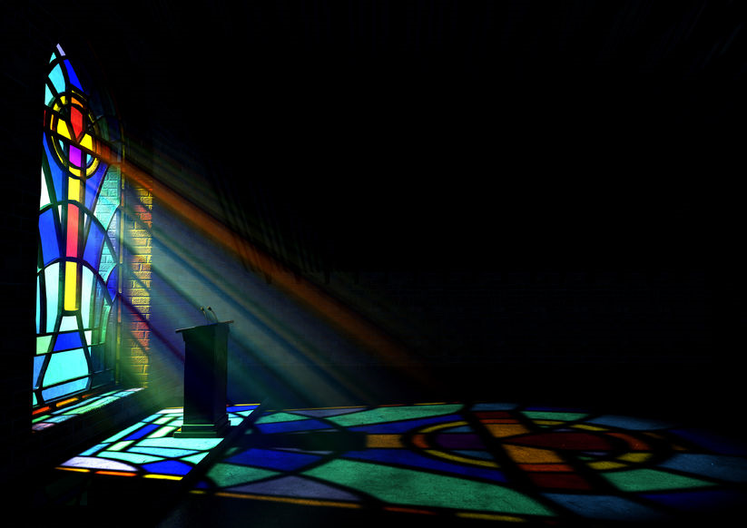
WORSHIP
All the nations you’ve made will come and bow down before you, Lord; they will glorify your name because you are awesome and a wonder worker. You are God. Just you.—Psalm 86:9-10 (CEB)
But the time is coming—and is here!—when true worshippers will worship in spirit and truth. The Father looks for those who worship him this way.—John 4:23 (CEB)
Notes:
Dwell in these Scriptures – what do they say to you?

Slide 6
PRAYER
God of creation, God of life, open our eyes, our ears, our minds that we might discern and understand where you would have us serve in your kingdom. Open our eyes, our ears, our minds that we might learn from one another as we study and discuss our role as worship leaders in your church. We pray this in Jesus’ name. Amen.
Notes:
Let’s pray together:
God of creation, God of life, open our eyes, our ears, our minds that we might discern and understand where you would have us serve in your kingdom. Open our eyes, our ears, our minds that we might learn from one another as we study and discuss our role as worship leaders in your church. We pray this in Jesus’ name. Amen.

Slide 7
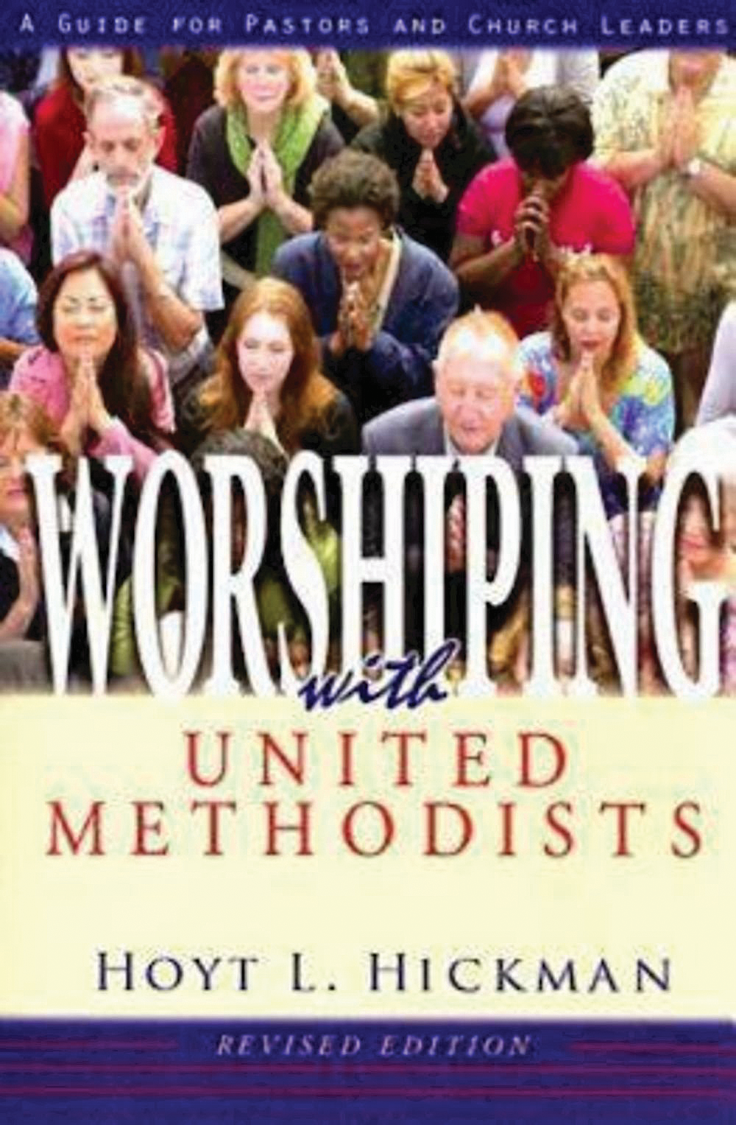
INSIGHTS AND QUESTIONS
Share at least one new learning and one question that you have developed from chapters 1 and 2.
Notes:
Share at least one new learning and one question that you have developed from chapters 1 and 2.

Slide 8

BREAK
Notes:
10-minute break

Slide 9
FIVE BASIC PRINCIPLES OF CHRISTIAN WORSHIP
God’s Word is primary
Active congregational participation is crucial
Spontaneity and order are both important
Worship should be relevant and inclusive
Worship is communion
Notes:
Review the “Five Basic Principles of Christian Worship” from Worshiping with United Methodists, 17-18.

Slide 10
THE BASIC PATTERN OF WORSHIP
Entrance
Proclamation and Response
Thanksgiving and Communion
Sending Forth
Notes:
Review the four elements of The Basic Pattern of Worship (Worshiping with United Methodists, pp. 21-23)
Walk through highlights of the history of Christian worship leading to our present ritual and its use of the basic pattern (Worshiping with United Methodists, pp. 23-65).

Slide 11
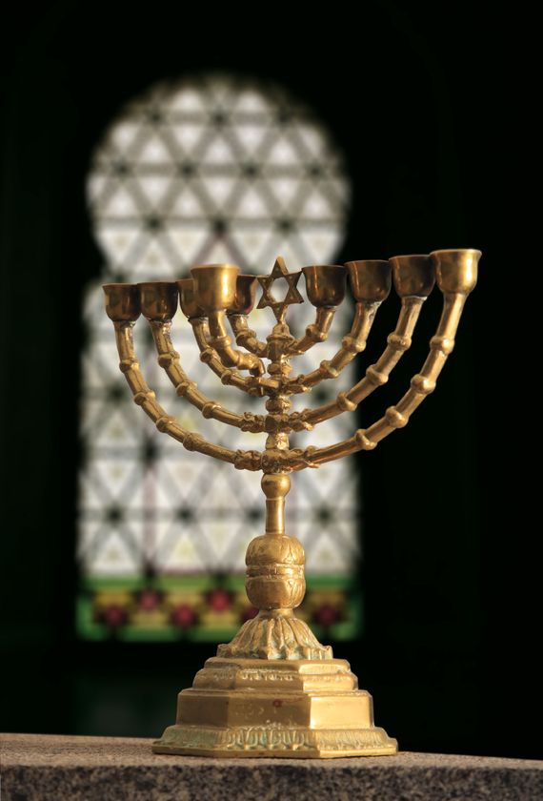
BEGINNINGS OF CHRISTIAN WORSHIP
Service of the Word
Service of the Table
Notes:
Christian worship begins within the Jewish forms of synagogue and temple. Synagogue worship became the template for the “service of the Word” and temple worship became the model for the “service of the Table.” Until decisions made by some town councils in Switzerland in the 16th century, Christians had always kept these two together—Word and Table—for their weekly gatherings on the Lord’s Day.

Slide 12
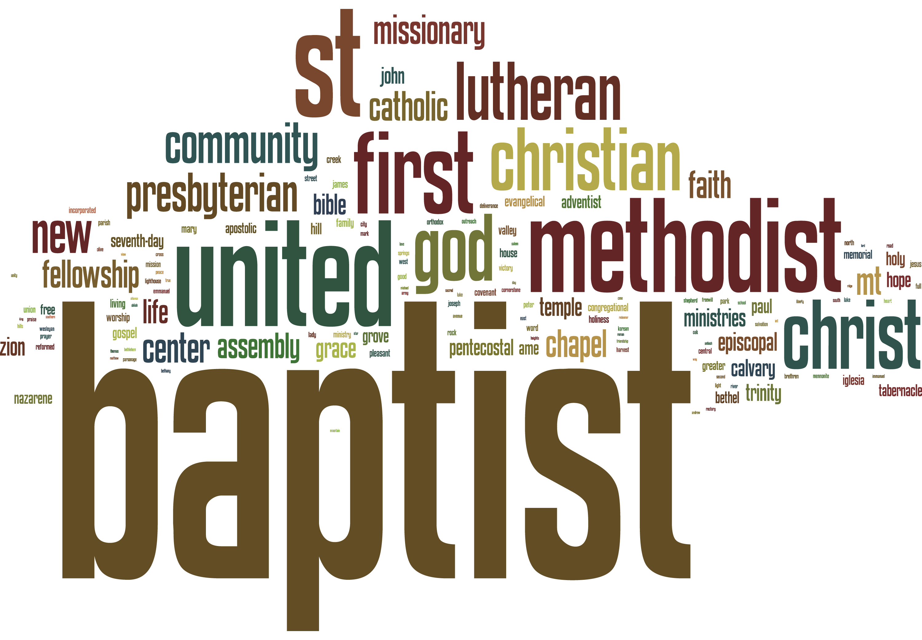
Take
Bless
Break
Give
Notes:
• The first three centuries of Christian worship are marked by great similarity in the basic actions of worship (basic pattern) and great diversity in the actual “texts” used in worship from place to place. While prayers at Holy Communion were often improvised, the actions at Holy Communion were nearly universal: Take (prepare the table), Bless (give thanks for what God has done for us in salvation history and in Christ, and ask for the Holy Spirit to make the bread and cup the body and blood of Christ for us), Break, and Give.
• When Christianity became the official religion of the Roman Empire by the late fourth century, (375 A.D.), greater attention was paid to creating and using standardized texts for Christian worship so that the content of Christian worship would be roughly the same everywhere, regardless of the training or skill of the presiders. Just as the Empire itself was already split East and West, distinctive Eastern (Orthodox) and Western (Roman/West Mediterranean) textual traditions began to emerge and diverge from each other. Both still hold the Basic Pattern to this day.
• The Eastern tradition has changed relatively little in texts or emphases in the intervening years. The Western tradition underwent two changes in direction. First, by the 11th century, worship had become more penitential in focus. This is seen both in the greater emphasis given to penitential texts and the importance of the confessional, and in the art in Western churches, most notably the introduction and spread of crucifixes portraying a dead and bleeding Jesus as a prominent image in many congregations. Second, worship became increasingly less participatory. The bulk of the service was still offered in Latin, a language fewer and fewer of the laity were taught or understood. Laity also rarely received Communion, owing in part to the penitential emphasis that left the clear impression they may be unworthy to receive. When they did receive, it was generally only the bread. This meant that, for the most part, laity were at best passive observers of ritual performed by clergy and monastics on their behalf.
• Reformations beginning in the 16th century in the West brought the liturgy and the Bible into local languages and dramatically increased participation in Communion (both bread and cup) and worship generally (congregational hymns in Lutheranism, congregationally sung Psalter in Reformed traditions). Roman Catholic responses at the time (Council of Trent, mid-16th century) reinforced most existing patterns. Lutheran worship piety began to shift away from solely penitential toward Christ as Conqueror of Sin and Death.

Slide 13
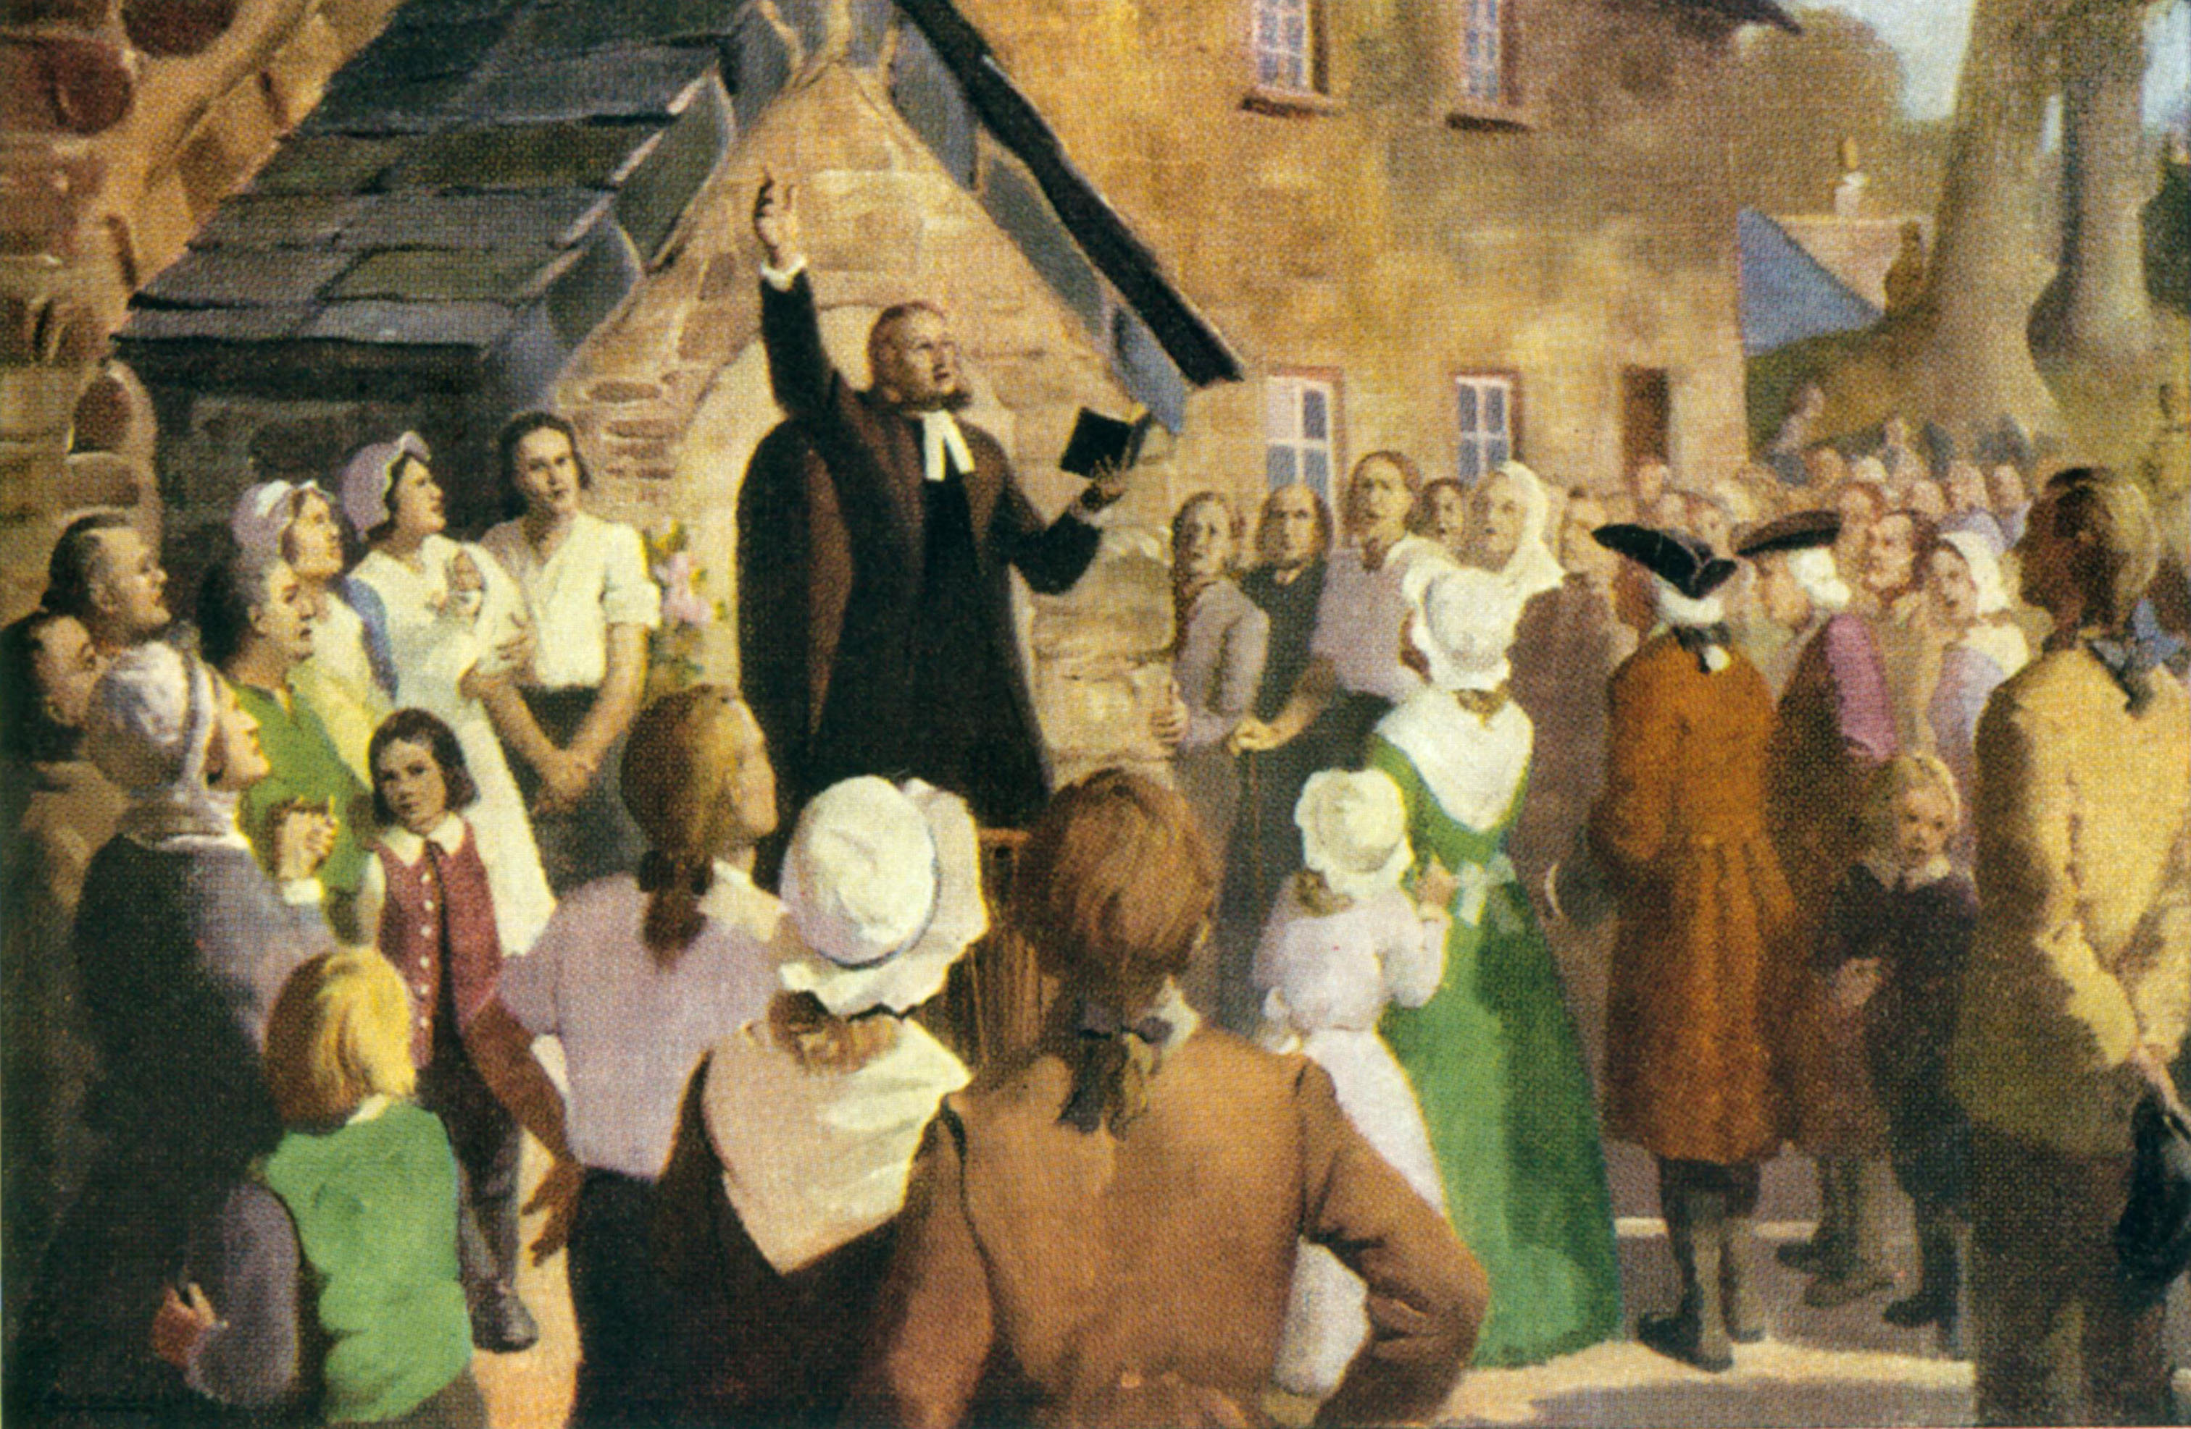
Notes:
• Wesleyan Methodism brings rich hymnody to daily lives of Methodists, though not to official Church of England worship at the time. (Hymn singing would not be allowed in the Church of England until the 19th century). Early Methodists in America began with both society-style worship on Sunday evening (vigorous singing, exhortatory preaching, and ex tempore prayer) and Anglican-style worship on Sunday morning (a service mildly revised from the 1662 Book of Common Prayer with the expectation of weekly Communion). By 1792, a shortage of clergy to serve the growing number of Methodist Societies/congregations (average of 1 elder appointed to 12 charges) led to significant alteration in Sunday morning ritual to resemble more closely the Sunday night society-style, lay-led service, while leaving the sacramental texts for Communion and baptism essentially intact.
• Through 19th and early 20th century, the growth of Methodism in the US led to changes in official worship resources to make worship more “acceptable” to “higher class” tastes. The “basic pattern” became obscured by a whole host of “additions” to turn worship more into an “inspirational program” modeled on the pattern of Anglican Morning Prayer or the revival meetings (“entertainment evangelism”). The amount of scripture being read was dramatically reduced, and the way worship was arranged and planned meant that the scriptures read and the sermons preached may have little to do with each other. Sacramental practice was viewed as an “add-on” that lengthened “the preaching service” rather than integrated as a normal part of worship.

Slide 14
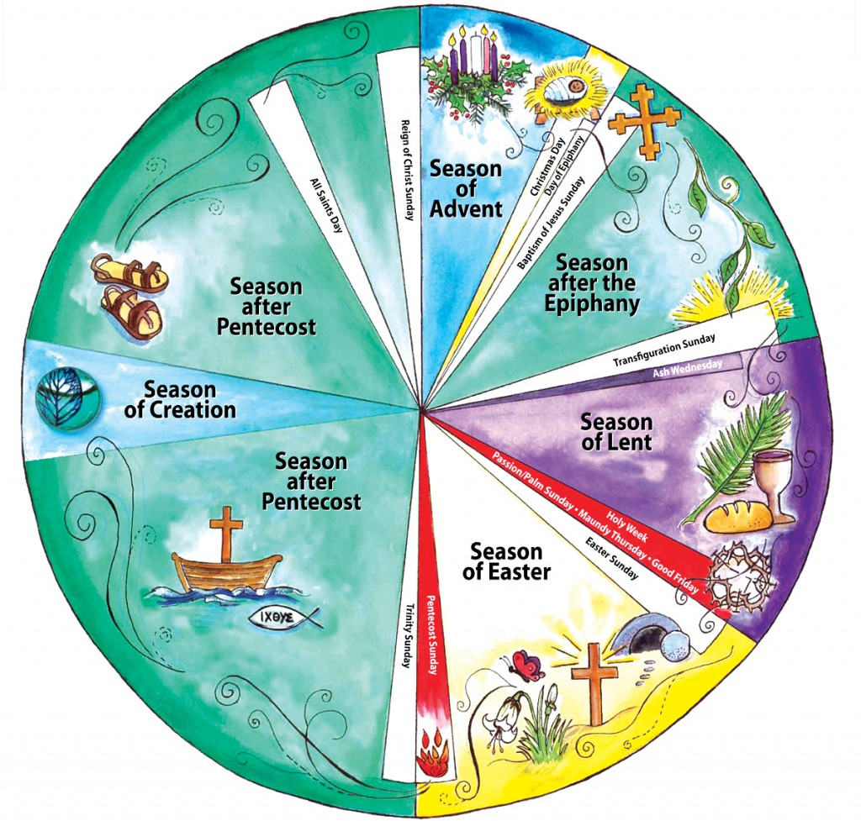
The Christian Year
Notes:
• Dramatic reforms in Roman Catholic worship in Vatican II (early 1960s), fueled by significant discoveries and scholarship of early Christian worship texts and patterns, led to similar reforms across most Protestant denominations worldwide. The basic pattern as embodied in third- and fourth-century texts became the norm for designing official worship texts, and Word and Table became the required norm for Sunday morning worship among Anglicans and Lutherans. Around the same time, it also became the recommended norm among most other Protestants in the US, including United Methodists, Presbyterians, and United Church of Christ. The reading of Scripture became a much more significant part of worship, especially with the introduction and adoption of the ecumenical Christian Year and the Revised Common Lectionary (1992) that supported it. United Methodists became the first US denomination to adopt the Revised Common Lectionary as its primary recommended resource for worship when it adopted The United Methodist Book of Worship at General Conference in 1992. This marked the culmination of a 24-year period of developing a new hymnal and new ritual for The United Methodist Church.
The Christian Year was developed over centuries to help congregations understand and rehearse the good news of salvation in Jesus Christ and become and grow as his disciples.

Slide 15

ADVENT
CHRISTMAS SEASON
Notes:
Advent- Ultimate Salvation-- The second coming of Christ and the culmination of all things in new creation (Colors : blue or purple, Nov/Dec 24 [day])
Christmas Season— The Savior Born-- God becomes flesh and dwells among us (Colors : White or Gold, Dec. 24 [night] – Jan 6)

Slide 16
AFTER EPIPHANY
BAPTISM OF THE LORD
TRANSFIGURATION SUNDAY
Notes:
After Epiphany—The Beginnings of Salvation-- The early ministry of Jesus (Color : Green, except for Baptism of the Lord and Transfiguration Sunday, White or Gold; Jan 7 until Ash Wednesday)

Slide 17
LENT
HOLY WEEK
Notes:
Lent – The Shape of Discipleship to Jesus-- Preparation for baptism and renewal of commitments to follow Christ (Color : Purple, Ash Wednesday until Palm/Passion Sunday)
Holy Week: The Cost of Discipleship and Salvation-- Remembering the last days of Jesus and his crucifixion and burial (Colors : Red for Palm/Passion Sunday through Maundy Thursday;; no colors Good Friday and Holy Saturday day)

Slide 18
AFTER PENTECOST
EASTER
Notes:
Easter : Salvation Unleashed-- 50 Days of celebrating the resurrection and ascension of Jesus and the coming of the Holy Spirit (Colors: White or Gold, Easter Vigil [Holy Saturday night] until Pentecost [Red])
After Pentecost: Living as Disciples Announcing and Embodying Salvation-- The teaching and ministry of Jesus (Gospel), the meaning and practice of the Christian life (Epistle), and the stories of the prophets, kings and patriarchs (Old Testament) (Color: Green, except for Trinity Sunday and Christ the King Sunday [White] and All Saints Sunday [White or Red], late May/early June through much of November).

Slide 19
YEAR/SEASON | A | B | C | Lent and Easter (ABC)
GOSPEL | Matthew | Mark (John 6) | Luke | John
OLD TESTAMENT | Patriarchs and Moses | David | Elijah, Isaiah, and prophets of the exile | Prophets
EPISTLE | 1 & 2 Cor, Romans, Phil., I Thess. | 1 & 2 Cor, Romans, Ephesians, James, Heb. | 1 Cor, Gal., Col., Heb., Phm, I & 2 Tim 2 Thess | I Peter, Epistles of John, Revelation
Notes:
Briefly review the Revised Common Lectionary and how to use it to find readings for each Sunday of the Christian year. See The United Methodist Book of Worship, pp. 227-237 and the Discipleship Ministries’ website (http://www.umcworship.org). Note that for the Sundays after Pentecost, the readings are organized by date.
Here is a chart describing the organization of the Revised Common Lectionary across the three-year cycle that you may copy into a presentation and distribute to your class.

Slide 20

INSIGHTS
Notes:
Have participants work in pairs. Ask the members of each pair to tell each other one or two things they have learned or had reinforced for them during this session.
After about 7 minutes, invite the pairs to share one of these with the whole group, and record for all to see and briefly discuss, if time allows.
QUESTIONS FROM THE READINGS
Review the questions listed at the beginning of the session. Mark the questions that have already been answered during the course of this section. Answer any remaining questions you can. Then decide and indicate how all unanswered questions will be addressed during the coming week.
Choose people to lead opening worship for Session II.

Slide 21
Assignment
Body Work
Read: “Attentional Worship,” https://blog.umcdiscipleship.org/attentional-worship
Read: “Bearings in Worship Series,”
https://blog.umcdiscipleship.org/bearings-in-worship-series-map-2
Notes:
ASSIGNMENT FOR NEXT SESSION
1. Body Work: Reading Scripture aloud.
Starting today or tonight, participants should read one of the lectionary texts for the coming Sunday aloud as if they were reading it for worship. Remind class members of this basic rule of thumb for reading aloud in worship. Read half as quickly and twice as loudly as your normal conversational voice, being careful to enunciate clearly. Read the passage in this way aloud at least once before going to bed at night, and read the same passage the next morning. Choose a different passage for the second night, reading it again the following morning. Repeat this pattern daily until the next session.
2. Reading: “Attentional Worship”
http://umcworship.blogspot.com/2012/03/attentional-worship.html
“Bearings in Worship Series”
http://umcworship.blogspot.com/2012/05/bearings-in-worship-series-map.html
Remind participants to bring with them their lists of one to three significant insights and one to three questions they have from the reading or body-work for this week.

Slide 22
SENDING
Leader: Go now in the peace and strength of Christ.
People: Thanks be to God.
Notes:
SENDING:
Song: “Now, on Land and Sea Descending,” verse 1 (United Methodist Hymnal, 685)
Leader: Go now in the peace and strength of Christ.
People: Thanks be to God.

Slide 23
Session 2:
The Character of the Presider—Energy, Presence, and Flow
Notes:
During this session, you will get practice and supportive feedback on planning and leading the first two movements of the basic pattern of worship.
INSIGHTS AND QUESTIONS
Invite participants to share one to three new learnings and one to three questions they have from their readings, depending on class size.

Slide 24
WORSHIP
Notes:
For this and succeeding sessions, choose persons from your class to serve as greeter, liturgist, reader, music leader (someone who can sing), and prayer leader. The greeter will be responsible for placing the baptismal bowl near the entrance and greeting people as they enter, with the words, “Remember you are baptized, and be thankful.” The liturgist will begin worship and offer the blessing. The reader will read the Scripture. The prayer leader will lead the prayers.

Slide 25
INSIGHTS AND QUESTIONS
Share at least one to three new learnings and one to three questions you have from your readings.
Notes:
Invite participants to share one to three new learnings and one to three questions they have from their readings, depending on class size.

Slide 26

What Affects Perception of Worship
ENERGY
PRESENCE
FLOW
Notes:
Distribute copies “Observations and Feedback for Worship Leaders” and “What Affects Perception of Worship” handouts in the addendum. Note that this workshop is partly based on “What Affects Perception” and will be used in sessions 3 and 4 to help class members record their observations about how others lead worship.
Walk through and explain “What Affects Perception.” You may use or adapt this script:
In addition to whatever thoughts or feelings may be rushing through people’s minds as they enter your church campus and ultimately your worship space, there are seven major factors that will affect how they perceive what is happening in worship.
Several of these (noted in brackets) are almost automatic and generally unconscious. These include how the space is arranged, how the space and the people “feel” (warm, inviting, somber, joyful, etc.), the kind of energy happening, and, at least in part, the kind of presence worship leaders embody.
Worshipers may be more consciously aware of some elements of the presence worship leaders embody, the ways they actually lead worship and the flow of worship, especially when worship does not flow well. All five of our sessions and the readings and body work assigned between sessions are designed to help you improve your skills in leading worship. Your primary role as a worship leader is to use your gifts and role as a worship leader to help the people you are leading worship and respond to God the best ways they can. Your role as a leader is to help them worship and respond to God.
This session focuses on three of the seven elements that affect the perception of worship: the different kinds of energy involved in the four movements of worship, your presence as a leader, and how well you help facilitate the flow of worship.

Slide 27


ENERGY
Embody · Model · Show · Tell
Notes:
Turn to the “Observations and Feedback” handout. Under “Energy,” you will see an outline the details the kinds of energy needed for a congregation to connect well with the purposes of each of the four major movements of worship.
Now, look under “Leadership.” One key to effective worship leadership is for you, as a worship leader, to embody and model the kind of energy needed for each movement and moment in worship. This is an important point. Leading the people in worship is more about showing what needs to be done with the kind of energy needed to do it than telling people what to do, though each has its place. Showing is primary. If what you show supports what you tell, people are more likely to hear and follow what you tell with more commitment.
Following the handout, let’s walk through and practice embodying the different kinds of energy needed for each different movement in worship.
Say, “I want to invite some of you to show us and let the rest of us guess before you tell us what your energy is like and where your focus is when you first enter the sanctuary as a worshiper on a typical Sunday.” Give time for several responses and guesses by the class. Thank each person by name for sharing. After three to five of these, affirm how they illustrate the point that we need something fairly dramatic to move a group of people with all these different levels of energy, thoughts, and feelings to offer themselves to God in worship individually, let alone as a whole congregation.

Slide 28
SYNCHRONIZATION
Notes:
What we need to begin worship has to synchronize all of this scattered energy and focus and redirect the energy and focus of all toward the praise of God.
Regardless of style, worship leaders need to embody and so lead worshipers with a kind of energy that helps break distraction and unifies worshipers in body, voice, and spirit in the praise of God.
In traditional worship, this may be a brief, powerful call to worship, followed or preceded by a processional hymn. The procession of a choir or even just clergy creates a feeling of forward movement and focus in the entire congregation while they sing words and music that synchronize their thoughts, bodies, and voices. The energy of worship leaders here must be bold, strong, and confident, whether they are leading singing, or a brief call to worship, or simply processing down the aisle.
In contemporary worship, synchronization at the Entrance happens through what some contemporary worship artists refer to as “the band blast,” a loud, strongly rhythmic opening song by soloist or praise team that invites the whole congregation to get up and move, hands clapping, feet keeping rhythm or dancing in place.
As we have experienced in our opening services for these classes, a period of intentional silence can have an equally powerful synchronizing effect. Synchronizing with silence is often found in more contemplative forms of worship typical of neo-monasticism, some “emergent” worship settings, Taizé, and, in our case, the praying of the Daily Office (morning or evening prayer). Silence as bodily action can slow the pace of thoughts and synchronize individuals and groups around heartbeat and breathing.
Imagine yourself as a worship leader for the entrance to either traditional or contemporary worship. (Take a moment to allow people to imagine this). Now stand up and show us your posture and what you would be doing with your body as you would lead this action. We won’t ask you to sing! (Notice a few people and ask them by name to share what they’re doing and the energy in their bodies as they do it.)

Slide 29
WORD/RESPONSE:
ACTIVE AND ATTENTIVE LISTENING
How would you describe the energy you need to listen to Scripture as it is read?
What kind of energy derived from music or singing helps you increase the focus of your attention?
What sort of energy exhibited by the preacher helps you pay attention during the sermon or refocus your attention when your mind wanders?
Notes:
There is a significant shift in energy from the Entrance to the second movement, Word and Response. Having offered praise to God together, we now turn toward actively listening for God’s Word to us, individually and as a congregation, in Scripture, song, and preaching.
Ask class members for their responses to these questions.
1) How would you describe the energy you need to listen well to Scripture as it is being read?
2) What kind of energy in music or singing helps you increase the focus of your attention?
3) What sort of energy from a preacher during the sermon helps you pay attention or come back to attention if your mind has wandered?
Allow time for people to write and share responses. See if you can develop a summary response from their collective responses. Then ask, "If you need worshipers to maintain active listening, what kind of energy might you need to be ready to offer as a worship leader to help the worshipers you lead maintain active, attentive listening?
Ask for three volunteers to read aloud one of the Scriptures they practiced in their body work this week, keeping in mind the responses the class has just shared. After each, invite the class to share their impressions about how well the way it was read helped them sustain active, attentive listening.

Slide 30
The Table
PARDON
PEACE
OFFERING
GREAT THANKSGIVING
DISTRIBUTION
AFTER RECEIVING
Notes:
While clergy will typically lead the confession, pardon, peace, announcement of the offering, and the Great Thanksgiving, as lay servants or lay speakers, you may be asked to bring the gifts of bread and cup to the table, or prepare the table, or serve Communion, or serve at a station for prayer or healing after people have received. In each of these cases, you are functioning as a worship leader, and the energy you model matters.
If you bring gifts to the table, do so with an energy of confident joy, roughly matching in speed and intensity the energy of ushers who may bring the monetary offerings forward.
If you are assisting with setting the table, make sure you have practiced this beforehand with the presiding pastor, so you know how she or he prefers the table set and so you can set it efficiently with confidence and grace.
If you are serving the bread, look the person in the eye, break off a piece of the bread, raise or lower it to the recipient's eye level, then place it in the hands as you smile and say with solemn joy, "Name, the body of Christ given for you." If you serve the cup, make eye contact, tilt the cup slightly toward the person receiving so there is no need to dip fingers into the cup, smile, and say, "The blood of Christ given for you." In either case, let the energy in your body language and your words exude a confident, joyous declaration.
(If you have time, you may want to demonstrate this yourself, as class leader, and invite two or three volunteers to try this as well.)

Slide 31
SENDING
Propulsion into the World
Notes:
Immediately prior to the last acts of worship, the energy of the worship leaders shifts again for the sending. The purpose of this part of the service is to send the congregation, having praised God, heard God's word, responded to the word, and been fed at Christ's table, boldly and powerfully into the world as the "body of Christ, redeemed by his blood" in the strength of the Holy Spirit. The energy here is similar to the energy of the entrance, only kicked up a step. Joy, faith, hope, and love should be palpable in the words you say, the gestures you offer, and the way you hold and move your body as a worship leader. While clergy are more likely to offer the benediction (the blessing of the people in the name of the Triune God), you may be asked to offer the words of sending. Proclaim them with joy, boldness, and strength. If you are asked to write or improvise them yourself, be brief. Brevity conveys confidence better than many words. Think along the lines of "Go in peace to love God and serve every neighbor, near and far" or "Go into the world, rejoicing in the strength of the Holy Spirit" or "Let us go forth in the name of Christ."
Invite the class to stand. Model how you might say such a brief sending for the class; do it together in unison; and then invite two or three volunteers to try it out.

Slide 32
BREAK
Notes:
10-minute break

Slide 33
PRESENCE
Notes:
How do you feel in your body and come across when you lead in worship? How present are you to God? To those you are leading? To yourself?
The nature of your presence as a worship leader in each moment of worship and as worship moves from moment to moment will have a lot to do with how well the people you lead are able to worship.
Look at the “Observations and Feedback” handout under “Presence.”
In his book, Strong, Loving and Wise: Presiding in Worship, Robert Hovda has identified four key things to work on in body, mind, and spirit to improve the ways your presence as a worship leader can help others worship well.

Slide 34
PRAYERFULNESS
“heavy on awe and mystery, light on answers and recipes”
—Robert Hovda
Notes:
In a very real way, all of worship is either prayer or preparation for prayer. Most of our singing is prayer. The reading of Scripture and even the sermon are forms of communication between God and the worshipers, and so are prayer in function, if not always in form. The Great Thanksgiving is prayer. And the benediction and sending are prayers of encouragement and strength.
Since all of worship either is prayer or an invitation to prayer, it is important that you as a worship leader be prayerful in how you lead. Regardless of context or the type of service you are leading, you must first be a person of prayer yourself to lead worship with prayerfulness.
Prayerful leadership, as Hovda describes it, is “heavy on awe and mystery, light on answers and recipes.” Your role as a worship leader at every point in worship is to be focused on the awe and wonder of God yourself as you seek to help the worshipers reach and sustain their attentiveness to God. The more you are in “the prayer zone” and the less you are in the “advice zone,” both in your words and especially in your actions, the more you will be able to sustain your own focus on God and help them sustain theirs as well.
Exactly how your prayerful presence can best sustain attention will vary from context to context and may vary widely by worship style or genre.
Take out your copy of “Attentional Worship,” one of the readings for this session. You may remember it gives examples of prayerful worship leadership in three very different kinds of worship settings, each with its own distinct kind of prayer language. (If you have projection and a wireless connection available, you may wish to display this on a screen.)
I invite you to take three minutes around your tables to try to pick just one of the three positive examples in the article, describe the prayer language and the kind of prayerful presence you observe, and how that fits with the context of the people and the kind of service being described.
(After the three minutes, give each group one to two minutes to share their observations and answers, depending on time.)

Slide 35

COMFORT IN YOUR OWN SKIN
CONFIDENCE
CARE WITH WORDS
Notes:
Hovda means this quite literally: How does your physical presence as a leader communicate your physical comfort level? Are you gracious and unrushed in your body language in each moment and able to help the congregation flow seamlessly into the actions and emotions of the next? Or are your hands fidgety, your movements abrupt, and your eyes constantly consulting the bulletin to find out what you are supposed to do next? If your movements are gracious and unrushed, people will sense your comfort as a leader and become more comfortable both with your leadership and with offering worship themselves. If your body language conveys nervousness, uncertainty, or discomfort, or if it seems you are faking the emotion of the moment, worshipers may be more likely to feel the same things in their own bodies, trust your leadership less, and give themselves to God less as they worship.
Few people are ever fully aware of what their body is doing as they lead or wait to lead an act of worship. All of us can benefit from others watching us lead and offering their feedback about where we seem comfortable or uncomfortable in our own skin. That is why this appears on the evaluation form we will use in the next two sessions. After you take this course, it may be helpful for you to gather with a small group of people you trust from time to time to view video recordings of your worship leadership and get their feedback about this element of your presence in particular.
Confidence
Confidence is partly about how comfortable you appear in your skin. It is also in how you hold your body, how you make eye contact, and how you use your voice when you lead in worship. These may vary widely in different cultural contexts. It is always important to know, or learn quickly, what kinds of body posture and eye contact convey too much shyness — on the one hand—or aggression on the other. Likewise, in some cultures, a louder voice and a quicker pace of speech convey arrogance, hostility, or an attempt to deceive, while a quieter, more gentle and deliberate pattern of speaking conveys reliable wisdom. Know the cultural context in which you are leading, and adjust your posture, type of eye contact, and the volume and pace of your voice to match what that culture is more likely to interpret as confidence.
Care with words (“when we do use words, an effort to make them really count”)
Turn again to “Attentional Worship.” Look at the opening example. What do you notice about the way the worship leader uses words? And what sense do you get about the presence of this worship leader? (Allow time for a few responses from the whole class.)
Care with words means three things: First, it means use words in a caring way, showing care for God and trust and respect for the congregation. Second, it means to remember and trust that worship is what we do, and indeed something the worshipers probably know how to do well enough, that fewer words rather than more words may be needed. Third, the worship leader must understand that worship is about our attention to God and the words we use in worship should be chosen carefully, focusing attention on God and not the worship leader.
Ask the class to look at the “Attentional Worship” handout. Invite participants to notice the ways the worship leader uses words in the opening example. What sense do participants get about the presence of the worship leader? Allow time for responses from the class.

Slide 36
FLOW
Notes:
Flow, how worship moves seamlessly from Entrance through Sending, is all about transitions. Effective worship leaders guide worshipers to make smooth transitions in actions and energy as they manage their own presence.
Turn again to the “Observations and Feedback” handout. You will see two major categories listed under flow: “Minor Transitions” and “Bearings.”
Minor transitions are transitions between one action and the next within a given movement of worship (Entrance, Word/Response, Thanksgiving/Communion, or Sending). These involve changes in actions of worship, and they may involve changes in the intensity of energy, but they rarely involve changes in the kind of energy required of leaders and worshipers. For example, the transition from a call to worship to an opening hymn is a change in the action, from speaking to singing, and may signal a slight increase in the intensity of the energy by adding volume, speed, or movement, but the kind of energy involved—active bodily involvement, will not have changed.
At the heart of effective minor transitions, which are usually primarily changes in action, is making sure the next action can take place as soon after the previous action as possible. Unless you are intending to leave pauses for silence or contemplation, as between readings of Scripture, the next action should start immediately, leaving little or no “dead space.” If you are asked to lead in worship by reading Scripture, for example, start moving toward the lectern during the final verse of the preceding hymn. That way, you will be ready to announce the text and start reading as soon as the hymn is over and the people are seated or remain standing.
Bearings are the transitions between the major movements of worship and, therefore, often involve changes in actions, intensity of energy and kind of energy, as we have described earlier. Because the kind of energy also changes, bearings require particular attention by worship leaders. This is very much like shifting gears in a manual transmission automobile. Effective worship leaders shift the energy smoothly, starting inside themselves, so worshipers may do the same without the shift points distracting from the worship of God.
The “Bearings in Worship Series” from this week’s readings details how worship design and worship leaders in typical “high church,” traditional, and contemporary styles may manage the bearings between the major movements of worship effectively.
At your tables, choose one of transitions between movements in worship and share examples of how you have seen worship leaders model effective bearings.
Allow 3-5 minutes for table sharing. Then allow 1-2 minutes for each table to report what was shared.

Slide 37
INSIGHTS
Notes:
INSIGHTS FROM THIS SESSION
Have participants work in pairs. Ask the members of each pair to tell each other one or two things they have learned or had reinforced for them during this session.
After about five minutes, invite the pairs to share one of these with the whole group, and record for all to see and briefly discuss, if time allows.
QUESTIONS FROM THE READINGS
Review the questions listed at the beginning of the session. Mark the questions that have already been answered during the course of this section. Answer any remaining questions you can. Then decide and indicate how all unanswered questions will be addressed during the coming week.

Slide 38
Assignment
Body Work
Read: Worshiping with United Methodists, chapters 5-6
Review: “Attentional Worship,” http://umcworship.blogspot.com/2012/03/attentional-worship.html
Review: “Bearings in Worship Series,” https://blog.umcdiscipleship.org/bearings-in-worship-series-map-2/
Notes:
ASSIGNMENT FOR NEXT SESSION
Body Work— Embodying the energy of the first two of the four movements of the basic pattern and the transition between them. The daily exercise for this week and the next involves getting in touch twice daily with the kind of energy involved in each of the four movements of the basic pattern of worship and the transitions in energy between them. The four movements are listed and briefly described on page 2 of The United Methodist Hymnal. They are more fully described on pp. 16-32 of The United Methodist Book of Worship.
Starting after this session, participants should review the readings and discussion from this session and The United Methodist Hymnal about the energy of the first two movements, Entrance and Word/Response. With this background in mind, participants should practice each night and morning some way of embodying the energy of each movement and the transitions between them to generate a smooth flow.
Leaders, prepare to show how you would do this as an example. Show how you might you position or move your body to represent the full-body energy of the Entrance? Then how you would embody the “active, attentive listening” energy of Word/Response. Then show how you would physically move between them to create a smooth flow. Invite two or three volunteers to try this themselves in their own way. Remind the class that each person is free and encouraged to embody each of the elements and the transitions between them in her or his own way.
Read Worshiping with United Methodists, Chapters 5-6.
Review “Attentional Worship:” http://umcworship.blogspot.com/2012/03/attentional-worship.html and “Bearings in Worship:” http://umcworship.blogspot.com/2012/05/bearings-in-worship-series-map.html and the “Bearings in Worship” series on The United Methodist Worship Blog. For the blog entries, be sure to let class members know they are encouraged to leave comments and questions on the blog as well.
Finally, remind participants to bring with them to the next session their lists of one to three significant insights and one to three questions they have from the reading or body-work for this week, or post them on the social media site you have created for the class at some point during the week.

Slide 39
SENDING
Leader: Go now in the peace and strength of Christ.
People: Thanks be to God.
Notes:
SENDING:
Song: “Now, on Land and Sea Descending,” verse 2 (United Methodist Hymnal, 685)
Leader: Go now in the peace and strength of Christ.
People: Thanks be to God.

Slide 40
Session 3:
Planning and Leading Entrance and Proclamation/
Response
Notes:
The goal of this session is to practice and receive supportive feedback on planning and leading the first two movements of the basic pattern of worship.
Invite participants to share one to three new learnings and one to three questions they have from their readings, depending on class size.

Slide 41
WORSHIP WORKSHOP
Notes:
During this session and the next, you will work in teams to develop a rough draft for a worship service, built on the basic pattern and using the readings (at least the gospel) from one of the four Sundays of Advent, Year C, at your team’s choosing. You will develop, lead, and get feedback on the first two movements of the service, Entrance and Word/Response. You are not expected to prepare a sermon!
In your reading for this week, Hoyt Hickman noted that each of these two sections can be of highly variable length in an actual service, depending on your local context and the nature of the particular day or service. For this class session, your teams should plan to lead the class through these two movements in no more than 5-10 minutes. (The length of the services depends on the number of teams. If you have two teams, each may have time for up to 10 minutes. If you have four teams, you will have time for up to 5 minutes for each team.) This will give teams time to present and for participants to offer constructive feedback.
TEAM PLANNING
Divide the group into their worship teams. Team size should be no greater than 5-7, depending on the size of the class.
Share copies of the” Basic Pattern of Worship” and “Readings for Advent, Year C” handouts found in the addendum.
Remind group members to pay particular attention to the items on the evaluation sheet and to draw on the identified gifts and roles of each team member as they flesh out, prepare, and rehearse. What they should produce is a fairly complete “worship bulletin” for these first two movements to distribute to all class participants, plus an actual “mini-service” (which may not contain all of these elements) they will lead.
Teams are not expected to offer a sermon (a title and a one-sentence description on the “bulletin” will be enough). Depending on the time available, teams may not be able to lead the group in a “complete” version of their plan. At a minimum, they should lead the class in an entrance, at least one verse of a song of praise appropriate to their theme and Scriptures, the “bearings” from Entrance to Proclamation/Response, at least one reading of Scripture, and one act of response to the Word (confession of faith, invitation to discipleship, the prayers).

Slide 42
BREAK

Slide 43
WORSHIP
Notes:
Each team will lead the group in worship, using the plans the teams have developed. Each team should begin its presentation by identifying its members, the theme for the series or season in which this service would occur, the theme for this service, and something about the local context where this service would be used. Other class members may note these on their evaluation forms.
After each team has led in worship, allow two minutes for class members to complete their evaluation forms. Then ask for volunteers to share their comments about energy, presence, leadership, and flow. Plan to allow about half as much time for this feedback as the length of the service itself.
If you have a large number of teams, consider running two or more services and evaluation sessions concurrently in different places, with other teams observing and providing feedback.
Allow a brief break between services or service sessions to allow for the next team to do any final setup it needs before beginning its service.

Slide 44
BREAK

Slide 45
INSIGHTS
Notes:
INSIGHTS FROM THIS SESSION
Have participants work in pairs with people from a different worship team. Ask the members of each pair to tell each other one or two things they have learned or had reinforced for them about leading worship during this session. After about five minutes, invite the pairs to share one of these with the whole group; record for all to see and briefly discuss, if time allows.
QUESTIONS FROM THE READINGS
Review the questions listed at the beginning of the session. Mark the questions that have already been answered during the course of this section. Answer any remaining questions you can.

Slide 46
Assignment
Body Work
Read: Worshiping with United Methodists, chapters 7-8
Review: “Attentional Worship,”
https://blog.umcdiscipleship.org/attentional-worship
Review: “Bearings in Worship Series,” https://blog.umcdiscipleship.org/bearings-in-worship-series-map-2/
Notes:
Body Work— Focus this week on embodying the third and fourth movements of the basic pattern.
Encourage group members to give particular attention to the bearings between proclamation/response and table, table and sending, and sending into dispersion in the world.
Remind the class that the energy at the end of proclamation/response moves from congregational prayer toward a multisensory act of congregational praise, the celebration of Holy Communion, which may include the kinetic acts of standing, kneeling, praying, singing, moving, receiving, eating, and reflecting. The sending often marks a decisive shift in energy from the personal reflection after receiving to corporate “expulsive” energy.
Be sure you let your class know that each person is free and encouraged to embody each of the elements and the transitions between them in her or his own way. Then invite participants to do a quick
“run-through” of this together, do it again at their homes near bedtime and then again the following morning as part of their daily morning prayer time. As with the previous body work exercises, class members should plan to repeat this every night and every morning until the next session.
Read: Worshiping with United Methodists, Chapters 7-8
Review: “Attentional Worship:” http://umcworship.blogspot.com/2012/03/attentional-worship.html
Review: “Bearings in Worship Series:” http://umcworship.blogspot.com/2012/05/bearings-in-worship-series-map.html
Remind participants to bring with them their lists of significant insights and questions they have from the reading or body-work for this week, or to share them in advance on your class’s social media site.

Slide 47
SENDING
Leader: Go now in the peace and strength of Christ.
People: Thanks be to God.
Notes:
SENDING:
Song: “Now, on Land and Sea Descending,” verse 3 (United Methodist Hymnal, 685)
Leader: Go now in the peace and strength of Christ.
People: Thanks be to God.

Slide 48
Session 4:
Planning and Leading Thanksgiving/
Communion and Sending
Notes:
The goal of this session is to practice and receive supportive feedback on planning and leading the third and fourth movements of the basic pattern of worship.
Invite participants to share one to three new learnings and one to three questions they have from their readings.

Slide 49
The Great Thanksgiving
TAKE
BLESS
BREAK
GIVE
Notes:
At his final meal with his disciples. Jesus took the bread, blessed it, broke it, and gave it to his disciples (Mark 14:22). From the earliest times, Christians have patterned the Great Thanksgiving into the same four basic actions: take, bless, break, and give.
Taking the bread and cup refers to preparing the Lord’s table. Our English Anglican and Methodist forebears used the term “offering” to refer primarily to bringing the gifts of bread and wine to the Lord’s table rather than to the collection of money. They called that “collecting the alms.” When the gifts arrive at the Lord’s table, a deacon, the pastor or a lay servant designated for this task may “take” them and finish preparing them for the prayer of great thanksgiving that follows. If the gifts are already on the table before the service begins, a deacon, pastor, lay servant or Communion stewards may uncover them at this time. Then the pastor and those who will serve wash their hands.
Blessing is the primary action of the Great Thanksgiving. Led by the pastor, the congregation blesses our Triune God for the many ways God has saved us, especially in Jesus Christ. Christians from the earliest times have called this act of blessing by pastor and congregation a “sacrifice of praise and thanksgiving.” That is why we pray, “And so, in remembrance of these your mighty acts in Jesus Christ, we offer ourselves in praise and thanksgiving, a holy and living sacrifice in union with Christ’s offering for us” (See UMH, p. 10).
The Great Thanksgiving has a Trinitarian shape. The prayer begins with praising the Father (first person of the Trinity). After singing or praying “Holy, Holy, Holy” (often called the “Sanctus,” the Latin word for “holy”), we continue by giving thanks to the Father for Jesus, the Son. We remember all Jesus did for us and his words and actions at his final meal with his disciples. Then we ask for the Holy Spirit to be poured out on us and on the gifts of bread and cup. The conclusion of the prayer is a doxology that recapitulates the Trinitarian shape of the whole: “Through your Son Jesus Christ, with the Holy Spirit in your Holy Church, all honor and glory is yours, Almighty Father (God), now and for ever.” The “Amen” that we sing or say together after this doxology is often called “The Great Amen.” It is intended to be sung or said with great gusto as a joyous and affirmative conclusion to our Trinitarian praise.
During the blessing, lay servants who are at the Lord’s table should pray the parts given to the congregation to pray. At the pastor’s direction, they may also join the pastor in raising hands in the gesture of prayer.
Breaking the bread happens after the Great Amen and the Lord’s Prayer. Breaking the bread after the prayer follows the biblical pattern of thanksgiving sacrifices. In that biblical pattern, what is placed on the altar as a sacrifice is broken for sharing among those who offered it after the prayer of blessing is complete.
After the bread is broken, it is time to give the blessed elements to the people. Jesus gave the bread to his disciples after he had broken it. His disciples received the broken bread from him. They did not take it, nor did they break it for themselves. That is why the instructions at this point in the service in every Methodist ritual have always specified that the bread and cup are given or served rather than taken by the people.
The action of giving should move smoothly but never be rushed. A good rule of thumb is to provide one serving station for every 50 people present.
Lay servants may assist in serving at the pastor’s direction. If there are only as many stations as presiding clergy, the presiding clergy (pastors or deacons) normally serve the bread. Laypersons normally serve the cup. Lay servants may also be asked to assist in resetting the Lord’s table after all have been served.

Slide 50
WORSHIP WORKSHOP
Notes:
Move people into the teams they formed in the last session. Invite teams to use the basic pattern of worship and readings for Advent, Year C, the first two movements they developed last session, and insights from readings and class instruction to develop a plan for the third and fourth movements (Thanksgiving/Communion, Sending) of the basic pattern.
Remind teams to pay particular attention to the items on the evaluation sheet and to draw on the identified gifts and roles of each team member as they plan, prepare, and rehearse. What they should produce is a fairly complete “worship bulletin,” for that now includes all four movements to distribute to all class participants, plus an actual “mini-service” (which may not contain all of these elements) they will lead.
Teams should plan to lead the class through these two movements in no more than 5-10 minutes. The services they present should begin with the last action of Proclamation/Response the team had planned the previous week, and show the transition between this action and the Invitation to the Table, confession, pardon, peace and offering. For the Great Thanksgiving, teams should show what they would do in their roles as Lay Servants during the Great Thanksgiving in their chosen context, such as bringing the gifts, assisting with the preparation of the Lord’s table, serving, or helping to re-set the Lord’s table. They should give particular emphasis to the transition between persons receiving and the beginning of the Sending to ensure that energy and attention flow smoothly between these two very different kinds of actions. Groups may wish to consult “Bearings in Worship: Between Table and Sending” (http://umcworship.blogspot.com/2011/04/bearings-part-iii-e-between-table-and.html) as they develop their plans to lead the class through each movement and the transition between them.

Slide 51
BREAK

Slide 52
WORSHIP
Notes:
Each team will lead the group in worship, using the plans it has developed. Each team should begin its presentation by identifying its members, the theme for the series or season in which this service would occur, the theme for this service, and something about the local context where this service would be used. Other class members may note these on their evaluation forms.
After each team has led in worship, allow two minutes for class members to complete their evaluation forms. Then ask for volunteers to share their comments about energy, presence, leadership, and flow. Plan to allow about half as much time for this feedback as the length of the service itself.
If you have a large number of teams, consider running two or more services and evaluation sessions concurrently in different places, with other teams observing and providing feedback.
Allow a brief break between services or service sessions to allow for the next team to do any final setup it needs before beginning its service.

Slide 53
BREAK

Slide 54
INSIGHTS
Notes:
INSIGHTS FROM THIS SESSION
Have participants work in pairs, preferably with a person from a different worship planning team. Ask the members of each pair to tell each other one or two things they have learned or had reinforced for them during this session. After about five minutes, invite the pairs to share one of these with the whole group, record it in some way for all to see, and allow for brief discussion—as time allows.
QUESTIONS FROM THE READINGS
Review the questions listed at the beginning of the session. Mark the questions that have already been answered during the course of this section. Answer any remaining questions you can. Then decide and indicate how all unanswered questions will be addressed during the coming week.

Slide 55
Assignment
Body Work
Review: The United Methodist Book of Worship, pp. 20-22, 24-25, 445-447, and 568-580
Read: The United Methodist Hymnal, pp. 2, 876-879
Read: The United Methodist Book of Worship, pp. 568-580
Notes:
Body Work— Practices of Public Prayer
During the coming week, class members should practice praying aloud as if they were praying in public. Remind them that much like public reading of Scripture, public praying requires a different kind of “voicing” than personal prayer. Public prayer is not personal prayer offered in front of a larger group. Instead, public prayer involves leading the group or congregation in prayer. That is why public prayer often involves a different kind of vocabulary than personal prayer.
Point class members to the following resources in The United Methodist Book of Worship to guide their daily morning and evening practices of leading public prayer: pp. 20-22, 24-25, 445-447, and 568-580.
Remind the class as well that posture is part of embodying these prayers. Prayers of thanksgiving or intercession may be offered simply standing, or standing or seated in the ancient Christian “orans” position (Demonstrate this posture for the class: palms up, arms extended to the sides, elbows slightly bent). Indeed, “orans” is appropriate for all forms of prayer. Additionally, prayers of confession may be offered kneeling, and prayers of blessing may be offered with an outstretched arm. Ask class members to use forms of embodying the prayers that fit with the type of prayer they are offering in their daily morning and evening practice sessions. Encourage them to keep practicing these various postures with these forms of prayer until they get a sense about how their own body can best offer each posture of prayer as they lead it.
Read: The United Methodist Hymnal, pp. 2, 876-879
Read: The United Methodist Book of Worship, 568-580.
Remind participants to bring their lists of significant insights and questions they have from the reading or body work for this week to the next session or post them in advance to the group’s social networking site.

Slide 56
SENDING
Leader: Go now in the peace and strength of Christ.
People: Thanks be to God.
Notes:
SENDING:
Song: “Now, on Land and Sea Descending,” verse 4 (UMH 685)
Leader: Go now in the peace and strength of Christ.
People: Thanks be to God.

Slide 57
Session 5:
Planning and Leading in Other Settings
Notes:
The goal of this session is to learn about and practice leading worship in a variety of settings, other patterns of worship, and multiple forms of prayer. Worship settings for this session include contemporary worship and emergent/interactive worship or house churches. Additional patters of worship include morning and evening prayer (daily office), group devotions, and sharing Communion with the sick and homebound. Additional forms of prayer include singing or praying the Psalms, centering prayer, lectio divina, and Tongsung Kido (praying together aloud).
Invite participants to share one to three new learnings and one to three questions they have from their readings.

Slide 58
Planning and Leading Other Styles of Worship
ENERGY
PRESENCE
FLOW
Notes:
The patterns of planning and leading worship this course has reviewed so far can apply to a variety of “styles” of worship. This session helps to make clear how they can be used in two specific styles that may not always have used them as well—“contemporary” and “emergent” or “house church.”
Every full service of worship on the Lord’s Day, by any Christian worshiping community in any style needs to do the same four things in the same order: enter, hear and respond to Scripture, give thanks and celebrate around the Lord’s table, and be sent forth to serve. The difference is not in what is done, but only in how the congregation may offer themselves and its leaders lead them in doing so.
The principles discussed in session 2 also apply, whatever style or context. Energy, presence, and flow always matter. A lay servant minister’s role as a worship leader is to lead the people to offer their worship to God. Maintaining flow and being attentive to the kind of energy each movement and each element of worship requires to accomplish its particular purpose is needed, regardless of the number of people or the size of the place where you worship. Your presence as a worship leader, in whatever role that may be, should always embody the graciousness of God in the idiom of the worshiping community.
Here are some additional principles for worship planning and leading that will help you contextualize the basic pattern and basic principles in your particular setting.

Slide 59
SIZE MATTERS
Notes:
Size matters. The smaller the group, the smaller the space, voicing, gestures, “holy things,” and “technologies” are necessary. The larger the group, the bigger the space, the louder the voicing, the grander the gestures, the larger the “holy things,” and the more intensive use of technologies may be essential. “House churches” and other worshiping communities that gather in “nontraditional” spaces often tend to be small, face-to-face, and more intimate ; and they meet in smaller spaces. “Contemporary worship” with a “praise band” and/or “praise team” requires a larger space and more people, not only because of the higher sound level of the band and worship team, but also because of the number of additional people needed to run the more complicated sound and lighting equipment this kind of service typically requires.

Slide 60
AMBIENCE MATTERS
Notes:
Ambience matters. Contemporary worship tends to create an upbeat ambience with its music and a challenging message at its heart. Interaction is typically between the worship leader and others “on stage” or the leader and the congregation as a whole. Many worship leaders in this style tend to speak declaratively and definitively, even if with a more casual vocabulary typical of pop culture. If you are asked to lead a service like this and you have not done so before, plan to get some pointers and coaching from other worship leaders in this service so that your voicing, vocabulary, and style of presentation are in sync with theirs.
In house churches or other alternative worshiping communities, the ambience is often more intimate and vulnerable, with a greater openness to leaving some questions unanswered. Interaction here is much more personally interactive between leaders and the people and even among the people. The overall feel is often more intimate. The language of prayer and ritual used in these settings may be more conversational. Leadership in these contexts requires attentiveness to the presence of the Spirit in the interactions of the people and, at the same time, to keeping the service moving forward so it does not devolve into mere conversation. The leader’s voice is often pitched, in volume and tone, just a couple of steps above a conversational level, enough to maintain a sense of leadership but not enough to overpower the sense of being a face-to-face community of relative peers.

Slide 61
THE GIFTS AND SKILLS OF THE PEOPLE MATTER
Notes:
The gifts and skills of the people matter—including yours! Worship is not a “show” for a particular niche audience. As we’ve noted before, worship is the “work of the people” gathered offering their gifts the best ways they can. This means worship should have no pre-set “canons of style” except for what worshipers in a particular worshiping community can offer best in as coherent a way as they can in their context.
It also applies to you as a worship leader. While you should always strive to learn more and improve your skills as a worship planner and leader, you are not expected to be able to lead worship equally well in every possible style or in every possible act of worship. Become aware of your own strengths and lead from them. And feel free to say “not yet” to any pastor or other leader who asks you to lead in ways or contexts where you find yourself to be less skilled or experienced. Take the time you need to learn how to lead in that style or context well before saying “yes.”

Slide 62
PURPOSE MATTERS
Hear · Abide · Offer · Discern
Notes:
Purpose matters. Different worshiping communities gather for different secondary reasons. All come to worship God as a primary purpose. But what they seek from that encounter with God may vary widely and may vary even across other differences of size, culture, and style. Here are four distinctive possibilities.
a) To “hear a word from the Lord,” a word of comfort, challenge or teaching.
b) To “abide in the presence,” whether through sermon, sacrament, or song.
c) To offer God a “worthy sacrifice” in every act of worship they offer.
d) To discern the work of God in the midst of the interaction and conversation of the people gathered at that moment (especially house churches and some “emergent” settings).

Slide 63
DISCUSSION
Which of these four secondary purposes best describes the community in which you worship?
Which of these four seems to best describe what you seek in worship?
What do you believe it takes for someone to lead well in each of these four secondary purposes?
Which of these four purposes do you feel best equipped in as a worship leader? For which are you least equipped?
Notes:
Take two minutes to ask yourself these questions; then talk about your answers in your team.
1. Which of these four secondary purposes, or some other one, seem to describe your current worshiping community the best—hearing the word, abiding in the presence, offering a worthy sacrifice, or seeking God in and with one another in the moment?
2. Which of these four seem to describe best what you seek in worship?
3. What do you believe it takes for someone to lead well in each of these four secondary purposes?
4. For which of these four purposes are you best equipped now as a worship leader? For which are you least equipped? For which of these do you think you could gain more competence and confidence by further learning and practice? In which may you be likely never to be able to lead well?

Slide 64
BREAK

Slide 65
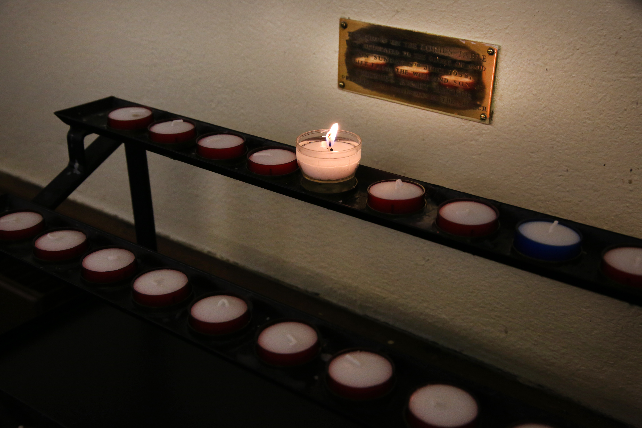
DAILY OFFICE
Notes:
We are now going to discuss three other patterns of worship (daily office, group devotions, extending the table).
Daily Office
The early church developed two distinctive patterns of worship. One is the basic pattern we have been working with all along. This is the pattern for Sunday worship or worship on other occasions that included Holy Communion. All of the major services in The United Methodist Hymnal (Sunday morning, marriage, and services of death and resurrection) are built on this pattern.
The other is the “daily office,” a pattern the early church developed for household or small-group prayer throughout the day, every day. The word “office” comes from the Latin word officium, which means “duty.” Early Christians used this word because they considered it their duty to stop to praise God and offer intercession, together if possible, several times a day every day. The United Methodist Hymnal contains orders for the morning and evening “offices.” The United Methodist Book of Worship and The Upper Room Worshipbook also contain orders for prayer at mid-day and at night. Night prayer is sometimes also called “compline,” from the Latin word, “completorium,” meaning the “completion” of the day. It is the service intended to be used before individuals, families, or groups retire for the night.
We have been using morning or evening prayer to begin each of our sessions together. It is particularly well designed for smaller groups to use. Its form and history connect us in with well over seventeen centuries of Christians who have prayed in this way before us. Many Christians still pray at least these four offices every day.
The basic pattern of these services may be described as entrance, readings/response, and prayer. These services also normally include psalms and ancient Christian songs, some taken directly from the Bible, called “canticles.” The Song of Zechariah from Luke 1 is associated with morning prayer. The Song of Mary (sometimes called “Magnificat,” from the first word of this song in Latin) and the Song of Simeon, both also from Luke’s gospel, are associated with evening prayer. While our hymnal and Book of Worship suggest a few Scriptures for each of these services, whole lectionaries have been developed for these services of daily prayer. One of the most recent is Revised Common Lectionary Daily Readings, developed by the Consultation on Common Texts as a companion to the Revised Common Lectionary that United Methodists adopted in 1992. It may be purchased in book form or downloaded for free at http://www.commontexts.org/publications.
The services of the daily office may be used effectively for the opening or closing of meetings. The longer services (morning and evening prayer) may fit best for longer meetings, such as church council, spiritual formation, finance, or trustees. The shorter services (mid-day or night prayer) may fit better for shorter meetings. Lay or clergy may lead any part of any of them. Using these in your leadership of meetings and sharing leadership of them with others, as we have modeled with opening worship in this course, may become an opportunity for you, as a lay servant, to help others grow in their own leadership of worship in a non-threatening way.

Slide 66
GROUP DEVOTIONS
Photo courtesy of UMCOM.org
Notes:
Group Devotions
Sometimes, you may be called on to lead devotions for a group or committee meeting. The purpose of devotions is to center the committee or group on the direction of the Holy Spirit for the work they are about to do. Devotions are typically very brief, usually no longer than 5-7 minutes.
A common pattern is to sing a verse or two of an appropriate hymn or song, read Scripture, offer a brief reflection on the Scripture (one or two minutes at most), and close with a unison prayer, which may be the Lord’s Prayer.
The Scripture you choose should be central to the song or hymn you select and the reflection you offer. You may find it helpful to use one of the Revised Common Lectionary readings for the past or upcoming Sunday or the Revised Common Lectionary Daily Readings for that particular day. Using the lectionary in this way may help keep the work of the committee or group more in sync with the worship life of your congregation and the millions of United Methodists and other Christians who use this lectionary around the world.

Slide 67
EXTENDING THE TABLE
Photo courtesy of UMCOM.org
Notes:
Extending the Table
As lay servant ministers, you may be asked from time to time to share the elements from your congregation’s celebration of Holy Communion with people who were unwillingly absent. In this role, you are not “presiding” or “consecrating” the elements. You are sharing the elements already consecrated as part of a regular service of Word and Table celebrated in your congregation. Pages 51-53 of The United Methodist Book of Worship provide an outline and guidance for visits and a brief order for sharing the gifts. Note that you do not pray the prayer on page 52. Instead, you proceed immediately from the Peace to praying the Lord’s Prayer while holding the bread and cup. You then break the bread (unless it is already broken) and share it. You may pray the prayer printed in unison if the other person or persons are able to pray aloud with you, or offer it yourself on behalf of all present. At the blessing, laypersons would say, “be with us all” rather than “you” all.
A complete book and study guide is available for learning more and training others for this important lay ministry. It is Extending the Table by Dr. Mark Stamm. You and participants may order this book here: https://bookstore.upperroom.org/Products/DR553/extending-the-table.aspx

Slide 68
1. How do you use, might you use, or suggest others may use the daily office to open meetings or focus other groups in prayer?
2. What has been your experience with devotions at the opening of meetings or shorter groups? How might the suggestions offered in this session help you craft or teach others to craft better devotions? What other helpful patterns have you seen or might you suggest?
3. Briefly describe experiences you have had with sharing Communion with persons unable to attend worship.
Notes:
Ask the teams to take five minutes to discuss the following in their teams:
1. How do you use, might you use, or suggest others may use the daily office to open meetings or focus other groups in prayer?
2. What has been your experience with devotions at the opening of meetings or shorter groups? How might the suggestions offered in this session help you craft or teach others to craft better devotions? What other helpful patterns have you seen or might you suggest?
3. Briefly describe experiences you have had with sharing Communion with persons unable to attend worship.

Slide 69
FOUR PRACTICES OF PRAYER: PSALMS, CENTERING PRAYER, LECTIO DIVINA, TONGSUNG KIDO
Chanting or Praying the Psalms
Notes:
For the final part of this workshop, we will demonstrate and give you an opportunity to try four additional practices of prayer from The United Methodist Hymnal and The United Methodist Book of Worship in your teams.
Chanting or Praying the Psalms
The fourth-century Christian bishop and theologian Augustine of Hippo is credited with saying, “Whoever sings prays twice.” The psalms are songs that have helped hundreds of generations of Jewish and Christian people pray. Whether sung or spoken, however, the psalms are intended to be prayed and not simply read.
No one has access to the original tunes used to sing them. Generations of Jewish and Christian singers and composers have developed many different ways to sing or pray them over time. The oldest continuous form of singing and praying the psalms is to chant them.
Many different ways have been developed for the chanting of the psalms. Because of the roots of Methodism in the Church of England, many Methodist hymnals over the years have set the psalms to what is known as Anglican Chant. However, the system of learning and notating Anglican Chant can be challenging to follow or print.
The current United Methodist Hymnal offers a simpler way of chanting the psalms. Turn in your hymnal to Psalm 1 (UMH 738). Look at the text of the psalm itself. Do you see the red dot that appears above some of the words?
Now turn back one page to page 737. Do you see the five different “tones” at the bottom of the page? Notice the musical structure of these tones. First, there is a whole note. Then, there is a red dot over the next note and two more notes. Then, that musical pattern repeats with different notes.
The whole note is called “the leading tone.” You start (or “lead”) each line singing every syllable on this note as if you were speaking it. Then, when the red dot appears in the text, you sing the rest of the line, to the final three notes, usually one note per syllable.
(Note: If you as leader do not feel comfortable leading the singing, assign someone else to do so. You or that person should demonstrate how to chant the first two verses of Psalm 1 with Tone 3. Then invite the class to join you in chanting those two verses. Then invite them to chant the entire psalm together. )

Slide 70
DISCUSSION
Notes:
INSIGHTS FROM THIS SESSION
Have participants work in pairs, preferably with a person from a different worship planning team. Ask the members of each pair to tell each other one or two things they have learned or had reinforced for them during this session. After about five minutes, invite the pairs to share one of these with the whole group, record it in some way for all to see, and allow for brief discussion as time allows.
QUESTIONS FROM THE READINGS
Review the questions listed at the beginning of the session. Mark the questions that have already been answered during the course of this section. Answer any remaining questions you can. Then decide and indicate how all unanswered questions will be addressed during the coming week.

Slide 71
FOUR PRACTICES OF PRAYER: PSALMS, CENTERING PRAYER, LECTIO DIVINA, TONGSUNG KIDO
Chanting or Praying the Psalms
Notes:
For the final part of this workshop, we will demonstrate and give you an opportunity to try four additional practices of prayer from The United Methodist Hymnal and The United Methodist Book of Worship in your teams.
Chanting or Praying the Psalms
The fourth-century Christian bishop and theologian Augustine of Hippo is credited with saying, “Whoever sings prays twice.” The psalms are songs that have helped hundreds of generations of Jewish and Christian people pray. Whether sung or spoken, however, the psalms are intended to be prayed and not simply read.
No one has access to the original tunes used to sing them. Generations of Jewish and Christian singers and composers have developed many different ways to sing or pray them over time. The oldest continuous form of singing and praying the psalms is to chant them.
Many different ways have been developed for the chanting of the psalms. Because of the roots of Methodism in the Church of England, many Methodist hymnals over the years have set the psalms to what is known as Anglican Chant. However, the system of learning and notating Anglican Chant can be challenging to follow or print.
The current United Methodist Hymnal offers a simpler way of chanting the psalms. Turn in your hymnal to Psalm 1 (UMH 738). Look at the text of the Psalm itself. Do you see the red dot that appears above some of the words?
Now turn back one page to page 737. Do you see the five different “Tones” at the bottom of the page? Notice the musical structure of these tones. First, there is a whole note. Then, there is a red dot over the next note and two more notes. Then, that musical pattern repeats with different notes.
The whole note is called “the leading tone.” You start (or “lead”) each line, singing every syllable on this note as if you were speaking it. Then, when the red dot appears in the text, you sing the rest of the line, to the final three notes, usually one note per syllable.
(Note: If you as leader do not feel comfortable leading the singing, assign someone else to do so. You or that person should demonstrate how to chant the first two verses of Psalm 1 with Tone 3. Then invite the class to join you in chanting those two verses. Then invite them to chant the entire psalm together. )

Slide 72
Have you chanted a psalm in this way before?
What was this experience like for you?
How might chanting the psalms help you pray them? How might it get in the way?
Notes:
After chanting the psalm together, ask people to talk about their experience of this in their teams for two minutes. Specifically, ask people to discuss these questions:
1. Have you chanted the psalms this way before?
2. What was it like for you to sing the psalms this way?
3. How does singing the psalms help you pray them? How does it get in the way?
Point out to the class the two other kinds of resources our psalter includes. There are responses designed to be sung at the beginning and end of each psalm and at other places designated by the red letter “R.” Responses may be sung whether the congregation chants or speaks the psalm. There is also an alternation of regular face and bold face print. This is for praying the psalm either responsively or antiphonally. In responsive praying, the leader (which may be you as a lay servant) prays the lines in regular face, and the congregation prays the lines in bold face. In antiphonal praying, the congregation is divided into two groups, such as left and right side, or high and low voices, or the choir or praise team and the rest of the congregation. One group prays the regular face, and the other responds with the bold face.
Lead the class to pray Psalm 1 antiphonally by teams. Divide the teams into two groups as needed.

Slide 73
FOUR PRACTICES OF PRAYER: PSALMS, CENTERING PRAYER, LECTIO DIVINA, TONGSUNG KIDO
Centering Prayer
Notes:
Centering Prayer
In addition to leading evening prayer or a devotion, you may offer or be asked to lead a group in a centering prayer. The United Methodist Book of Worship offers three examples of a centering prayer (470-472). Some forms of centering prayer are active and kinetic, as is the Native American example on 470. Others are responsive and contemplative at once, as the Asian example on 471. Others are more individual and purely contemplative, as the example on 472. In the model of 472, note that the ellipses at the end of each line indicate a time for extended silence to enable what each line of the prayer says to “sink in.”
Have each team choose one of these three forms of centering prayer, select a leader, and practice it together. You may want to move the teams to other locations so that each team can use this form of prayer without disturbing others. Call the teams back together in a few minutes.

Slide 74
FOUR PRACTICES OF PRAYER: PSALMS, CENTERING PRAYER, LECTIO DIVINA, TONGSUNG KIDO
Lectio Divina
Notes:
Lectio Divina
Lectio Divina (Latin for “divine reading”) is a way of reading Scripture aloud in a group setting, reflecting on it, and sharing what is heard with one another. A chosen Scripture is read three times. Before the first reading, all are asked to listen for what “grabs their attention.” A time of silence is allowed for people to write down or become clear about what seemed most striking. Before the second reading, all are invited to listen for what the Holy Spirit may be saying to them in what most caught their attention the first time. Again, silence is offered afterward for people to write down or become clear about the Spirit’s direction. Before the third reading, all are invited to decide how they will respond to what the Spirit has shown or asked. A final period of silence follows this to enable people to write down or make their commitment firm. After the silence, people are invited to share what struck them, what they heard, and what they will do in response. This is a time of reporting and testimony, not group discussion.
Invite the teams to take the next few minutes to practice Lectio Divina together with the scripture for this session, John 20:19-29 (evening) or John 21:1-14 (morning).

Slide 75
FOUR PRACTICES OF PRAYER: PSALMS, CENTERING PRAYER, LECTIO DIVINA, TONGSUNG KIDO
Tongsung Kido
(Praying Aloud Together)
Notes:
Tongsung Kido (Praying Aloud Together)
While the name of this way of praying in The United Methodist Book of Worship (446) is Korean, in reality this is a typical way of praying in many Asian, Hispanic and Latino Christian communities. Lay servants may be asked to lead this way of praying in some contexts.
Tongsung Kido is designed for “the prayers of the people.” It is a way for all of the people to pray actively, aloud, and all at once. As the description in the Book of Worship indicates, the prayer leader announces a topic for all to pray about. Then all people present offer their particular prayers around that topic aloud and at the same time. Praying this way may not come naturally to those who are accustomed to a single voice leading prayer for all or to waiting for others to pray before speaking. It may be helpful to think of this as something like a group of people of many cultures praying the Lord’s Prayer all at once in their own first languages.
Before the break, lead the whole class to pray Tongsung Kido using the intercessory prompts you have used in opening worship during each class session (UMH 879 or UMH 877).

Slide 76
BREAK

Slide 77
INSIGHTS
Notes:
INSIGHTS FROM THIS SESSION
Have participants work in pairs. Ask the members of each pair to tell each other one or two things they have learned or had reinforced for them during this session. After about five minutes, invite the pairs to share one of these with the whole group, and record for all to see and briefly discuss, if time allows.
QUESTIONS FROM THE READINGS
Review the questions listed at the beginning of the session. Mark the questions that have already been answered during the course of this section. Answer any remaining questions you can.

Slide 78
SENDING
Leader: Go now in the peace and strength of Christ.
People: Thanks be to God.
Notes:
SENDING:
Song: “Benediction Hymn” (Worship and Song, 3182)
Leader: Go now in the peace and strength of Christ.
People: Thanks be to God.

Slide 79
Thank you!

