Slide 1

Life Together in the United Methodist Connection

Slide 2
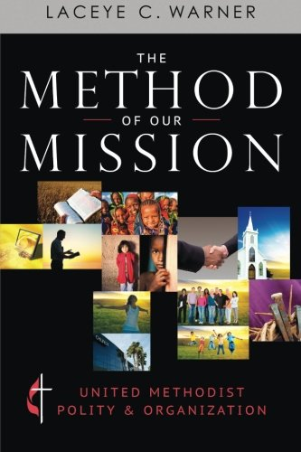
WELCOME!
Life Together in the United Methodist Connection
Notes:
Introduce yourself and welcome participants. Invite participants to make brief introductions and to use cardstock and markers to create large tent-style name cards so everyone can easily read everyone else’s name.

Slide 3
COURSE GOALS—
To understand the purpose and overall structure of the United Methodist connectional system.
To understand the uniqueness and purpose of the episcopacy, the itineracy and appointment process, ordering of ministry, and annual conference.
To have a wider understanding of the many ways our connection works together to make disciples of Jesus Christ.
To have a better understanding of jurisdictions, General Conference, Judicial Council, and central conferences, as well as other international affiliated churches.
To be equipped with new insight and tools for discernment in making decisions on the local church and conference level.
Notes:
Review course goals.

Slide 4
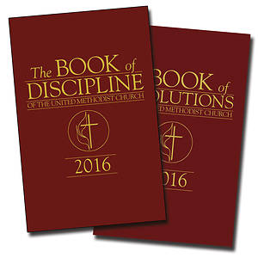
Session 1:
The Connectional Principle
Notes:
At the end of this session, you should have a better understanding of the purpose of denominations and the uniqueness, purpose, and overall structure of the United Methodist connectional system and its order of missionary preachers.

Slide 5
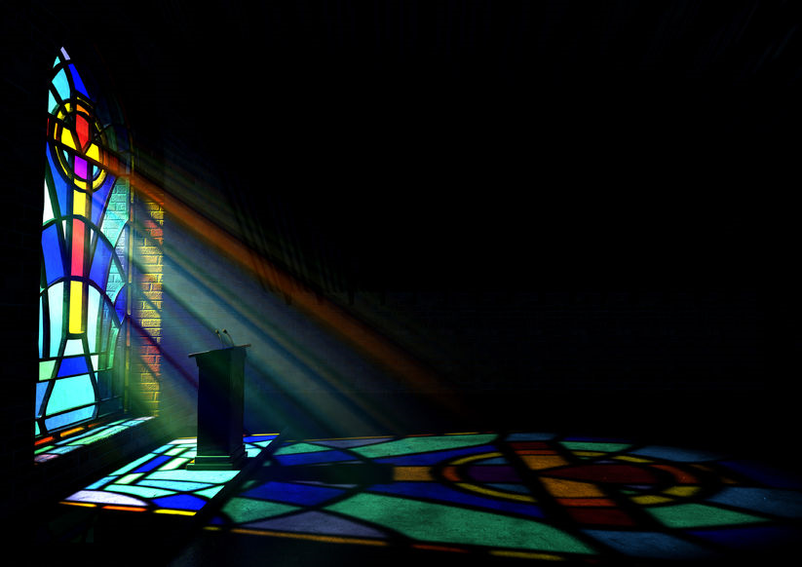
WORSHIP
Notes:
On the night in which Jesus gave himself up for us, he hosted a dinner for his closest friends. They came to the table, and he washed their feet as a servant, saying they should serve one another in the same way. He broke bread and shared wine with them. And then he prayed for them, and this is some of what he said:
“And now I am no longer in the world, but they are in the world, and I am coming to you. Holy Father, protect them in your name that you have given me, so that they may be one, as we are one. While I was with them, I protected them in your name that you have given me. I guarded them, and not one of them was lost except the one destined to be lost, so that the scripture might be fulfilled. … I ask not only on behalf of these, but also on behalf of those who will believe in me through their word, that they may all be one. As you, Father, are in me and I am in you, may they also be in us, so that the world may believe that you have sent me. The glory that you have given me I have given them, so that they may be one, as we are one, I in them and you in me, that they may become completely one, so that the world may know that you have sent me and have loved them even as you have loved me” (John 17:11-12, 20-23, NRSV).
Then they left the Table and went out into the world. Jesus knew that if they stayed connected with one another, they would accomplish amazing things for his kingdom. But if they split up, they would accomplish nothing and be lost themselves from his fellowship.
When we celebrate the sacrament of the Lord’s Supper, it is a sacrament of connection, the sacrament of unity with Christ and with one another. We come to the Table, bringing offerings of bread and wine to be consecrated. The bread of heaven is broken for us, and the fruit of the vine is poured and then distributed and shared. When we share Christ’s body and blood, we are united, bound together, connected in Christ’s body and blood, and we receive spiritual nourishment for doing Christ’s work in our world.
In the same way, in The United Methodist Church, we are united, bound together, connected. We call ourselves a connection. And we bring offerings of prayers, presence, financial and spiritual gifts, service, and witness. These are also gathered at a table – they are called the administrative board or ad council, annual conference or General Conference, or something else – they are consecrated to Christ’s service, divided, and shared. And so, connected, united, we accomplish amazing things for Christ’s kingdom. Separately, we could accomplish nothing and would be lost ourselves from Christ’s fellowship. Let us pray as we sing…
[Select one of the following songs:]
“Bind Us Together,” 2226 in The Faith We Sing
“Blest Be the Tie that Binds,” United Methodist Hymnal, 557
“We Are the Church,” United Methodist Hymnal, 558
“Jesus, United by Thy Grace,” United Methodist Hymnal, 561
“Blest Be the Dear Uniting Love,” United Methodist Hymnal, 566

Slide 6
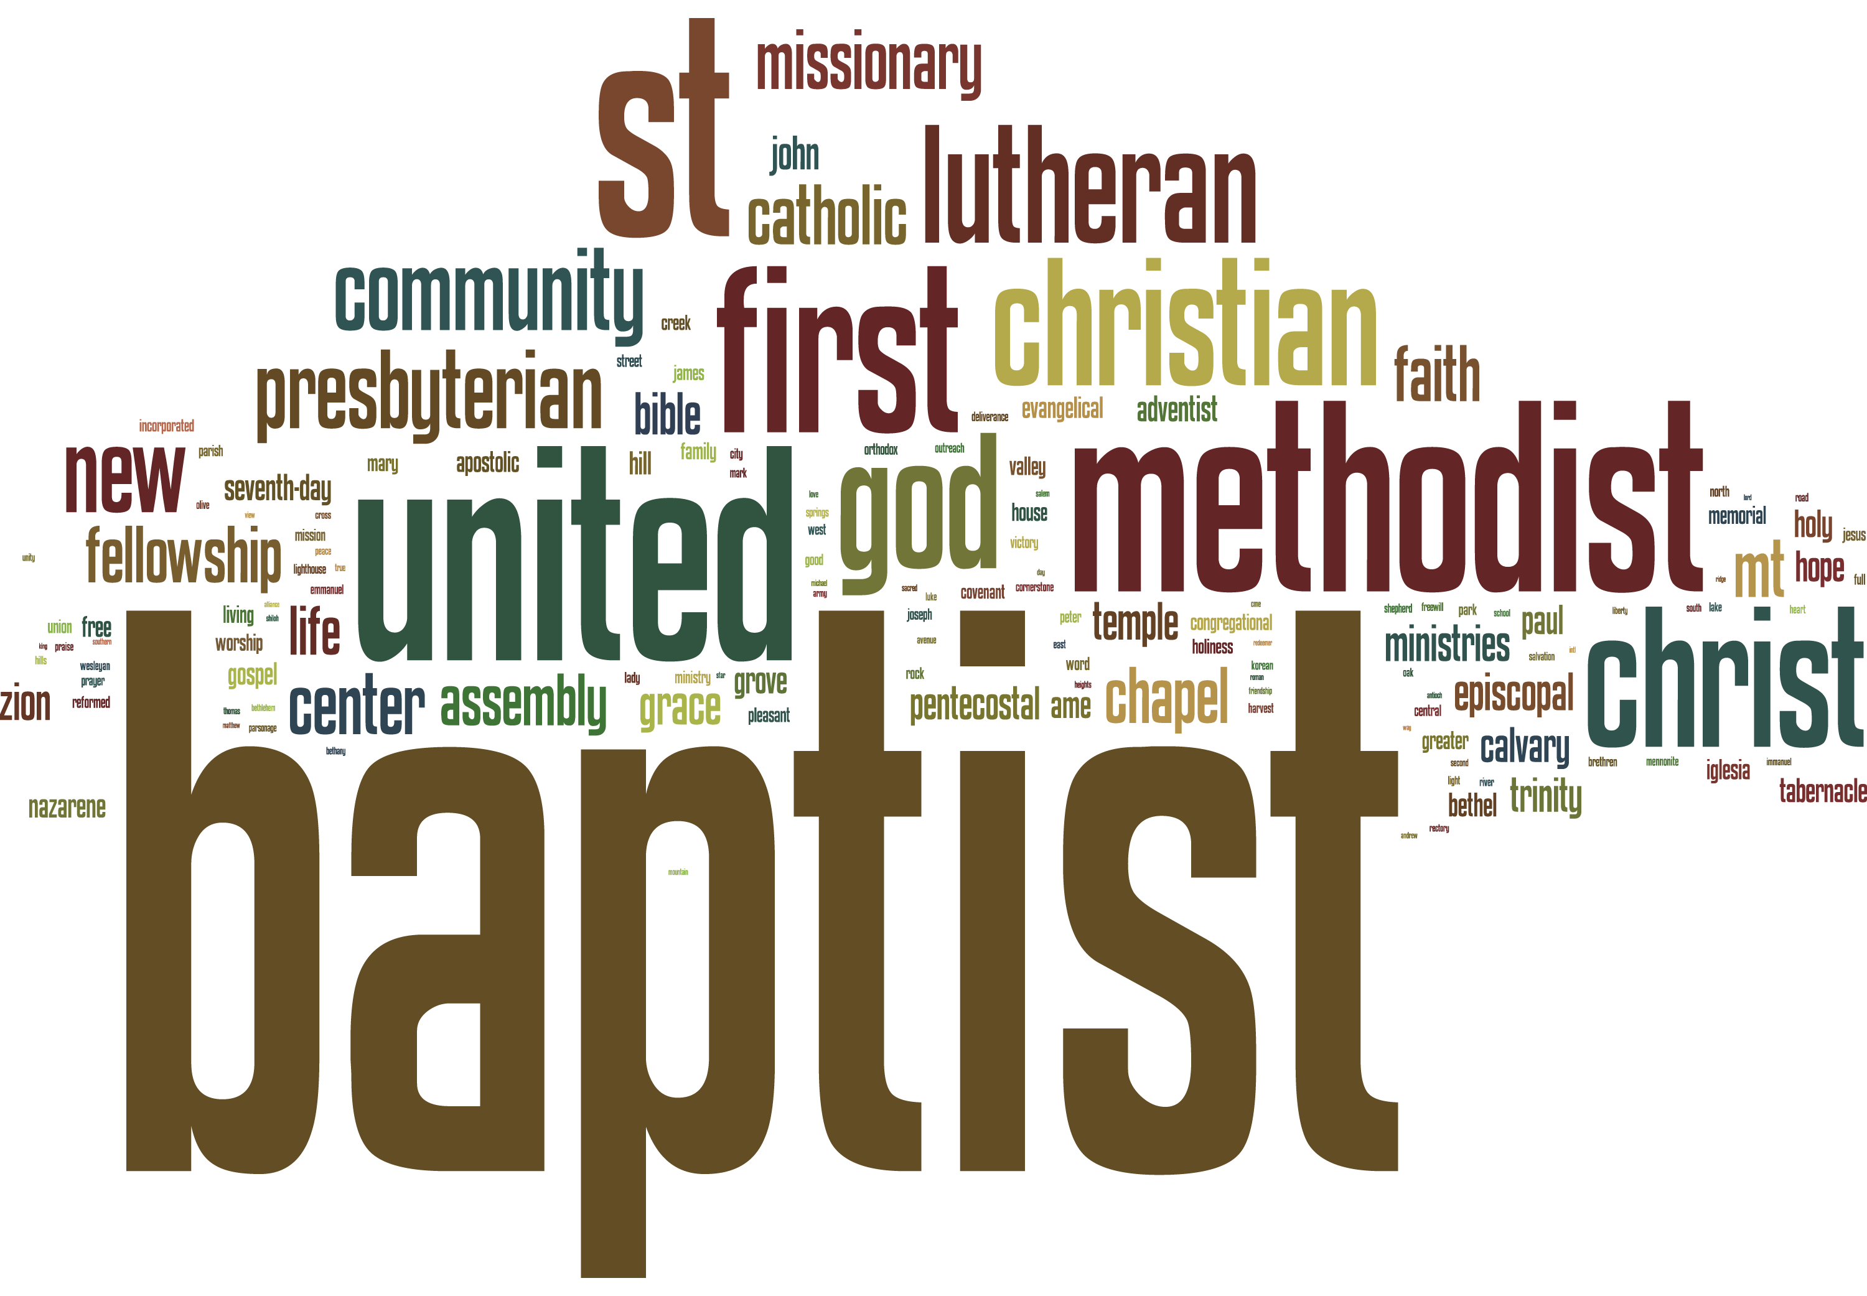
Notes:
Share with participants the idea that what we call The United Methodist Church
➢ Is not a church in the European sense of a national, tax-supported church to which citizens are expected to belong (like the Church of England), nor in the Orthodox sense of an ethnic, national church to which all members of an ethnic group belong (like the Russian Orthodox Church).
➢ Nor is it a sect in the sense of a small, defensive minority within the boundaries of a national or ethnic church.
➢ Nor is it a mystical cult focused on one leader, although we appreciate and celebrate the influence of the Wesleys and Asbury, Albright, Otterbein, and Boehm.
➢ Rather, when the United States declared its independence from Great Britain with the principle of separation of church and state, something new was born: the denomination, a completely voluntary association. Frank says, “Methodism was the quintessential American voluntary association” (p. 67).
Ask the class: “What do denominations do for us? What’s their purpose?”
Answers could include suggestions such as:
training and ordaining clergy and holding them accountable for their theology and their behavior (that is, church discipline)
deploying (or providing a framework for deploying) clergy
organizing and sending missions to evangelize and plant new congregations
providing accountability for and efficient use of funds raised (church discipline)
creating church institutions (hospitals, schools, charities)
providing training and resources for members’ ministries (such as Lay Academy)
handling pension funds for clergy and lay employees
continuing the theology and culture of the denomination through resources for practicing the faith: books, hymnals, liturgy, Sunday school materials, web resources, publications, etc. (church discipline)
providing a sense of unity around shared mission, theology, and culture
marketing – at least a beginning expectation, as people move into a new community, that a church will be similar to others of its denomination in theology, practice, and culture
presenting an identity, a face to the wider culture, with hoped-for influence
opportunities for assembly, inspiration, and fellowship (conferences)

Slide 7
“The UMC is a connectional mission, not a single corporation…the church is a living cultural tradition that endures because people are loyal to it, not because it has a precise Constitution” (Frank, p. 140).
THE CONNECTION PRINCIPLE
Notes:
Share with participants principles from Chapter 3:
Now that we know what we expect our denomination to do, the next question is, how does it do all that – which is the subject of this course. The UMC is organized differently from other large voluntary organizations.
The United Methodist Church has a constitution and a big Book of Discipline with a lot of organizational details. But does it surprise folks to know that The United Methodist Church as a whole does not exist as a legal entity? Invite folks to open the Discipline and briefly run down the contents. Turn to the Constitution and ¶139, which specifies that the UMC has no legal existence as a sue-able entity (Frank, p. 140).
Then what is The United Methodist Church? What “constitutes” the church?
The church is a connection, but a connection of what? People, generally, don’t get together and incorporate a congregation and then come asking to join the annual conference. And annual conferences didn’t get together and decide to create General Conference or The United Methodist Church.

Slide 8
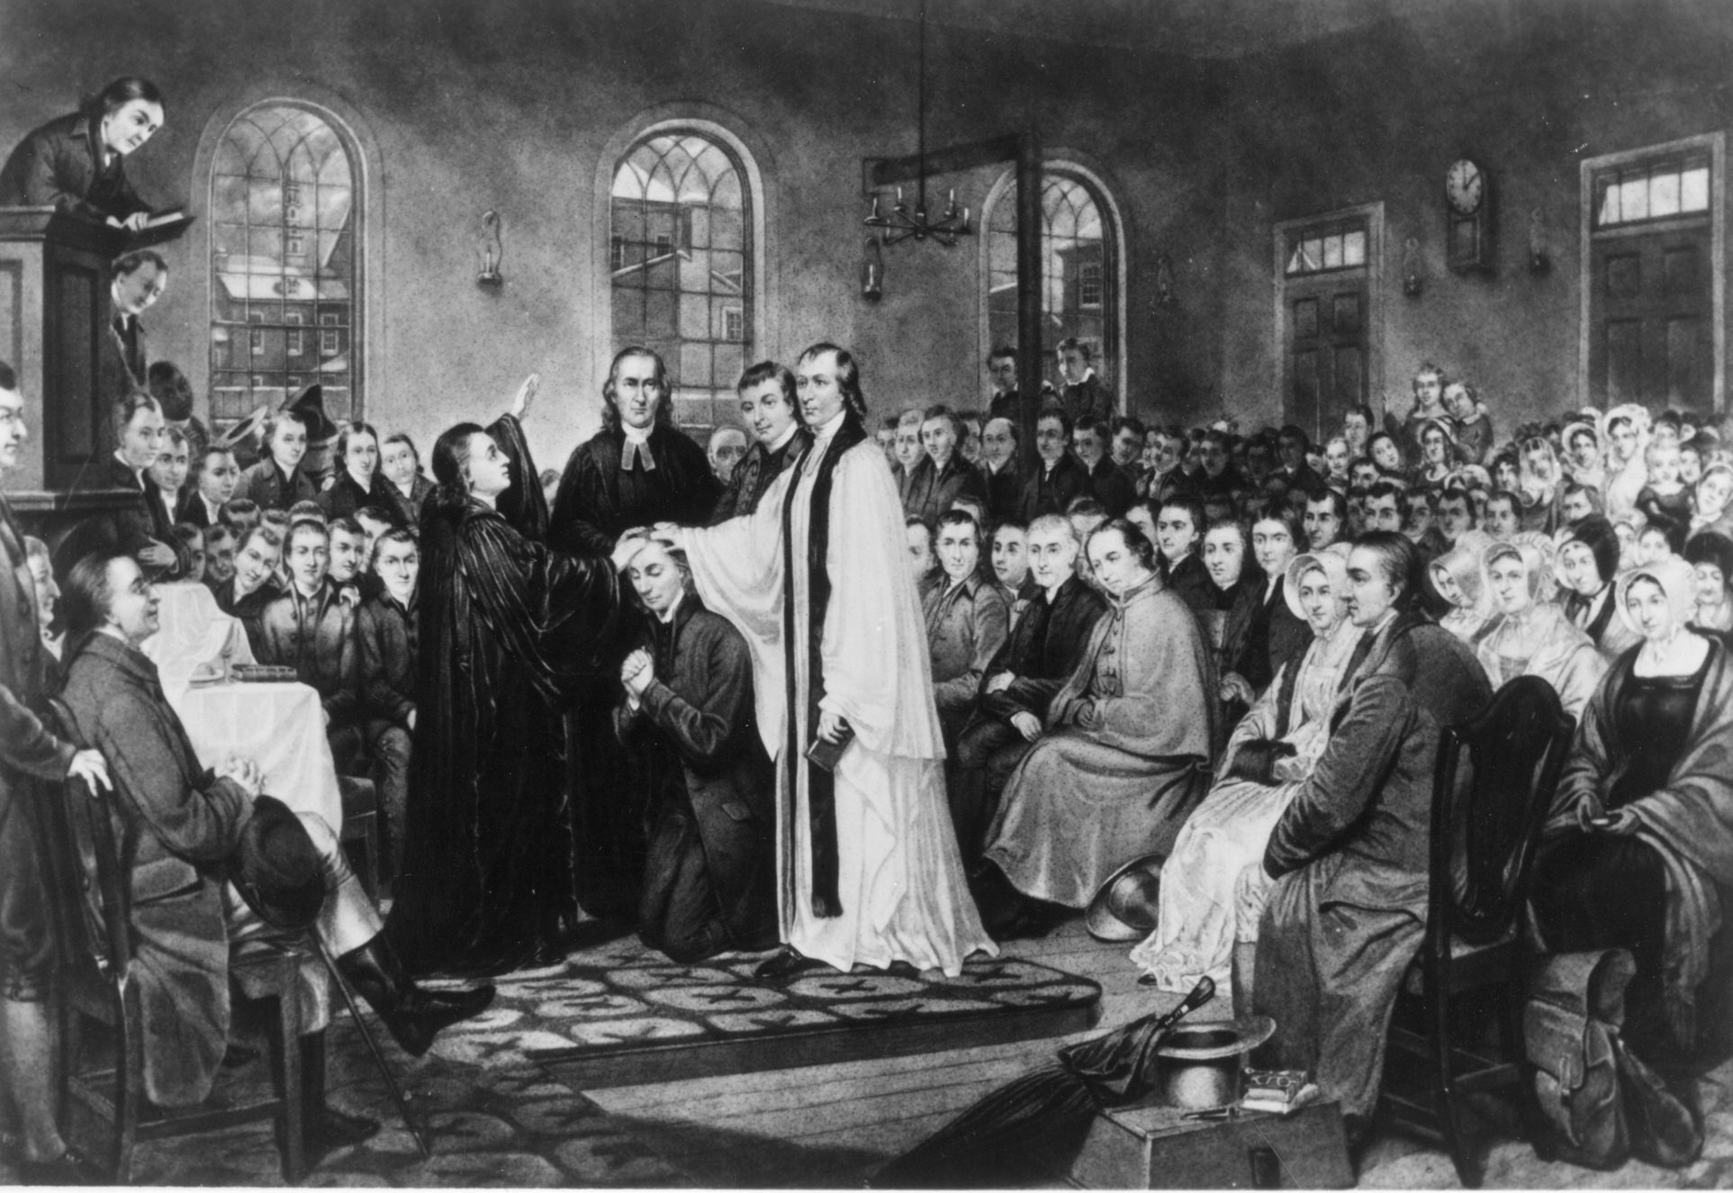
1784
Christmas Conference
Notes:
Frank says that, at its roots, the church is an order of missionary preachers. “Mr. Wesley’s Connexion” consisted of all the preachers who were “in connexion” with him. He gathered them annually in conference, for accountability, for teaching, and for assigning them to the circuits to which they were sent. They were, generally, celibate, serving until they married and “settled.” They agreed to go where they were sent, and Wesley agreed to send them.
After the revolution in America, the preachers of the connection met together in conference in Baltimore at Christmas, 1784, ordained Francis Asbury an elder in the church, and elected him to the office to which John Wesley had appointed him: superintendent (though he quickly began to be called bishop).
And so it was the order of missionary preachers, meeting in conference, that constituted the Methodist Episcopal Church. The principle was the same in the Evangelical and United Brethren traditions. Still today, ordained clergy (elders and deacons) hold their membership only in their annual conference. Bishops’ membership is in the Council of Bishops.
The history of the next 300 years is not part of this course, but is taken up in Living Our United Methodist Beliefs. Although a lot has happened in those years– laypeople
are now half of all members of annual conference and can almost always out-vote clergy if they wish, since many retired clergy don’t attend – our church is still, in a basic sense, an order of missionary preachers covenanting together in conference.

Slide 9
The Principle of Holy Conferencing
SMALL GROUPS
CHARGE CONFERENCE
DISTRICTS
ANNUAL CONFERENCE
JURISDICTIONAL AND CENTRAL
CONFERENCES
GENERAL CONFERENCE
Notes:
Wesley’s principle of “holy conferencing” pervades the church at every level:
Small groups – the Wesleyan “classes” and “bands” making up the local society (now experiencing a renaissance)
Charge conference, the congregation or congregations assigned to the “charge” of a preacher, at the local level
Districts – which don’t meet in conference but have important committee functions in screening candidates for ministry, encouraging and training laypeople, etc. – District Committee on Ministry (DCOM), Lay Academy
Annual conference at the geographic area level: the locus of the preachers’ covenant
Jurisdictional and central conferences at the regional or national level (the function of jurisdictional conferences in electing and assigning bishops; they may do programming but only Southeastern Jurisdiction does) (the function of central conferences in making culturally appropriate changes to the Discipline for their context)
General Conference of the whole worldwide church

Slide 10

SMALL GROUPS
Why do we do this?
What are the benefits of this kind of layered organization and connection?
What are the drawbacks?
Notes:
Break up into small groups. Have the groups discuss the following questions:
Why do we do this? What are the benefits of this kind of layered organization and connection? What are the drawbacks?
In the whole group, receive reports from the groups. Be sure these points are covered under “benefits”:
The clergy appointment system, itineracy or itinerancy, avoids the expense in time and money that “call” systems impose on local churches. (Also, if an appointment doesn’t work out, the people can blame the cabinet instead of one another!) And it enables sending preachers to plant new churches.
Clergy are thoroughly vetted before being ordained, and if they become untrustworthy, they are accountable —there is someone to complain to, who will take action if warranted.
Even small-membership congregations can have pastoral leadership.
Even small-membership congregations can be part of a worldwide mission and ministry and accomplish great things together that none could do separately.
The conference provides services to local churches, including: _______________ (Be sure you know your conference’s services!)

Slide 11
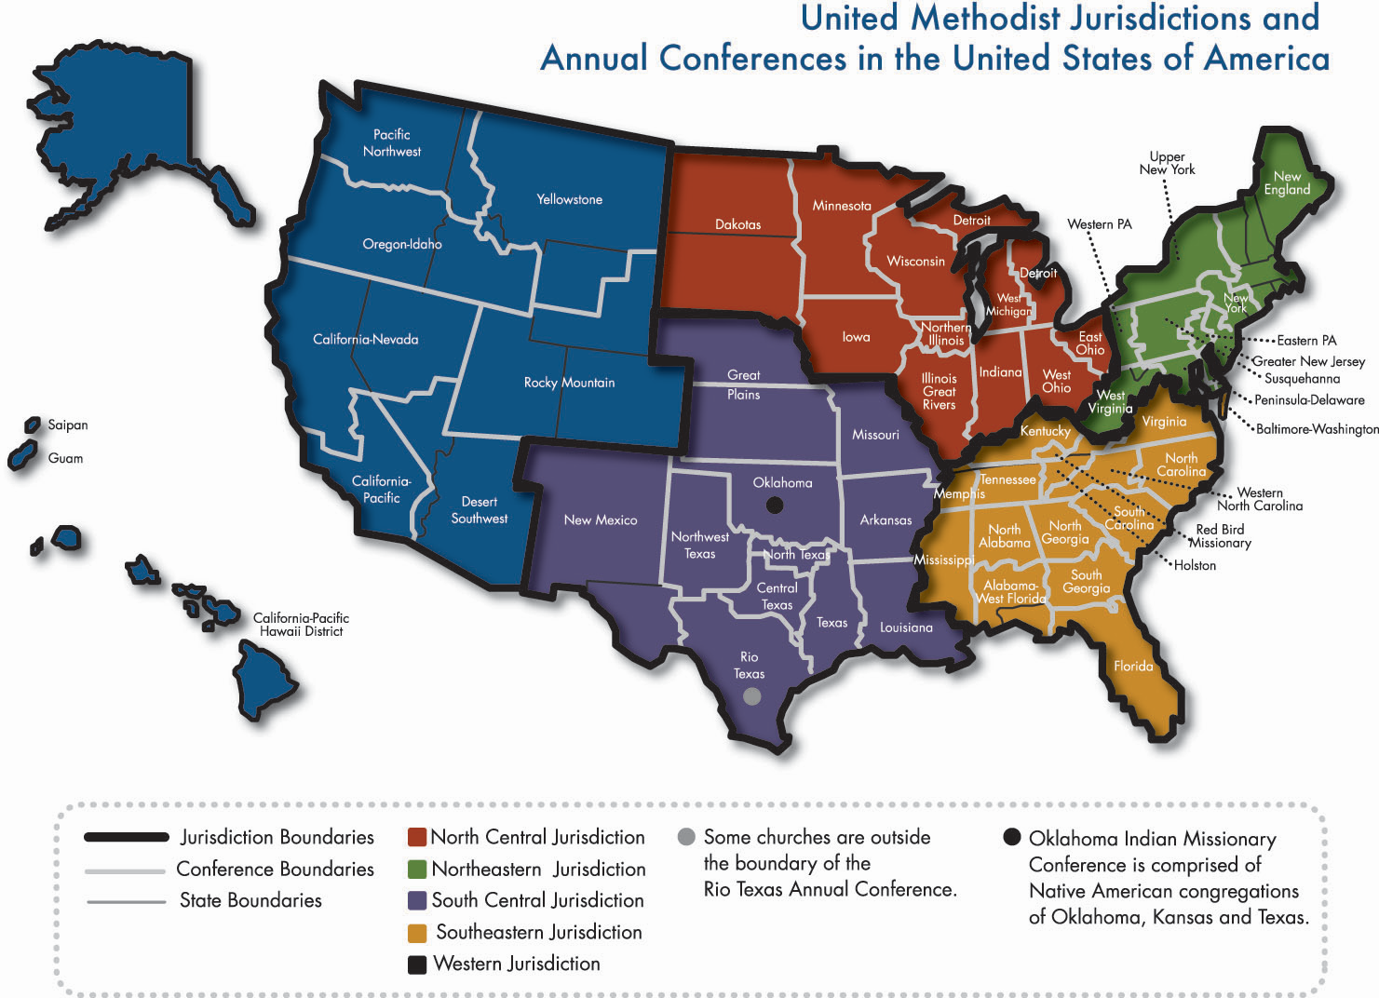
DISCUSSION
Notes:
Spend some time discussing the organization of your specific annual conference: its districts, district superintendents, the function of the superintendents, the bishop’s cabinet, your conference boundaries and headquarters offices, your bishop (does your bishop preside over an “area” – more than one conference?), your jurisdiction or central conference. Have maps!
Ask students to share what they know about each of these conferences. Do any of them serve on district or conference committees? Do they hold offices that must report at charge conference?
Say: “Despite the democratic conferencing principle, the United Methodist connection is an amalgam, a practical synthesis, of conferences and the episcopal principle, which we’ll take up next.”
Ask students to read Chapter 7, pages 195-218, Chapter 8 and Chapter 10 for next time. Assure them that this is the longest assignment of the class. Ask for prayer concerns, and close with prayer.

Slide 12
Session 2:
The Episcopal Principle itineracy, ministry, and annual conference
Notes:
At the end of this session, students will understand the uniqueness and purpose of the episcopacy, the itineracy and appointment process, ordering of ministry, and annual conference.

Slide 13

WORSHIP
Notes:
The Apostle Paul, on his last journey to Jerusalem, wanted to meet with the leaders of the church at Ephesus, but he was in a hurry. So he stopped at the harbor of Miletus. Luke reports in Acts 20:17-32:
From Miletus he sent a message to Ephesus, asking the elders of the church to meet him. When they came to him, he said to them:
‘You yourselves know how I lived among you the entire time from the first day that I set foot in Asia, serving the Lord with all humility and with tears… as I testified to both Jews and Greeks about repentance toward God and faith toward our Lord Jesus. And now, as a captive to the Spirit, I am on my way to Jerusalem, not knowing what will happen to me there, except that the Holy Spirit testifies to me in every city that imprisonment and persecutions are waiting for me. But I do not count my life of any value to myself, if only I may finish my course and the ministry that I received from the Lord Jesus, to testify to the good news of God’s grace.
‘And now I know that none of you, among whom I have gone about proclaiming the kingdom, will ever see my face again… Keep watch over yourselves and over all the flock, of which the Holy Spirit has made you overseers, to shepherd the church of God that he obtained with the blood of his own Son. I know that after I have gone, savage wolves will come in among you, not sparing the flock. Some even from your own group will come distorting the truth in order to entice the disciples to follow them. Therefore be alert, remembering that for three years I did not cease night or day to warn everyone with tears. And now I commend you to God and to the message of his grace, a message that is able to build you up and to give you the inheritance among all who are sanctified.’
The church appoints shepherds – which is what “pastor” means – and chief shepherds, who are named bishops – for the work of overseeing the spiritual well-being and the ministries of God’s people. Paul calls such leaders “overseers,” and though the names and processes may have changed, his warning to “Keep watch over yourselves and over all the flock” still expresses the duty of bishops and their assistants, the district superintendents.
The symbol of the bishop is the crozier, (KROH-zhih-er), a staff shaped like a shepherd’s crook, symbolizing the responsibility of the bishop as chief shepherd of the flock of Christ’s church. In The United Methodist Church, bishops are not a separate order of clergy. They are simply consecrated as bishops, not ordained, for the work of superintendency.
They remain ordained elders among other elders, set aside, not as the only shepherds, but leading shepherds. The logo of the episcopacy in The United Methodist Church is shaped like a shield with a crosier running through it, and the symbols of Christ – the Chi Rho in the shape of the cross – and of the Father, the Alpha and Omega (Rev. 1:8) – on a background of red, a symbol of the Holy Spirit.
Let us close by praying the prayer contained in one of these ordination hymns: “God the Spirit, Guide and Guardian,” United Methodist Hymnal, 648; “ Lord, You Give the Great Commission,” vs. 1, 2, 4, United Methodist Hymnal, 584.

Slide 14

United Methodist Episcopacy
Notes:
Ask participants: “What do we know about the episcopacy?” In the discussion, be sure to cover these points – OR, summarize these points about the United Methodist episcopacy:
United Methodist bishops in the United States have life tenure (but are elected for terms in other countries) – but remain elders. Their membership is in the Council of Bishops.
Bishops’ main power is that of appointing preachers. In appointing authority, John Wesley (who was never called a bishop) and Francis Asbury had absolute power, and that authority, while assisted by the district superintendents, still remains today.
Bishops ordain clergy, but not alone – always with other bishops, district superintendents, and elders also laying hands on the ordinands.
Bishops are not administrative CEOs of annual conferences, although they preside at conference sessions and exercise their appointive powers within annual conferences.
Bishops are elected by jurisdictional conferences and assigned to their “areas” (one or more conferences) by the jurisdictional committee on episcopacy.
Bishops have tremendous spiritual influence as preachers and teachers. The Council of Bishops has issued pastoral letters that do not speak for the church (only General Conference can do that) but urge consideration as an expression of their wisdom.
The episcopacy is one of the principles that constitutes the church – after all, its original name was “Methodist Episcopal Church.” Frank says, “The episcopacy is a constitutive principle of United Methodism by traditional practice, influence, and attributed authority far more than by organic law” (Frank, 127).
Ask participants: “When has a bishop’s leadership touched you spiritually? What is going on in your conference that is empowered or enlivened by the bishop?”

Slide 15

The Appointment Process
Notes:
Outline the appointment process. If your conference’s traditions – or your bishop’s procedures – are a little (or a lot) different from what’s outlined here, explain your procedures instead. If you are a layperson teaching this course, you may wish to check with your pastor about how your conference does appointments.
Each year the church fills out, at charge conference, its church profile form. This is where the church gets the chance to say what is very important to it in pastoral leadership. The cabinet and bishop take these forms seriously.
Each year, each clergy person also fills out a form indicating his or her availability for a move (this doesn’t mean the pastor - or the church - will necessarily get what they ask for).
The district superintendents, who know the clergy better than the bishop, form the bishop’s cabinet. (Bishops may also meet at times with an “extended cabinet” that includes other conference officers, but that is not about appointments.) Together, the bishop and the cabinet work on appointments.
Appointment changes may be initiated when:
a pastor retires or goes on sabbatical leave
a pastor requests a move or a church requests a change
the cabinet feels a particular pastor is needed in a different appointment
The cabinet and bishop work prayerfully and seriously, trying to match the needs of churches, clergy, and their families. Eventually, they agree to a particular move – and usually, they plan a whole string of moves at the same meeting. The pastor’s district superintendent calls him and (if the proposed move is to a different district) tells the pastor to wait for a call from the DS of the other district. The DS of the church where there is a vacancy calls the pastor and says something like “We would like you to prayerfully consider a move to ______.” This generally means, “You’re moving.” A pastor can raise very serious objections at this point, but they must be very serious indeed. The DS calls the staff-parish chair of the new church and sets a time to meet with the staff-parish relations committee, but without saying who the new pastor is.
Meanwhile, the pastor and spouse are probably feverishly studying the new church’s statistics in the conference Journal, maybe even driving past the church and parsonage – all in great secrecy. Then the DS meets with the pastor and spouse to discuss the new appointment, followed the same evening with the staff-parish committee. The DS brings the pastor and spouse to the committee to “introduce the new pastor.” (The pastor is not a “candidate” or a “proposed” pastor.) If there are very serious reasons that arise in the staff-parish meeting against the appointment, it may be reconsidered, but they must be very serious indeed. If the pastor is going on sabbatical or retiring, his or her current church already knows about the change. Otherwise, the DS calls the staff-parish chair of the pastor’s current church with news of the move, which is not announced until worship the next Sunday. The grieving process begins.
Simultaneously, the staff-parish chair of the new church announces the name of their new pastor, also not until that same Sunday. The DS calls the next staff-parish chair and pastor in the chain…and so on. Exceptions: founding pastors of megachurches may serve their entire ministries in the same charge. (Their successors will have quite a challenge and will probably serve very short tenures.) If a pastor is moving from one conference to another, the bishop of the receiving conference must ask the bishop of the current conference to make the transfer, and the current conference bishop must agree.)

Slide 16

DISCUSSION
Notes:
What are folks’ general experiences with the appointment process?
There is no way to keep folks from discussing this at this point. Don’t allow people to discuss personalities or specific appointments in recognizable terms. Guide the conversation to recognize the benefits of the process, including:
That few churches go for long periods without pastors, a common problem in a congregational call system.
That smaller churches receive pastoral leadership one way or another.
That if a particular appointment turns out to be a bad match, the people can blame the cabinet rather than one another, which shortens the healing process.
That if a pastor leaves for another church, it’s usually not because the pastor was asked to leave, but because he or she was needed elsewhere. Again, there is no need to cast blame, and this shortens the natural grieving process that is always part of a move.
That, at its best, pastors with specific gifts and passion are matched with churches which need those particular gifts and passion for their mission.
That the itineracy helps to develop strong lay leadership.
That the itineracy provides opportunities for women and people of color and different ethnicities to answer God’s call, blessing the church with diversity and many gifts that otherwise would be lost.
Do emphasize that lay servants can help to interpret the itineracy system to their congregations, to help avoid the shock and anger that can occur when persons from other denominational backgrounds are suddenly faced with a pastoral change.

Slide 17
The Ministry of All Christians
Ordained Clergy: Elders and Deacons
Licensed Clergy: Licensed Local Pastors
Lay Ministry: The Baptized, Certified Personnel, Deaconesses and Home Missioners, Class Leaders, Lay Missioners, Certified Lay Servants, Certified Lay Speakers, Certified Lay Ministers
Notes:
Summarize the main categories of our ordering of ministry. Our terminology and structure of ministry is very confusing. Invite and answer questions! Your folks will be especially interested in certified lay speakers, certifications, and certified lay ministers.
There is an excellent chart which you might display or print. It’s available from the General Board of Higher Education and Ministry at http://www.gbhem.org/atf/cf/%7B0BCEF929BDBA-4AA0-968F-D1986A8EEF80%7D/DOM_MinistryofAllChristiansChart.pdf
Ordained clergy:
Elders – “traveling elders in full connection,” ordained to ministries of word, service, order and sacrament. Elders are pastors in charge, DS’s, bishops, military chaplains, and in “extension ministries.” Appointed by the bishop with (so far) security of appointment.
Deacons – also members of conference in full connection, ordained to ministries of word, service, compassion, and justice. Deacons are the UMC’s specialist clergy: ministers of music, education, administrators, counselors, and a huge array of “appointments beyond the local church” (ABLC): social workers, teachers, doctors, lawyers, principals, hospital administrators, community organizers, chaplains… Deacons must find their own positions and have no security of appointment but, once the job is found, it must be approved and appointed by the bishop. Deacons who work outside the church also have “secondary appointment” to a local church, but exactly what that means is worked out at the local level. Deacons do not have sacramental authority (except in certain extraordinary situations approved by the bishop).
Licensed clergy:
Licensed Local Pastors: not members of conference in full connection, LLP’s are counted as clergy and participate in the clergy session of annual conference. They are appointed by the bishop, but do not have security of appointment. They have sacramental authority in their own charge only, an extension of the DS’s sacramental authority.
Lay ministry:
Baptism is the only ordination anyone needs for serving others in Christ’s name. All baptized persons are called to use their spiritual gifts in ministry. Ordained and licensed ministry is rooted in baptism.
Certified personnel: both laypeople and clergy can take classes in one of many specialized ministry areas and become certified. As of 2012, certifications were available in camp/retreat ministry, children’s ministry, Christian education, collegiate ministry, evangelism, ministry with the poor, ministry with people with disabilities, music ministry, older adult ministry, spiritual formation, urban ministry, youth ministry, church business administration, church communications. They are available in undergraduate, paraprofessional and professional categories.
Deaconesses and Home Missioners: Commissioned to lifelong full-time ministry of love, service and justice. These are primarily social workers or in other helping professions. In some central conferences, deaconesses are primarily church musicians and educators. They serve under the auspices of the United Methodist Women.
Class Leaders: The United Methodist Church is recovering the tradition of classes (small groups). Certification as a class leader is available.
Lay Missioner: Bi-vocational (“tentmaking”) Hispanic persons, who are appointed to start and lead new Hispanic congregations as part of the National Plan for Hispanic/Latino Ministries.
Certified Lay Servants: They serve in areas of leading, caring and communicating in the local church and/or beyond. Oftentimes, they will be called on to fill pulpits.
Certified Lay Speakers: are Certified Lay Servants who have taken seven core classes: Basic, preaching, United Methodist Heritage, United Methodist Polity, leading worship, leading prayer, and spiritual gifts. They are called to a specific ministry of pulpit supply. Pause for a question: How do class members use their lay servant training in ministry? How do they feel called to use it?
Certified Lay Minister: A relatively new category of bivocational laypersons who serve as part of a ministry team under the supervision of a clergyperson. They might lead in a congregational or community ministry or help lead a small congregation. Certified lay ministers are certified lay servants with advanced training who are recommended by the DS and also are interviewed/recommended by the dCOM. They undergo screening, including all background and psychological checks as required by the individual annual conference. They are assigned by the DS after being certified by the conference committee on lay servant ministries.

Slide 18

The Annual Conference—
The Center of a Set of Conferences
General Conference
Jurisdictional Conference and Central Conference
Annual Conference
Charge Conference
Committees
Notes:
Summarize: The United Methodist connection works through a set conferences. It includes:
General Conference – the worldwide body that meets every four years, and is the only body that can “speak for” the church.
Jurisdictional Conferences and Central Conferences. The primary function of jurisdictional conferences is to elect, appoint and supervise bishops. They also set conference boundaries and have a few other functions (Frank, p 270-272). Only Southeast Jurisdiction also runs programming, such as programs at Lake Junaluska conference center in North Carolina. Central Conferences are national or regional conferences outside the United States; they elect bishops and do much more. We’ll return to these later.
Annual Conferences – the regional body your church belongs to. Remind folks what was covered last time, if this class is a week later: the name of your conference, the number of churches, its districts, its bishop, its offices, and where and when annual conference meets. The membership of annual conference is all clergy, and laypeople elected from each pastoral “charge.” The number of lay members of conference usually needs to be increased to balance the numbers of retired clergy (even though many retirees no longer attend). How does your conference do this?
The annual conference does not exist between conferences, but it must provide for services to churches and clergy, so it also has staff and offices. Be prepared to share:
➢ Who is in charge of arranging for clergy moves – so each church doesn’t have to?
➢ Who cares for clergy pension and health benefits?
➢ Who does the print or electronic communications?
➢ Is there a conference media library that churches can use?
And there are hundreds of volunteers as well.
➢ What sort of committees, councils and task groups are there in your conference?
➢ Who helps organize new congregations, site churches, care for property and help local churches with building upgrades?
➢ Who mentors and recommends candidates for ordination, on the district and conference level?
➢ What other conference functions and committees are there? Mission trips? Conference mission agencies? Equitable Salary support?
Charge conference – the local congregation is called a “charge” because the pastor is responsible for, or “charged with,” its care. Once a year it will have a charge conference presided over by the district superintendent or another elder appointed by the DS. Special charge conferences may be called with the permission of the DS to approve real estate matters such as capital campaigns, purchases and building projects.
Ask: What district or conference committees or task groups do students serve on?
Each congregation’s legally required committees (in the United States) are: Trustees, Staff/Pastor-Parish and Nominations. Beyond that, the local church can choose how to organize itself, and what to name its teams or committees or task groups, but every church will need a central “Administrative board” or “Administrative council” to which the committees report, and which cares for keeping the wheels turning between Charge Conferences.
Ask: How are the your churches organized?

Slide 19
General Church Boards and Agencies
Discipleship Ministries (Nashville, TN)
General Board of Pension and Health Benefits (Glenview, Illinois)
General Board of Church and Society (Washington, DC)
General Board of Global Ministries (Atlanta, GA)
United Methodist Committee on Relief (Atlanta, GA)
General Board of Higher Education and Ministry (Nashville, TN) (GBHEM)
General Commission on Archives and History (Madison, New Jersey)
General Commission on Religion and Race (Washington, D.C.)
General Commission on the Status and Role of Women (Chicago)
General Commission on United Methodist Men (Nashville, TN)
General Council on Finance and Administration (Nashville, TN)
United Methodist Communications (Nashville, TN)
United Methodist Publishing House (Nashville, TN)
United Methodist Women (New York City, NY)
Notes:
Prepare ahead of time a set of slips of paper listing general church boards and agencies, unofficial caucuses, and their special Sundays (see Addendum for pages to copy and cut up). Choose the most important ones for your class, so that each person will have no more than two slips. Either fold them once and put them in a basket or fan them out on the table (face down) for folks to pick from. Ask them to research their assigned groups and agencies to be able to share them next time. Research can begin with the reading in Frank, Chapter 6 and Chapter 9 pp 275-285, and should include the agency’s website.
Share prayer requests and close in prayer. By the time participants reach this class, they probably have had classes in BASIC, leading worship, leading in prayer, and possibly preaching – so ask one of them to close with prayer.

Slide 20
Session 3:
Working Together Locally and Globally
Notes:
At the end of this session, you will have a wider understanding of the many ways our connection works together to make disciples of Jesus Christ for the transformation of the world -- from the local church to the global general agencies.

Slide 21
WORSHIP
Notes:
Money is part of life, and money is part of the church. From the very first moments of Jesus’ ministry, he and his disciples had a common purse. Sadly, without written records, they couldn’t be sure money coming in matched money going out, and John tells us that Judas, their treasurer, found it too tempting, and easy, to skim.
In the first heady days of the Jerusalem connection after Pentecost, Luke tells us this in Acts 2:41-45:
“So those who welcomed [Peter’s] message were baptized, and that day about three thousand persons were added. They devoted themselves to the apostles’ teaching and fellowship, to the breaking of bread and the prayers. Awe came upon everyone, because many wonders and signs were being done by the apostles. All who believed were together and had all things in common; they would sell their possessions and goods and distribute the proceeds to all, as any had need.
Even when we don’t live communally as the Jerusalem church did, money connects. Collecting and distributing money for the church’s needs and for mission and ministry enables us to accomplish much more than we can do alone – and that in itself knits us together in connection. Paul tells the Corinthians, and us, in 1 Cor. 16:1-5:
“Now concerning the collection for the saints: you should follow the directions I gave to the churches of Galatia. On the first day of every week, each of you is to put aside and save whatever extra you earn, so that collections need not be taken when I come. And when I arrive, I will send any whom you approve with letters to take your gift to Jerusalem. If it seems advisable that I should go also, they will accompany me.”
For Paul, this collection for the struggling mother church at Jerusalem was more than just money or a good cause. It was more than “apportionments.” He knew that the collection was connection. In the giving, it solidified his churches’ desire to be part of the connection. And in the receiving, the Jerusalem church would confirm its acceptance of these Gentile brothers and sisters as equally part of the connection of Christ’s church. Paul did not take the collection alone. He brought with him emissaries of the churches to be sure that their offerings were given and received in full and the message of connecting fellowship taken home. Collection is connection. And money is mission and ministry.
Let’s close by lifting our prayer through singing [select one of the following hymns]:
“Rise Up, O Men [or “ye saints”] of God,” UM Hymnal 576
“Lord, Whose Love Through Humble Service,” UM Hymnal 581

Slide 22
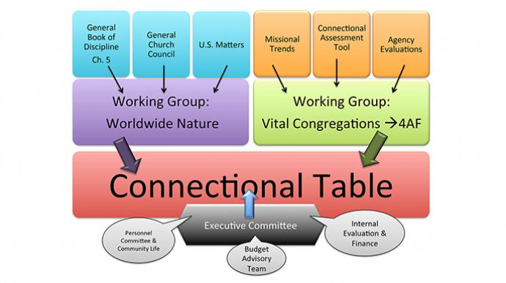
Notes:
Introduce the students’ sharing of information about the agencies and ethnic caucuses that they researched with a brief overview of the Connectional Table (or whatever structure replaces it. As of 2012, the efforts of General Conference to reorganize and streamline our general church structure had been ruled unconstitutional by the Judicial Council).
Share this good and simple diagram of the Connectional Table: http://www.umc.org/who-we-are/structure-and-membership
The purpose of the Connectional Table is to coordinate efforts among the many UMC general agencies. This same web page explains that:
Leadership of the Connectional Table includes an Advisory Team with rotating membership coordinating the work between gatherings. Task groups, each responsible for an area of the Connectional Table's work, make sure the related objectives outlined by The Book of Discipline are accomplished. The task groups are also responsible for sharing information about the work in their particular areas with the entire Connectional Table for discussion at the semi-annual gatherings of the entire body. Such organization has succeeded in distributing the work among the members and in moving forward the dialogue concerning vision and mission.

Slide 23
General Church Boards and Agencies
Discipleship Ministries (Nashville, TN)
General Board of Pension and Health Benefits (Glenview, Illinois)
General Board of Church and Society (Washington, DC)
General Board of Global Ministries (Atlanta, GA)
United Methodist Committee on Relief (Atlanta, GA)
General Board of Higher Education and Ministry (Nashville, TN) (GBHEM)
General Commission on Archives and History (Madison, New Jersey)
General Commission on Religion and Race (Washington, D.C.)
General Commission on the Status and Role of Women (Chicago)
General Commission on United Methodist Men (Nashville, TN)
General Council on Finance and Administration (Nashville, TN)
United Methodist Communications (Nashville, TN)
United Methodist Publishing House (Nashville, TN)
United Methodist Women (New York City, NY)
Notes:
With this overview in front of people, ask the students to share two to three minutes of information about their assigned agencies, special Sundays, or ethnic caucuses. You may need more time for this, or less, depending on students’ brevity – use an egg timer if needed!
Suggestion: Call for the reports in this order, which lists those most important to local churches – more or less, and by one very subjective accounting - first:
UMCOR
GBGM
Discipleship Ministries-GBOD
UMPH and Cokesbury
GCFA
UMCOM
UMW
UMM
GBHEM
GBOPHB (WesPath)
GBCS
GCORR
GCSRW
GCCUIC
GCAH
Ethnic Caucuses
Special Sundays

Slide 24
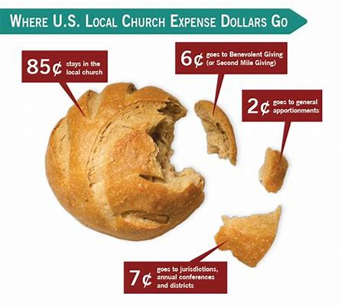
UMC Connectional Giving
Notes:
Point out that all that we have been studying is supported by the voluntary giving of United Methodists. Share these figures from “The Financial Commitment of the United Methodist Church,” a publication of the General Council on Finance and Administration, available at www.gcfa.org/sites/default/files/u3/Financial%20Commitment%20Book%202009-12.pdf This is the 2012 edition. Preferably, use the most recent edition at: http://www.gcfa.org/services/financial-services/the-financial-commitment-booklet-of-2017-2020/ (new version)
➢ About 85 cents of every dollar ($.845) in the collection plate stays in the local church.
➢ Another 12 cents ($.124) goes to the annual conference and districts to support services to the local church and ministries of the district and conference.
➢ Just over two cents ($.22) goes to general church apportionments.
➢ Almost one penny ($.09) goes to other general funds and special offerings, including United Methodist Women
Just over two cents! What an amazing amount of ministry happens through the connection, with only three cents of every dollar.

Slide 25
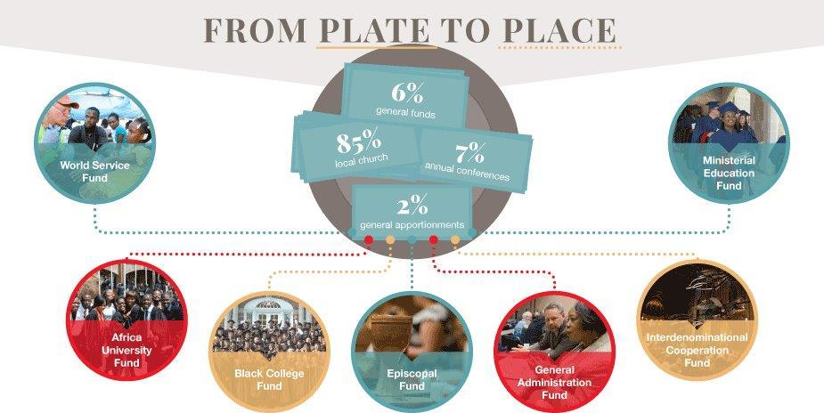
General Church
Apportionments
Notes:
➢ The general church budget, which is passed at General Conference, is divided, or apportioned, to the annual conferences.
➢ The annual conference budget, which is passed at its annual conference, is divided, apportioned, among its churches. (Some conferences still use the district board of stewards, in which apportionments first go to districts to be divided among churches. Find out and share how your conference does it.)
➢ The formulas for these apportionments attempt to take into account both membership numbers and economic strength of churches.
➢ There are seven funds in the general church apportionments:
o World Service Fund – missionaries, overhead, and dozens of specific ministries in the U.S. and worldwide
o Ministerial Education Fund – for recruitment and education of pastors and bishops
o Black College Fund – supporting the historically African-American Methodist colleges
o Africa University Fund
o Episcopal Fund – paying the salaries, office expenses, and benefits for bishops
o General Administration Fund – overhead support for financial controls, General Conference legislation, Judicial Council, records and history
o Interdenominational Cooperation Fund – supports involvement of the church in ecumenical organizations
➢ Annual conference apportionments (the 12 cents), of course, support items in the annual conference budget. If possible, have a resource for the students about your conference’s apportioned giving.
Apportionments are each church’s share of the cost of being part of a worldwide connection and the glory of sharing in this worldwide ministry and mission.
Please note: The six special Sunday offerings support agencies and projects that are not supported through apportionments – such as UMCOR.
In addition to what’s given through apportionments, the six special Sunday collections, the hundreds of Advance projects around the world, and dozens of partnership projects between conferences or individual churches offer unlimited opportunities for specific, targeted mission giving and involvement.

Slide 26
The Charge Conference and Local Church Structure
Notes:
From the worldwide connection, we turn to the local church and its charge conference. Review, if needed, the point that the local church has wide latitude in how it organizes itself into committees and ministry teams. There will be a church council which may be named in various ways, to which the committees report. In the United States, the committees required by the Discipline are Lay Leadership (previously known as Nominations), Finance, Staff-Parish Relations (also known as Pastor-Parish Relations) and Trustees. Certain officers and members of certain committees are elected by the charge conference.
Invite students to turn to the paragraphs in the current Discipline that detail the charge conference, church council, Lay Leadership, Finance, Staff-Parish and Trustees. The point is to find them, not to go over them in detail.
Discuss these principles. For each point, allow students to ask questions, and try to keep the discussion to the point and in a positive tone. What are the reasons behind each principle, and its benefits? (Paragraph numbers are from the Book of Discipline, 2008.)
➢ The local charge conference is part of the connection. ¶¶ 256-251. A United Methodist church is not “congregation” in the sense that, say, Presbyterian or Lutheran or Baptist churches are independent corporations – because of these facts:
➢ The Trust Clause: first and foremost, the church property itself is held “in trust” for the United Methodist connection. Property cannot be bought, sold, or substantially
changed without the involvement of the district superintendent and the district site committee, representing the conference. ¶2501-2503
A local church cannot decide it would rather be Baptist or independent. The people can so decide, and leave the church, but they cannot take their property with them. This principle dates back to John Wesley, and ensures that property bought and paid for by Methodists remains Methodist.
➢ The local church does not employ their pastors (even though the IRS insists on churches providing W-2’s for them, while also insisting that they are “self-employed” for self-employment tax (FICA) purposes). Rather, the pastor is a missionary appointed to this “preaching outpost” by the annual conference, and his or her “boss” is not the Pastor-Parish Committee but the DS. The pastor certainly pays attention to the annual evaluations filled out by the committee, but only the cabinet and bishop can move pastors. Only the clergy meeting at annual conference, after due process, can “fire” them from the connection. The differing expectations of pastor and people result, of course, not in “rules” but in a continuing dance of working together. ¶258.2, ¶¶430-433
➢ The finance committee cannot direct how the church spends its money. The finance committee’s job is to help the church raise the money to cover its ministry, which is determined by the church council. ¶258.4
➢ One important rule for financial accountability is that the church treasurer (who signs the checks) and the financial secretary (who receives and records people’s donations) are not the same person, nor members of the same family. ¶258.4
➢ The trustees do not direct how the church building can be used. They care for the building. The church council obviously has great influence on what ministries will be housed in the building, but ultimately, in fact, it is actually the pastor’s responsibility who gets to meet there. ¶2532
Assignment: Read Chapter 9, 268-275, and Chapter 12. Share prayer requests and close in prayer.

Slide 27
Session 4:
Beyond Annual Conference
Notes:
By the end of this session, you will have a better understanding of the connection beyond the borders of the annual conference: Jurisdictions, General Conference, Judicial Council, and central conferences, as well as other international affiliated churches.

Slide 28
WORSHIP
Notes:
Is church structure even necessary? It’s tempting to ask - Wouldn’t it be great just to go back to the days of the early church and forget conferences and structures and councils and rules and laws? Well, let’s return to those early days, and to the very first “General Conference” – what the universal church calls the first “Ecumenical Council” – the “Jerusalem Council,” which Luke relates in Acts 15:1-29:
Then certain individuals came down from Judea and were teaching the brothers, ‘Unless you are circumcised according to the custom of Moses, you cannot be saved.’ And after Paul and Barnabas had no small dissension and debate with them, Paul and Barnabas and some of the others were appointed to go up to Jerusalem to discuss this question with the apostles and the elders. …
The apostles and the elders met together to consider this matter. After there had been much debate, Peter stood up and said to them, ‘My brothers, you know that in the early days God made a choice among you, that I should be the one through whom the Gentiles would hear the message of the good news and become believers. And God, who knows the human heart, testified to them by giving them the Holy Spirit, just as he did to us; and in cleansing their hearts by faith he has made no distinction between them and us. Now therefore why are you putting God to the test by placing on the neck of the disciples a yoke that neither our ancestors nor we have been able to bear? On the contrary, we believe that we will be saved through the grace of the Lord Jesus, just as they will.’
… After they finished speaking, James replied, ‘My brothers, listen to me. … I have reached the decision that we should not trouble those Gentiles who are turning to God, but we should write to them to abstain only from things polluted by idols and from fornication and from whatever has been strangled and from blood.’
Then the apostles and the elders, with the consent of the whole church, … sent Judas called Barsabbas, and Silas, … with the following letter: ‘The brothers, both the apostles and the elders, to the believers of Gentile origin in Antioch and Syria and Cilicia, greetings. Since we have heard that certain persons who have gone out from us, though with no instructions from us, have said things to disturb you and have unsettled your minds, we have decided unanimously to choose representatives and send them to you, along with our beloved Barnabas and Paul…. For it has seemed good to the Holy Spirit and to us to impose on you no further burden than these essentials: that you abstain from what has been sacrificed to idols and from blood and from what is strangled and from fornication. If you keep yourselves from these, you will do well. Farewell.’
Conferences, and the election of delegates, and the sending of missionary preachers, and yes, even the passing of resolutions and the writing of minutes, have been part of the church from the beginning.
Let’s lift our prayer for unity by singing that grand hymn by Charles Wesley that opens every Methodist conference:
“And Are We Yet Alive?” 553 in the United Methodist Hymnal. [Sing at least verses 1-4.]

Slide 29
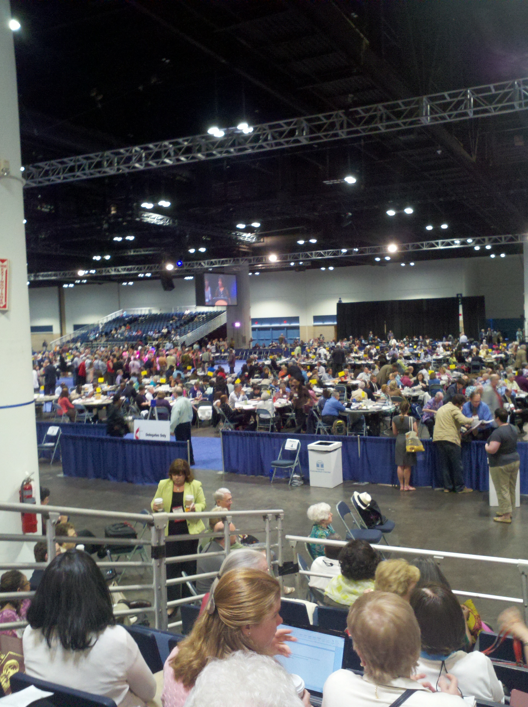
General
Conference
Elections
Notes:
Whenever we think about General Conference, our stomachs churn. If you are able to use projection, lighten the moment by playing this two-minute commentary from Western North Carolina Conference on the election of delegates for general and jurisdictional conferences: http://www.youtube.com/watch?v=glouvidNcjg. (If your meeting place does not have internet access, you can download it with one of several free downloaders offered at www.cnet.com.)
After the video, point out that what seems to be an error heightens the humor. With two valid ballots, the number required to elect is two – unless both were voting for Ken Carter! This humorous take does highlight the confusion and frustration that members of annual conferences – and their bishops – often experience during the voting process.
Highlight and invite questions:
➢ The amazing thing about General Conference is that it works at all, with 600 to 1,000 delegates speaking multiple languages.
➢ The General Conference secretary works out how many delegates each annual conference, missionary annual conference, or provisional annual conference may send by a formula based on the number of clergy and lay members of the conference.
➢ Once the number of clergy and lay delegates each conference will send has been established, separate ballots by clergy and laity are taken during the previous annual conference until the delegations, including several alternates, are elected.
➢ Then the balloting continues until an equal number of delegates are elected for jurisdictional conference only. All General Conference delegates are also jurisdictional conference delegates.
➢ General Conference worship can be richly inspiring and unifying; deliberations can be bitterly depressing and divisive. We’ll talk about some of the tensions in the next session.

Slide 30

Jurisdictional
Conferences
Notes:
On this slide, have the participants identify their annual conference and jurisdictional conference. Point out that jurisdictional conferences have the power to set conference boundaries and that conferences have been consolidating over the last 50 years in order to save money.
Ask: “Is your conference the result of such a merger? Are there reasons why a merger might be in your future? What are the arguments for and against merger?”
Review the historical reasons why we have jurisdictions, briefly, but as fully as necessary for your students. Point out that:
➢ The price of the 1939 reunification of the northern Methodist Episcopal Church and the Methodist Episcopal Church South (roughly what now comprises the Southeastern Jurisdiction) was the segregation of African-American churches in a “Central Jurisdiction.” The jurisdiction system ensured that no black bishop (or northern bishop) could ever be appointed to a southern annual conference.
➢ This deal was rejected in the Western Jurisdiction, which always has included all its black churches and clergy in its regular geographical conferences. The Western Jurisdiction is the most diverse of all our jurisdictions.
➢ Although the Central Jurisdiction churches were incorporated into the geographical jurisdictions and annual conferences in 1968, there still are two ethnic conferences: Rio Grande (Hispanic) and the Oklahoma Indian Missionary Conference. There is another missionary conference in the U.S., Red Bird, serving parts of Kentucky.
➢ All powers of jurisdictional conferences are conferred by General Conference, as are the central conferences’ powers.

Slide 31
Central Conferences
Africa Central Conferences:
Africa, Congo, West Africa
Europe Central Conferences:
Central and Southern Europe, Germany, Northern Europe and Eurasia
Philippines Central Conference
Notes:
➢ There are seven central conferences of The United Methodist Church: Africa, West Africa, Congo, Central and Southern Europe, Northern Europe, Germany, and Philippines.
Folks may have heard of the Central Conference Pension Initiative, an effort to provide minimal pensions to pastors and surviving spouses in Africa and eastern Europe.
Frank notes: “Central conferences have wide latitude to adapt United Methodist polity to indigenous cultures and practices…to manage church property according to local laws… They may adopt their own forms of rituals, ministerial preparation, or lay membership qualifications. …[but] they may not enact legislation contrary to the Constitution…this results in constant tests of what is appropriate for cultural adaptation and what is necessary to remain part of one internationally constituted ecclesiastical body …” (p 274)
If you have internet access, give the students a taste of the diversity of the UMC by displaying the episcopal offices, with their lists of conferences, from umc.org (links below). OR, if some students have cell phone-based internet, they can check these out and share in a small group, then report what they found to the whole group. Have them go to umc.org and search the site for international churches .
Africa, West Africa, and Congo Central Conferences: http://www.umc.org/who-we-are/africa-episcopal-areas
Central and Southern Europe, Northern Europe, and Germany: http://www.umc.org/who-we-are/europe-episcopal-areas
Philippines Central Conference: http://www.umc.org/who-we-are/philippines-episcopal-areas
Notice the “provisional” annual conference designation. These are conferences that aren’t numerous enough to stand on their own as annual conferences.
In all these areas of the world, The United Methodist Church is growing fast and is now sending “missionaries” back to bless churches in the United States. Ask, “What immigrant pastors – or bishops – in your own conference do your students know?”
➢ Affiliated Autonomous Methodist Churches and Affiliated United Churches
Some churches planted by U.S. Methodists or others:
- have chosen to be independent from the United Methodist Church but still retain a covenant affiliation with the UMC. Some planted by British Methodists also are affiliates.
- or have merged with other denominations in their own lands, and the union churches still maintain an affiliate relationship.
These churches may send non-voting delegates to General Conference, depending on the agreement, and of course their bishops are not members of the Council of Bishops.
If your conference has a relationship with one or more of these churches, point that out. The “International Churches” page at umc.org also has links to these kinds of churches. If you have time and technology, check out some of these, either together or in small groups as before. Point out any partnerships with your conference. Ask the students – their churches may also have such partnerships.
Africa: http://www.umc.org/who-we-are/affiliated-churches-africa
Asia: http://www.umc.org/who-we-are/affiliated-churches-asia
Central America/Caribbean: http://www.umc.org/who-we-are/affiliated-churches-central-america-caribbean
Europe: http://www.umc.org/who-we-are/affiliated-churches-europe
South America: http://www.umc.org/who-we-are/affiliated-churches-south-america
➢ Nonaffiliated autonomous and united churches
Conferences and churches and the General Board of Global Ministries, may also have partnerships with Methodist-tradition churches that do not have formal agreements or relationship with The United Methodist Church, such as the Church of South India (a union church) and the Methodist Church of Haiti, which are not listed as affiliated.
Invite students to check out the members list at the World Methodist Council site to see how diverse are the descendants of Wesley!
http://worldmethodistcouncil.org/about/member-churches/

Slide 32
Judicial Council and
The Book of Resolutions
The Judicial Council is the highest judicial body or "court" of The United Methodist Church. Its nine members are elected by the General Conference. The Judicial Council determines the constitutionality of acts or proposed acts of the General, Jurisdictional, Central, and Annual Conferences.
Notes:
Summarize Chapter 12:
➢ The judicial council has nine members, five laity and four clergy in one quadrennium, and five clergy and four laity in the next. They serve eight-year terms and may be re-elected. The council elects its own officers and sets its own rules.
➢ Members are nominated by the Council of Bishops, who name three times the number needed to fill vacancies. General Conference elects the council from this slate.
➢ Judicial Council decisions include:
o Declaratory judgments about the constitutionality or legality of actions taken by any body in the connection
o Automatic review of legal decisions by bishops presiding over conferences
o Appeals of bishops’ decisions of law that are submitted by a fifth of the annual conference’s members
o Appeals of legal questions that arise from church trials and similar actions.
Although we won’t go into details in this class, the 2012 General Conference struggled mightily with efforts to rearrange the church’s administrative structure, only to have all efforts either fail or be declared unconstitutional by the judicial council.
Since only General Conference can speak for The United Methodist Church, General Conference deals with thousands of resolutions. If you have one or more copies of the Book of Resolutions, share them with students to see the wide variety of subjects addressed. Stress that these resolutions are the best efforts of the delegates to faithfully address issues of concern to the world; that sometimes they may even contradict each other (sometimes in the same paragraph), and that they are not church law.
What does all this mean so far? What has been new or surprising to the students? What inspires them? What fills them with pride? What is a miracle that it works at all? If the students were in charge, how would they change things?
OR – if you have time, discuss the quote that follows. If not, read it as we move to closing prayer, asking students to think about it as they read the assignment and consider the tensions in the UMC structure, which we’ll take up next session.
Rev. Christy Thomas of Krum First UMC in Krum, Texas, wrote in a blog, also published in the United Methodist Reporter, in Nov. 2012:
“The United Methodist Church cannot be re-formed. It’s over for us with our current structure…It’s easy to get frustrated with the Judicial Council for the rulings of the last few months. Their work has thoroughly reversed decisions made by General and Jurisdictional Conferences….Because the members of the Council were faithful to the letter of the law, which is exactly what they are supposed to do, we now know for sure that this emperor has no clothes…[substantial and necessary change under the current rules] can’t work. Period.
“We are going to have to engender our own revolution/reformation or die slowly of strangulation by methods that no longer support the heart of Methodism….”
“We have the most powerful theology of grace that has ever infused the human race….Can grace-infused theology hold us together in the revolution that is now necessary? Can we plant ourselves firmly on opposite sides of huge issues, pray, argue and fight our way through this, and see a healthy and actually united Methodist church born yet once more? Can we free ourselves from the death strangle of our current methods and still be Methodists?”
(http://www.patheos.com/blogs/thoughtfulpastor/2012/11/14/judicial-council-decisions-the-emperor-has-no-clothes/)
Do you agree or disagree, and why? Think about all this for next time.
Assignment: Chapter 7, pp 218-229
Share prayer concerns, and let one of the students close with prayer.

Slide 33
Session 5:
For Such a Time as This
Notes:
In this session, you will grapple with two of a number of issues of United Methodist life together, using various formats for discussion and conferencing. Through this process, you will be equipped with new insight and tools for discernment in making decisions in the local church and, perhaps, the annual conference.

Slide 34
WORSHIP
Notes:
In the book of Esther, Mordecai asks his ward, Queen Esther, to risk her life to challenge the decree of destruction that has been issued against the Jews in Persia. He says:
‘Do not think that in the king’s palace you will escape any more than all the other Jews. … Who knows? Perhaps you have come to royal dignity for just such a time as this.’
We are living at a time of deep turmoil and huge challenges and changes. Perhaps we lay servants have been called to this ministry in our beloved United Methodist Church for just such a time as this. It’s a time very much like another time of deep turmoil and huge challenges and changes in which our Lord Jesus Christ taught:
[Pause after each, or assign one beatitude to each of 8 readers, for emphasis.]
When Jesus saw the crowds, he went up the mountain; and after he sat down, his disciples came to him. Then he began to speak, and taught them, saying:
Blessed are the poor in spirit, for theirs is the kingdom of heaven.
Blessed are those who mourn, for they will be comforted.
Blessed are the meek, for they will inherit the earth.
Blessed are those who hunger and thirst for righteousness, for they will be filled.
Blessed are the merciful, for they will receive mercy.
Blessed are the pure in heart, for they will see God.
Blessed are the peacemakers, for they will be called children of God.
Blessed are those who are persecuted for righteousness’ sake, for theirs is the kingdom of heaven.
Blessed are you when people revile you and persecute you and utter all kinds of evil against you falsely on my account. Rejoice and be glad, for your reward is great in heaven, for in the same way they persecuted the prophets who were before you.
… “You are the light of the world. A city built on a hill cannot be hid. No one after lighting a lamp puts it under the bushel basket, but on the lampstand, and it gives light to all in the house. In the same way, let your light shine before others, so that they may see your good works and give glory to your Father in heaven” (Matthew 5:1-14, NRSV).
Sometimes the wrangling in our churches and conferences dims God’s light and fails to give glory to God. Sometimes we finite human beings must admit, in all humility, that we can’t be sure what gives glory to God in any given situation. And as St. Paul noted, there have to be disagreements in the church if the church is to work its way through them to the truth of God’s call in such a time as this. But can we learn to disagree with love and grace, with humility, meekness, hunger for righteousness, mercy, purity, and peacemaking? Can it be that even in our conflicts, God is glorified? Let us pray so, as we sing:
[Select one of these:]
“Christ Has Risen” (The Faith We Sing, 2115)
“Lord, be Glorified” (The Faith We Sing, 2150)
“I’m Gonna Live so Christ Can Use Me” (The Faith We Sing, 2153)
“Let There Be Peace on Earth” (UM Hymnal, 431)

Slide 35

For Such a Time as This…
Notes:
Summarize briefly some of the general characteristics of the change in world culture in the early 21st century, from your own observations or from your reading of Phyllis Tickle or Brian McLaren. Don’t dwell on negative statistics, and resist getting sidetracked into discussion, but Include:
➢ The change in communication systems from primarily print-based to primarily digital, which has wrenching implications for every culture in the world, including how we work, our attention span, how we worship, and even how we think - now primarily in story rather than logical explanation
➢ The demographic shift of “the center of Christianity” to the southern hemisphere, and the demographic shift of the center of The United Methodist Church to Africa and Asia
➢ The consumer attitude in those in the U.S. who do attend church, in which shopping for a church that meets my and my family’s needs is much more important than denominational loyalty or theology
➢ The deep suspicion of (or is it disappointment in?) “organized religion,” and the rise of secular and parachurch organizations doing much of the mission and ministry that used to be the province of the denominations: Oxfam, CARE, Heifer Project, Habitat for Humanity, Church World Service, Doctors Without Borders, the Gates Foundation, and thousands of local specific-purpose charities and government programs: Food pantries, homeless shelters, free clinics, park district programs, etc.
➢ The rising challenge to authority of all sorts, especially religious authority and hierarchy, as knowledge and authority become democratized – “crowd-sourced.”
➢ The rising interest in the work of the Holy Spirit throughout the church, giving rise to charismatic and Pentecostal movements worldwide as well as renewed efforts in spiritual formation in mainline denominations (Upper Room, Walk to Emmaus, Academy for Spiritual Formation, spiritual direction, covenant groups, Taize music and worship)
➢ “Ancient-future” church, meaning renewed interest in deeply meaningful celebration of the sacraments of Communion and baptism, and other physical acts and sensory elements in worship such as candles, incense, fountains, foot-washing, reaffirmation of baptism, labyrinths, etc.
➢ The challenge of the digital age: What of worship is appropriate to put online? Where churches stream their worship services, or congregations exist only online such as several now in Second Life, or megachurches rescue struggling nearby churches by streaming the sermon, and people learn online, how can the full dimensions of discipleship be cared for: sacraments, small-group interaction, service?
➢ The challenge of increasing diversity of all kinds, in every city, rural village, and often, even in our families as our children marry across racial and religious lines, change denominations or even faiths, or are more open about sexual orientation.
What does all this mean for the church? This is simply the reality of our time and the background against which our church’s polity must work, or must change.

Slide 36
SMALL GROUPS
What is the issue:?
What if anything, did the BOD have to say about it?
Did everyone get a chance to share?
Was Christian love in evidence?
Notes:
For the rest of the session, divide into small groups of three or four persons. Each group will receive a challenge assignment to discuss using the information about the church’s polity that they have learned in this course. Assign a facilitator for each group to read the assignment. Each group will choose a recorder to report. The topic assignments are in the addenda to this leader’s guide.
Let the group recorders share:
What was the issue?
What, if anything, did the Discipline have to say about it?
Did everyone get a chance to share?
Was Christian love in evidence?
Hand out new assignments. If you wish, you can scramble the groups for the second small-group session, but the change of topic will probably be enough variety.
Let the group recorders share. If the groups did their work extra quickly so there is time, you can always assign a third discussion.

Slide 37
“We have the most powerful theology of grace that has ever infused the human race….Can grace-infused theology hold us together in the revolution that is now necessary? Can we plant ourselves firmly on opposite sides of huge issues, pray, argue and fight our way through this, and see a healthy and actually united Methodist church born yet once more? Can we free ourselves from the death strangle of our current methods
and still be Methodists?”
If we can’t, or we won’t, then we need to die anyway. We deserve
no better than to slowly lose oxygen as we wander forever lost
through the dead-end maze known as the Book of Discipline.
If we can and we will, then we will unleash the Spirit
of God yet once more. It’s time.
(http://www.patheos.com/blogs/thoughtfulpastor/
2012/11/14/judicial-council-decisions-the-emperor-has-no-clothes)
Notes:
Ask several students to share in reading this, from John Wesley and a contemporary pastor:
Rev. Christy Thomas, a pastor in Texas, posted in the wake of the 2012 General Conference and the Judicial Council decisions reversing its restructuring efforts:
“We have the most powerful theology of grace that has ever infused the human race….Can grace-infused theology hold us together in the revolution that is now necessary? Can we plant ourselves firmly on opposite sides of huge issues, pray, argue and fight our way through this, and see a healthy and actually united Methodist church born yet once more? Can we free ourselves from the death strangle of our current methods and still be Methodists?”
If we can’t, or we won’t, then we need to die anyway. We deserve no better than to slowly lose oxygen as we wander forever lost through the dead-end maze known as the Book of Discipline. If we can and we will, then we will unleash the Spirit of God yet once more. It’s time. (http://www.patheos.com/blogs/thoughtfulpastor/2012/11/14/judicial-council-decisions-the-emperor-has-no-clothes)

Slide 38
…But although a difference in opinions or modes of worship may prevent an entire external union, yet need it prevent our union in affection? Though we cannot think alike, may we not love alike? May we not be of one heart, though we are not of one opinion? Without all doubt, we may. Herein all the children of God may unite, notwithstanding these smaller differences. These remaining as they are, they may forward one another in love and in good works.
(www.ccel.org/ccel/wesley/sermons.pdf)
Notes:
In John Wesley’s sermon 39, Catholic Spirit, he lifts up many Scriptural comments on the Great Commandment. He writes:
[Jesus said,] “A new commandment I give unto you, That ye love one another: as I have loved you, that ye also love one another. By this shall all men know that ye are My disciples, if ye have love one to another” … This is that love on which the Apostle John so frequently and strongly insists… “Not that we loved God, but that he loved us, and sent his Son to be the propitiation for our sins. Beloved, if God so loved us, we ought also to love one another.”
…All men approve of this; but do all men practice it? Daily experience shows the contrary. Where are even the Christians who “love one another as he hath given us commandment?” How many hindrances lie in the way! The two grand, general hindrances are, first, that they cannot all think alike and, in consequence of this, secondly, they cannot all walk alike; but in several smaller points their practice must differ in proportion to the difference of their sentiments.
…But although a difference in opinions or modes of worship may prevent an entire external union, yet need it prevent our union in affection? Though we cannot think alike, may we not love alike? May we not be of one heart, though we are not of one opinion? Without all doubt, we may. Herein all the children of God may unite, notwithstanding these smaller differences. These remaining as they are, they may forward one another in love and in good works.
(www.ccel.org/ccel/wesley/sermons.pdf)
As Methodists in the 21st century, we need, somehow, to renew our connection in ways that will, as our founder put it, “forward one another in love and in good works” even though we cannot all think alike or worship alike or walk alike. We need the Holy Spirit’s help to renew our life together.
[Spend some time in silent prayer, and close with prayer, or in singing They’ll Know We Are Christians by Our Love, The Faith We Sing, 2223.]

Slide 39

Thank you!

